Slide 1
AVID Week 3
9/3/13 – 9/6/13

Slide 2
Bell Ringer
NO SCHOOL

Slide 3
Monday:
NO SCHOOL

Slide 4
Tuesday Morning Meeting
Mon: No School
Tues: Cornell Notes Quiz & college Vocab
Wed: Backwards Planning
Thurs: SAT Essay
Fri: PSAT Prep
Birthdays
Score Check
Brag Basket
NHS applications Fri.
Homecoming Nom Day Wed.
Last day to register for SAT Fri.
Back to School Night
Tonight! AVID Night

Slide 5
Tuesday Bell Work
Quick Quiz & Quick Survey
List the steps to the CORNELL WAY and what they stand for.
This is not group work!

Slide 6
Tuesday: : What college vocabulary should I be familiar with?
Create a list of all of the vocab words. Work together with your table groups to define the terms. This list will go into your college binders.
Your table group will be responsible for 7 words. Each word must have a FULL definition, and a visual representation.
Definitions must be in depth and not 1-simple sentence!
On Elmo

Slide 7
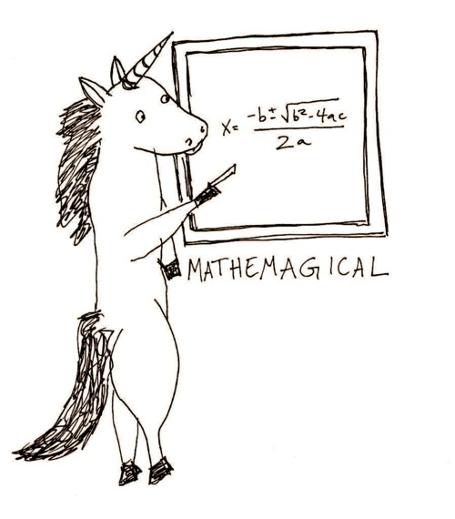
Wednesday Bell Ringer
Choose a card
With your table create a mathematical equation that will equal 4 or as close as possible.
Write your equation on the board.

Slide 8
Wednesday: What is backwards planning and how will it benefit me?
AVID Contract Signing: What are the expectations for AVID in your Junior year?
Backwards mapping explanation
Worksheet practice on wipe on wipe off
Planner

Slide 9
Thursday Bell Ringer
SAT Math Question: On Elmo
Go over answer

Slide 10
Thursday: What are the expectations for the SAT essay?
Timed Writing: 25 minutes
What is a goal you have for the future? Include examples, your plan of action, and the deadline with which to complete the goal.
Grading

Slide 11
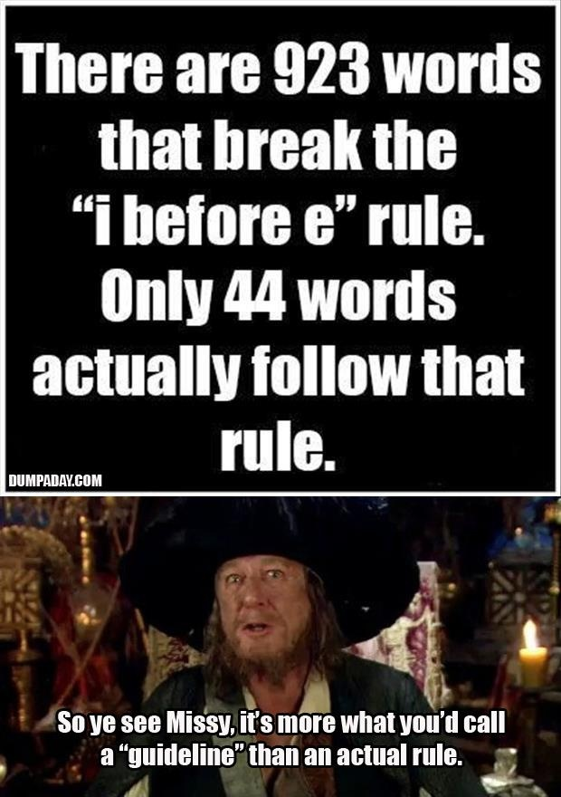
Friday Bell Ringer
Grammar Game

Slide 12
Friday: What will be on the PSAT?
Choose a partner and work on the PSAT scavenger hunt together.
Use the internet, and the PSAT guide book to help you.

