Slide 1
AVID 4 Week 3
9/3/13 – 9/6/13

Slide 2
Bell Ringer
NO SCHOOL

Slide 3
Monday:
NO SCHOOL

Slide 4
Tuesday Morning Meeting
Mon: No School
Tues: Tutorial
Wed: GPA Check and School Deadline Check
Thurs: Tutorial
Fri: College Essay Review and Revision
Birthdays
Score Check
Brag Basket
NHS applications Fri.
Homecoming Nom Day Wed.
Last day to register for SAT Fri.
Back to School Night
Tonight! AVID Night

Slide 5
Tuesday Bell Work
TRF Day – TRF Due Before Class

Slide 6
Tuesday: How well do I collaborate? How does inquiry help me?
TRF Day! Math Classes

Slide 7
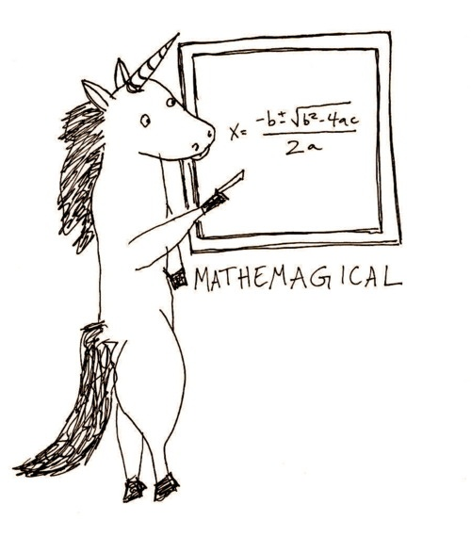
Wednesday Bell Ringer
Choose a card
With your table create a mathematical equation that will equal 4 or as close as possible.
Write your equation on the board.

Slide 8
Wednesday: What are the schools I have selected and why?
AVID Contract Signing: What are the expectations for AVID in your Senior year?
College Table Topics
Each Table Represents a Different College
Why did you choose this school? Have you toured it yet? What are you worried about with the process?
Work With the Students at the Tables to Fill In the College Chart
Calculating Your “Real” GPA
Homework

Slide 9
Thursday Bell Ringer
TRF

Slide 10
Thursday: How well do I collaborate? How does inquiry help me?

Slide 11
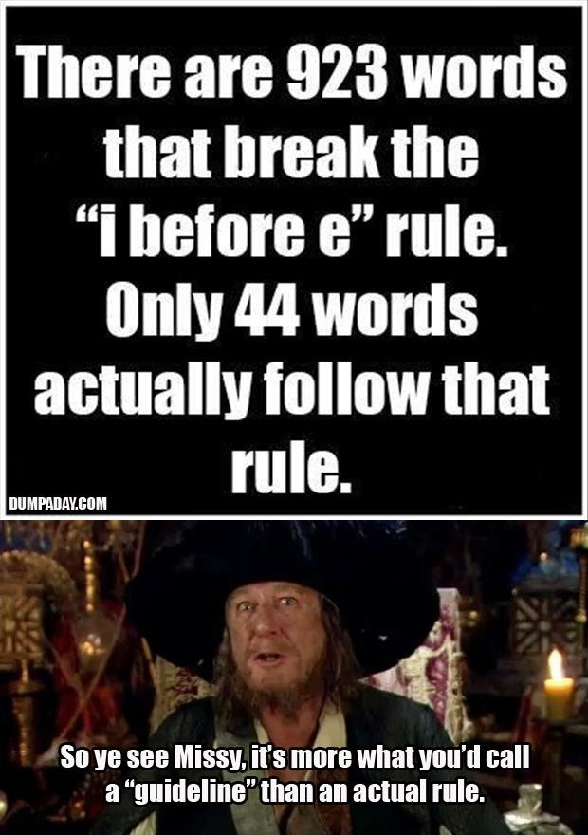
Friday Bell Ringer
Grammar Game

Slide 12
Friday: What are the expectations of my college essay?
PPT
Get in your college groups. Find the prompt for this years application
Work on brainstorming ideas for your essay with your group. Your brainstorm must be approved by the end of class.

