Slide 1
AVID PROGRAM
ADVANCEMENT VIA INDIVIDUAL DETERMINATION
[L. avidus]: eager for knowledge
Notes:
NOTES: Welcome, sign-in, and flyers

Slide 2
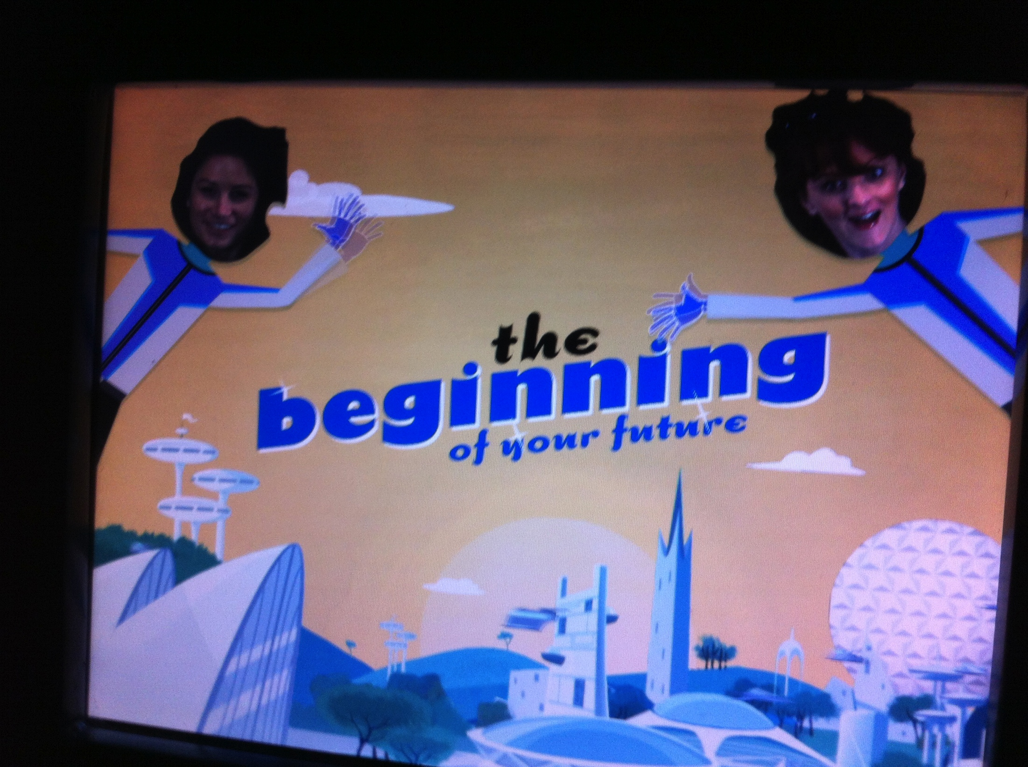
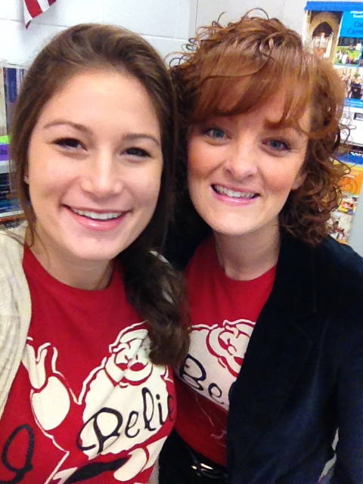
Introductions
Mrs. Prince and Mrs. Winer welcome you to an amazing experience! We are so excited you are a part of AVID!
Notes:
Introduce the kids. Each student should say their name, grade, AP classes they are or have taken, and clubs/sports/activities they are involved in.

Slide 3
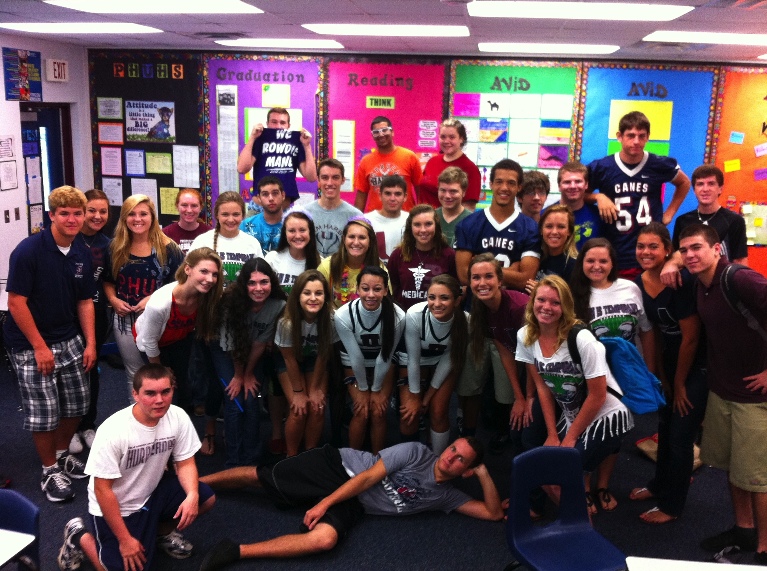
The Mission of AVID
AVID’s mission is to close the achievement gap by preparing all students for college readiness and success in a global society.
Notes:
NOTES: College readiness is what all education is shifting to and our AVID students will be the most prepared!

Slide 4
What AVID means to us!
“It is a class for people who can go farther than what others can. They are people who have a goal, and motivation to get where they want to go.” 10th grader PHUHS

Slide 5
AVID: Collaborative Support for the Success of Underserved Students
Colleges
and
Universities
AVID
Support
Staff
Community
Parents
AVID
Coordinator
(AVID Elective
Teacher)
Student
Administration
Tutors
Subject
Area
Teachers
Counselors
Notes:
NOTES: When you are an AVID student there is a whole network of people who are there to help. We have a very active faculty and

Slide 6
PHUHS Faculty Involved with AVID
Administration: Mrs. Tonry, Mrs. Barker, Mrs. Berry
AVID Teachers: Mrs. Prince, Mrs. Winer
English: Mrs. Weaver, Mrs. Pollack, Mrs. Hatem, Ms. Jackson
Math: Ms. Seamen
Science: Mr. Guercia, Mrs. Duncan
Social Studies: Mr. Stephan, Mr. Zollo, Ms. Tajbudi
IB: Mrs. Dierschel, Mr. Velez
Specialists: Ms. Kemble, Ms. Santana, Mrs. Montgomery
Notes:
Showing all of the teachers involved and using AVID strategies in their classrooms.

Slide 7
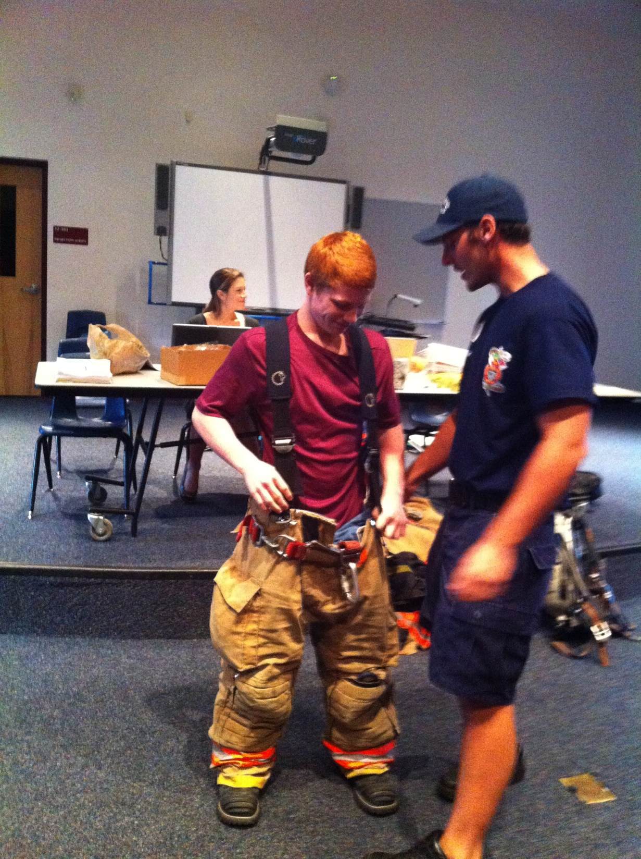
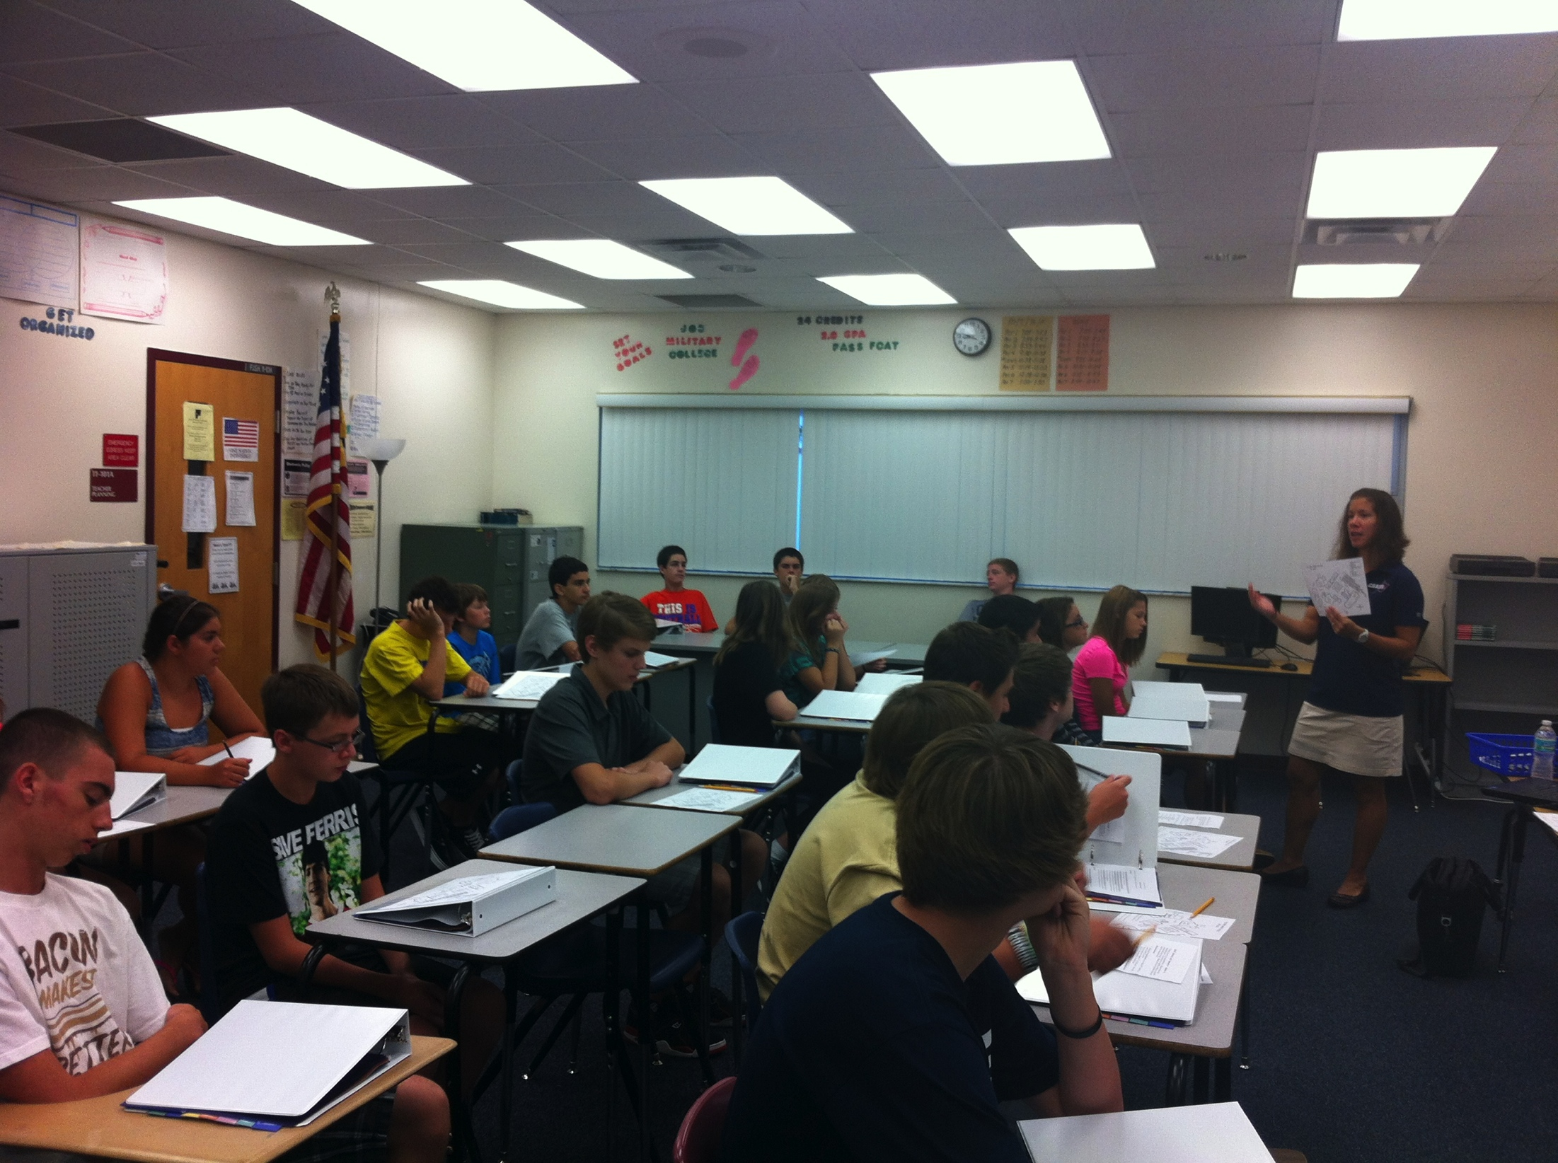
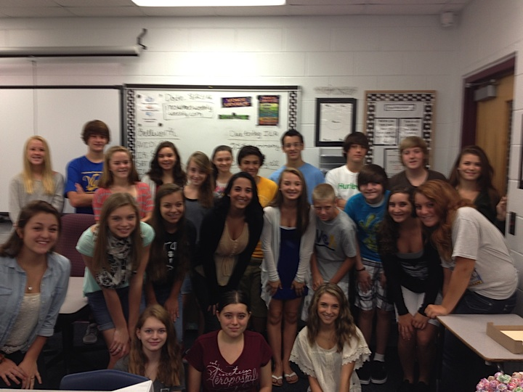
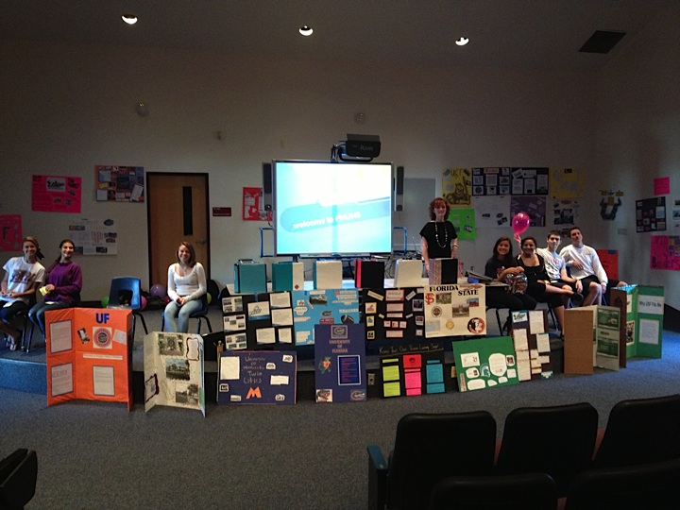
Community Involvement
Notes:
A student will share their experience with being involved with the school, and community with AVID. Probably a good one for Heather C.

Slide 8
The AVID Family
Tutors – College students who come in twice a week to help facilitate student led tutoring sessions.
Parents and Families – Chaperones for field trips, tutors, parent board members, fundraising, AVID Club
Community – Guest speakers, volunteer opportunities, college field trips
Notes:
Everyone

Slide 9
What AVID means to us!
“I feel like we are a family because we will be together until we graduate.” 10th grader PHUHS
“It makes me feel supported and my classmates are like my family.” 10th grader PHUHS

Slide 10
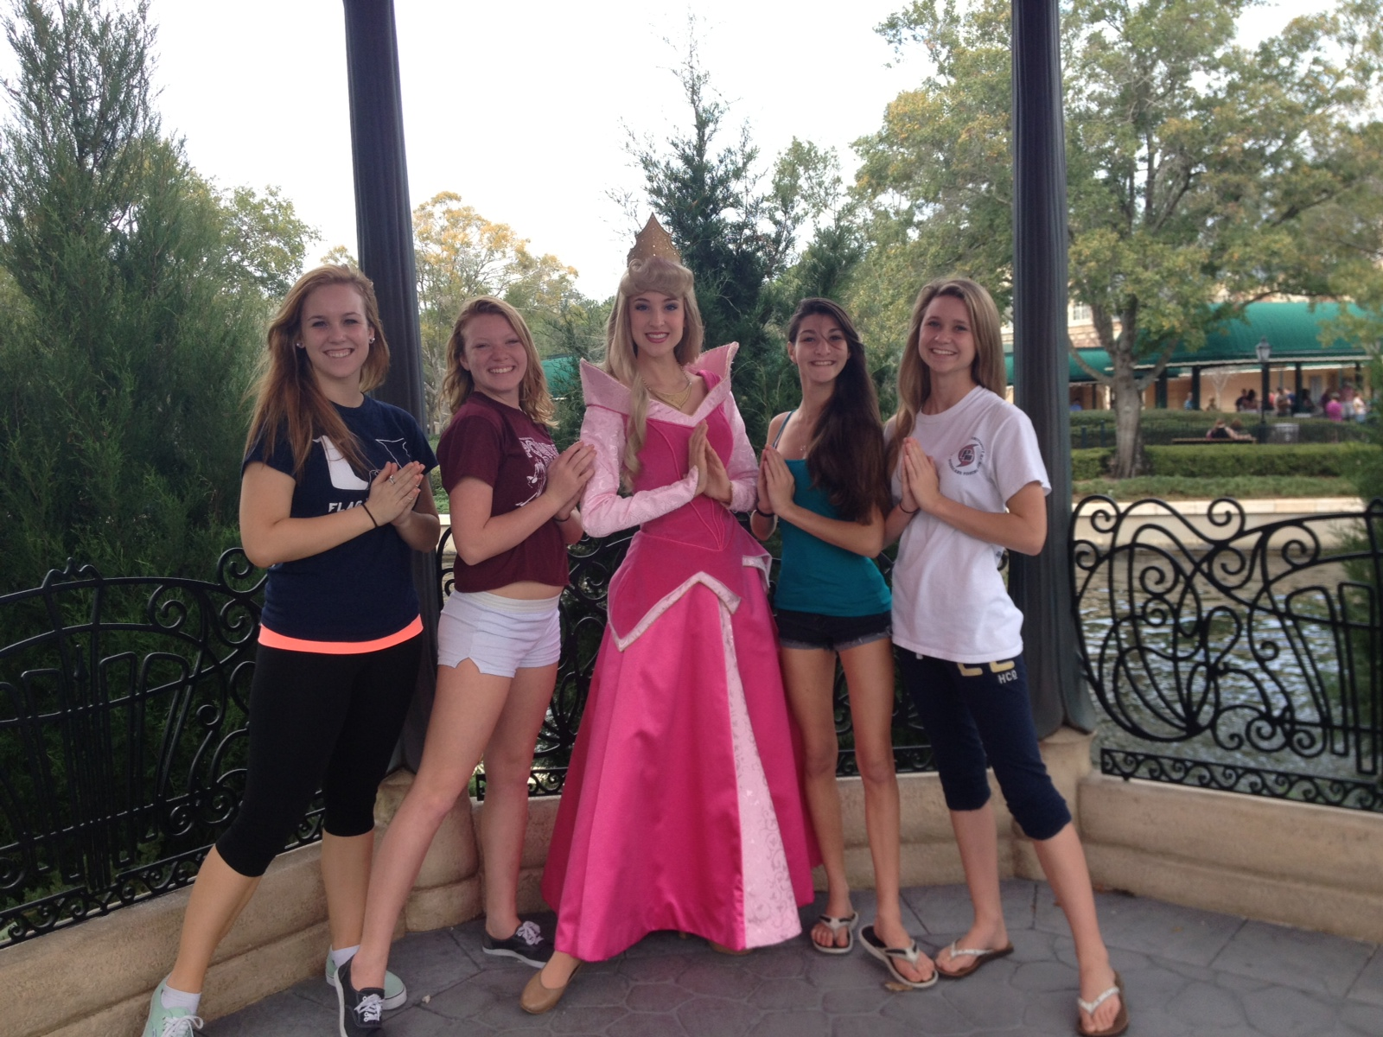
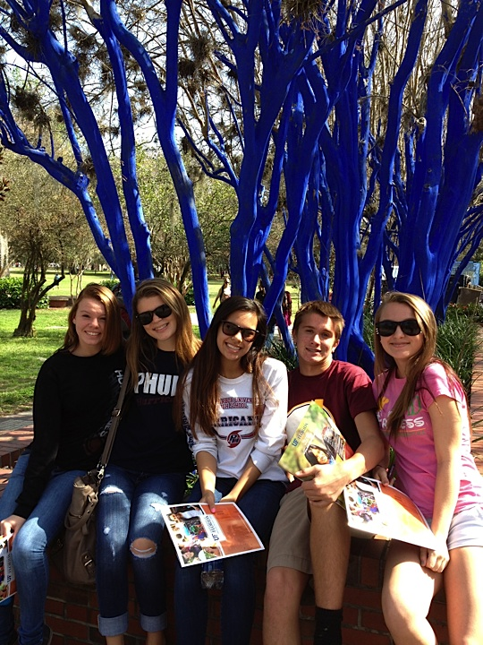
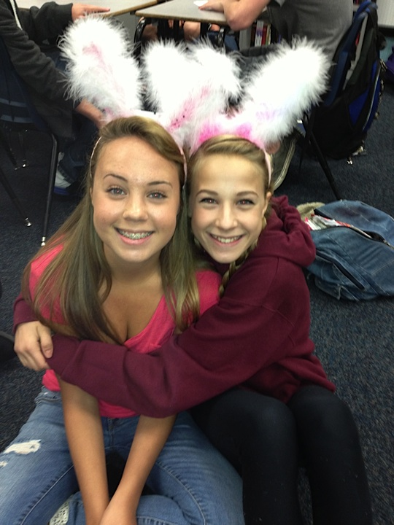
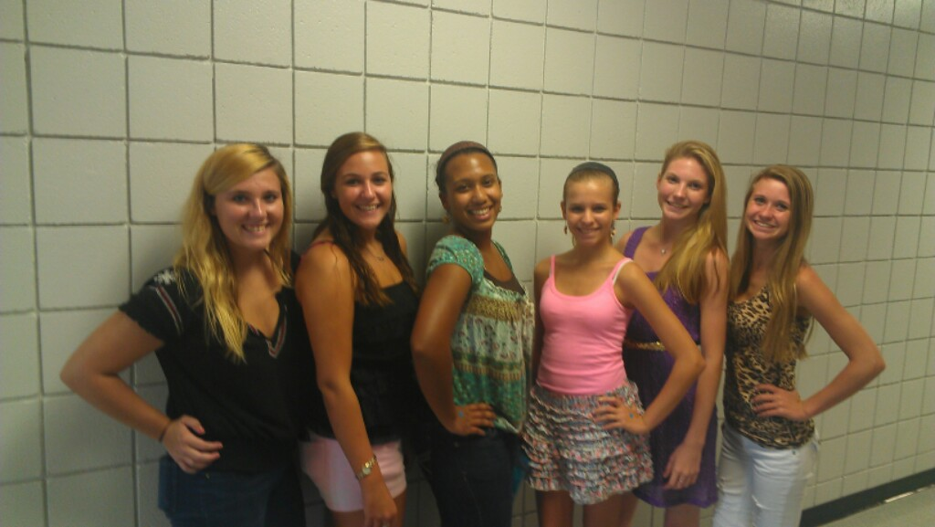
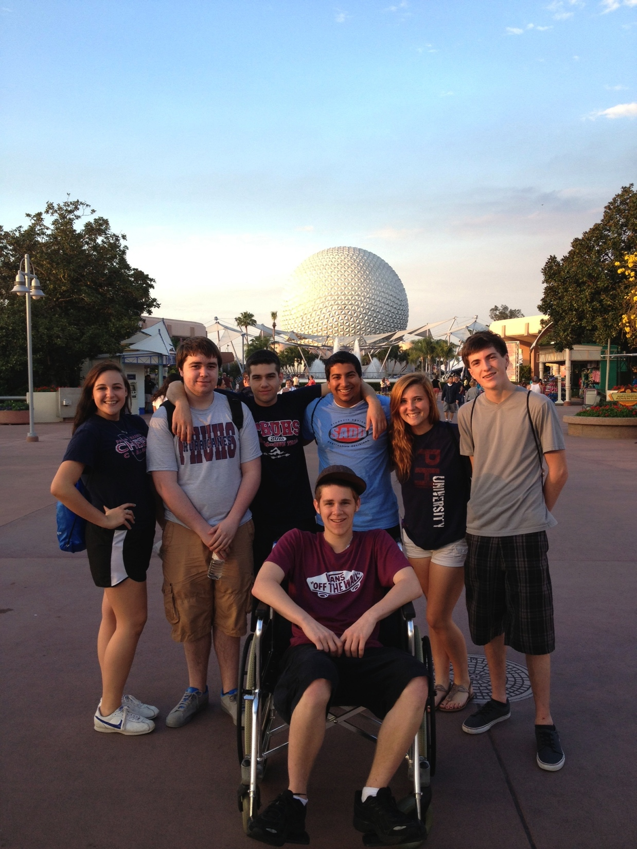
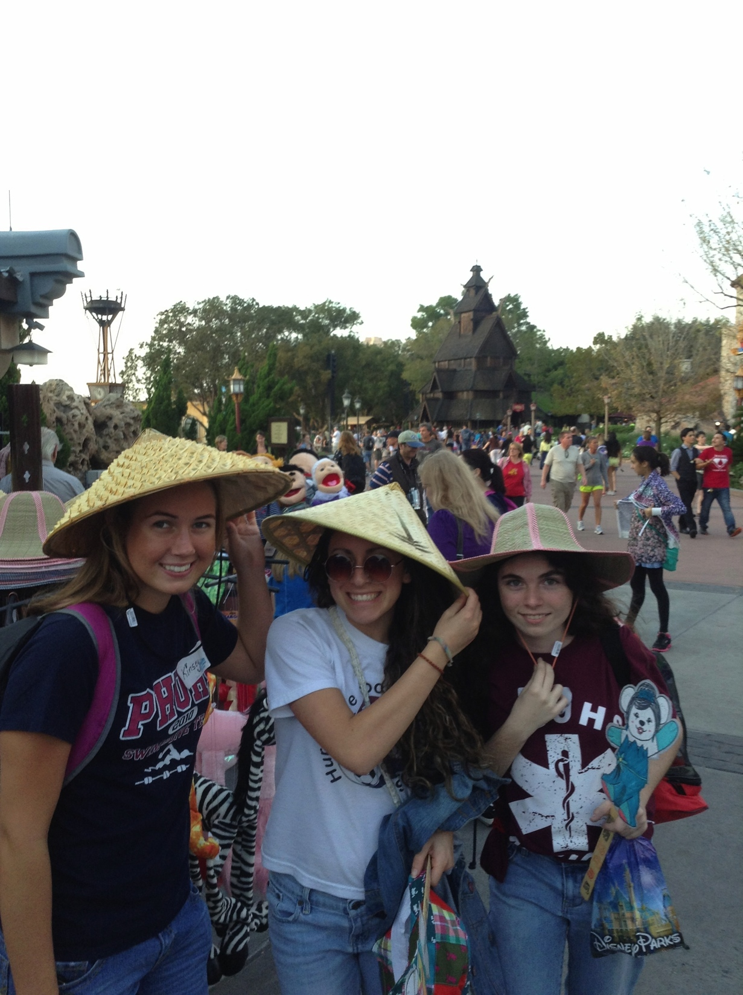
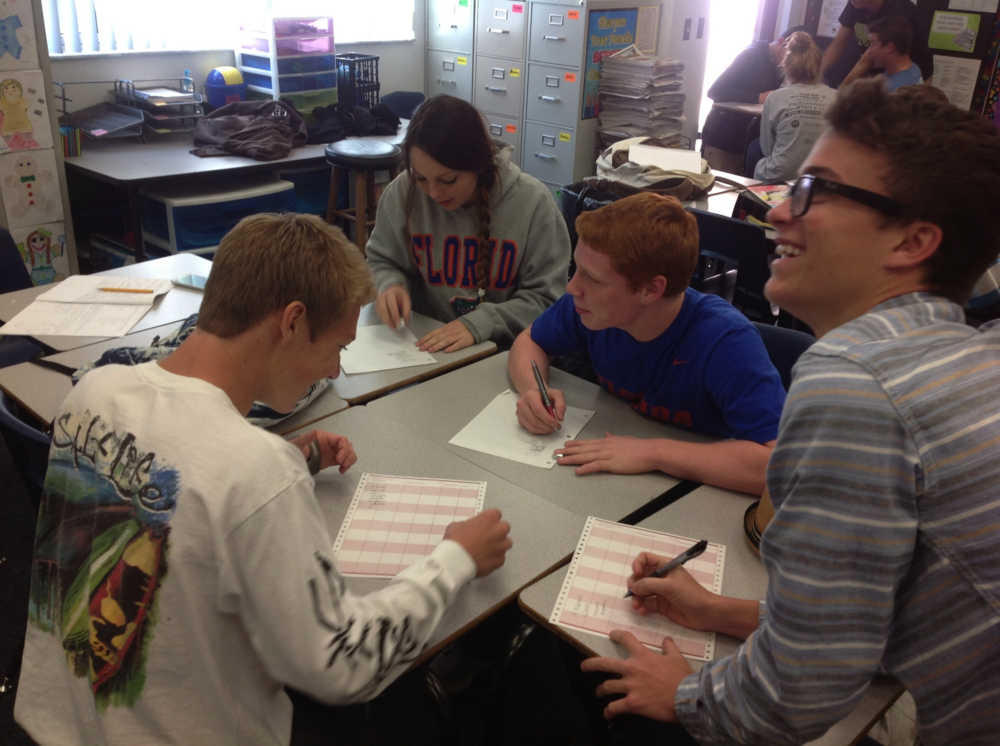
We are Family!!!
Notes:
Have a student talk about the family part of AVID.

Slide 11
The AVID National Student Profile
Students with Academic Potential
Average to High Test Scores
2.0-3.5 GPA
College Potential with Support
Desire and Determination
Meets One or More of the Following Criteria
First to Attend College
Historically Underserved in 4-year Colleges
Low Income
Special Circumstances
Notes:
What the national AVID website says. It may worry you, and you may be thinking that is NOT my child. For example your family may all be college graduates. That is why we have our own set of standards. We recognize a lot of our students are special circumstances; such as all of our athletes, and over scheduled students who need support during the day to keep up with all of their activities and responsibilities.
NOTES:

Slide 12
The AVID Student at PHUHS
AVID students have a GPA of 2.5 – 3.5 unweighted to enter the program
AVID students have a 3, 4, or 5 on both parts of the FCAT
AVID students have a desire to achieve more, and to take higher level classes.
AVID students have a desire to go to college
AVID students have less then 5 absences per semester
AVID students have less then 5 referrals for the year and uphold school rules.
Notes:
The PHUHS AVID student looks like……..Explain a little why each one is important.

Slide 13
AVID Implementation Offers…
Access to rigorous curriculum
Structured support
High-level tutorials
Contact with key adults
Access to college field trips
Skills needed to get accepted to college
Opportunities and options
Notes:
NOTES:

Slide 14
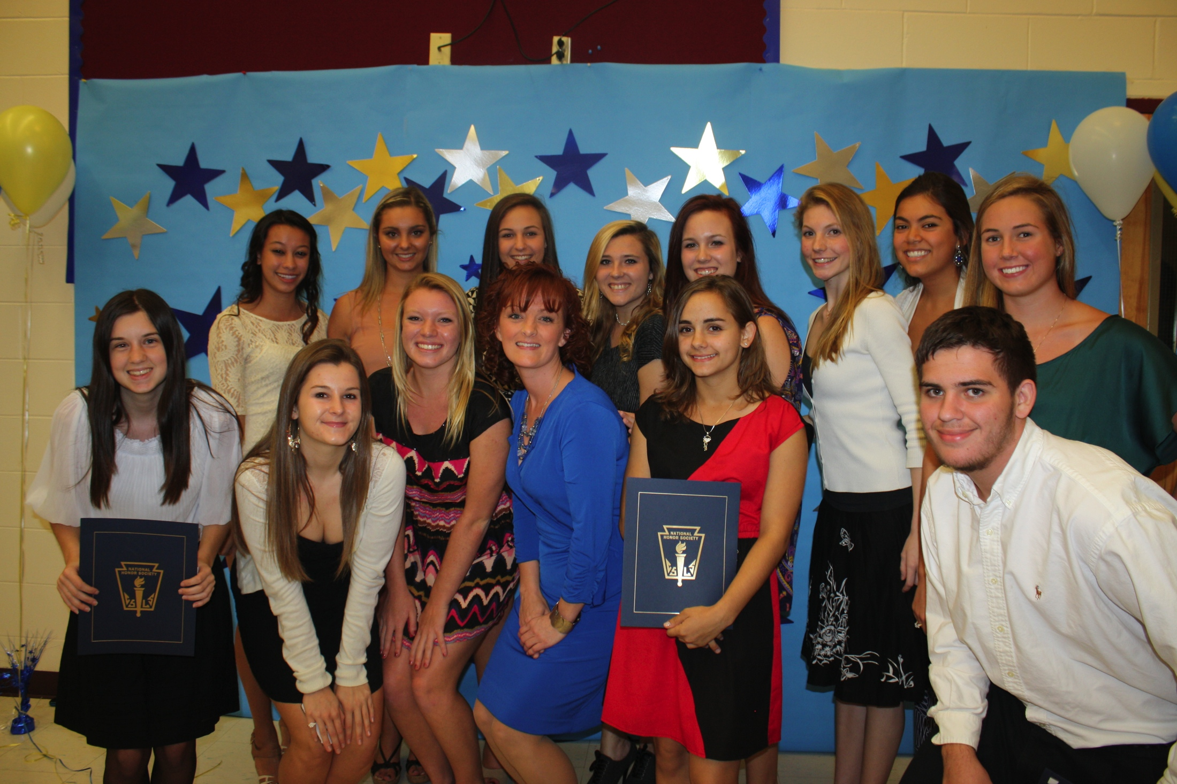
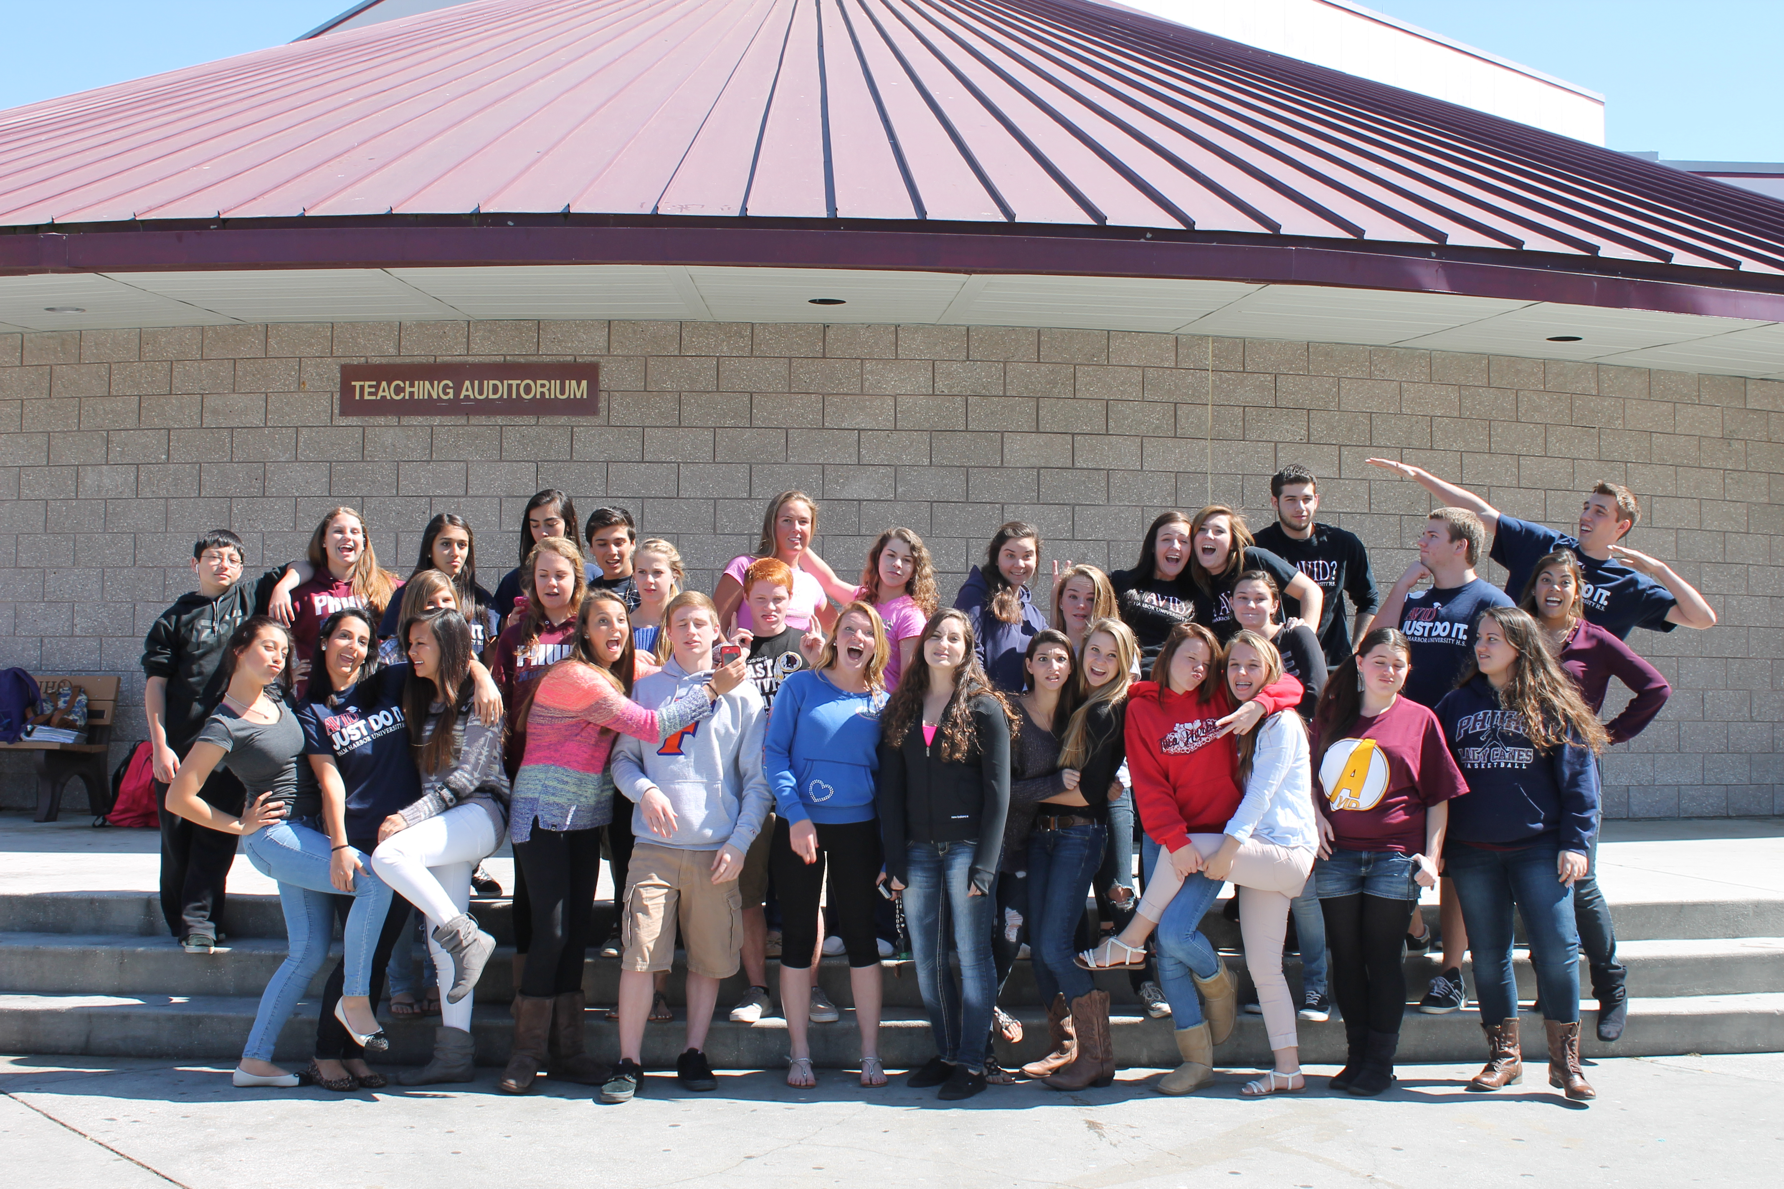
“AVID is more than a class to me. It’s a way to my future, my way to a better education.” 9th grader PHUHS
“Before AVID, I was very unorganized and didn’t know how to be prepared. I never knew anything about how important grades and GPA are towards my future.” 10th grader PHUHS
“WICOR and AVID have been 2 of the most important resources that I use in school.” 11th grader PHUHS

Slide 15
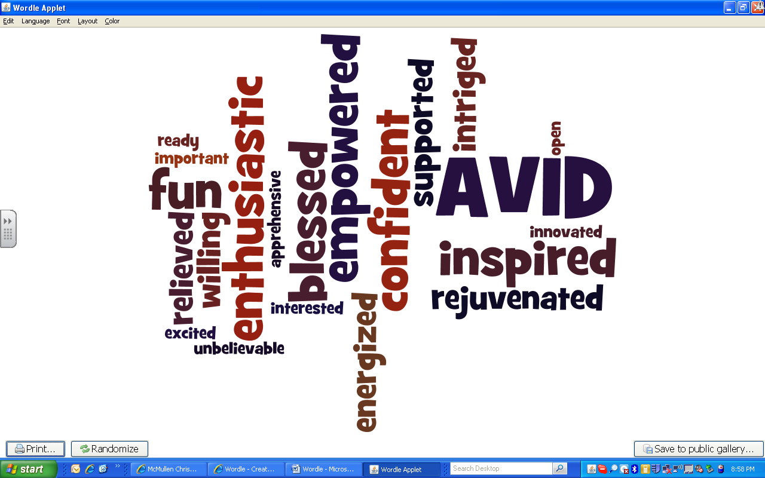

Slide 16
AVID Principles
WICOR: Writing to Learn, Inquiry, Collaboration, Organization, Reading
Organization: Binders, planners, scheduling techniques, Self-Monitoring
Study Skills: Tutorials, Test-Taking Skills, Cornell Notes, Study Smarter - NOT Harder!
Self- Advocacy!! It is YOUR motivation – not OUR motivation
Grade Monitoring and Goal Setting

Slide 17
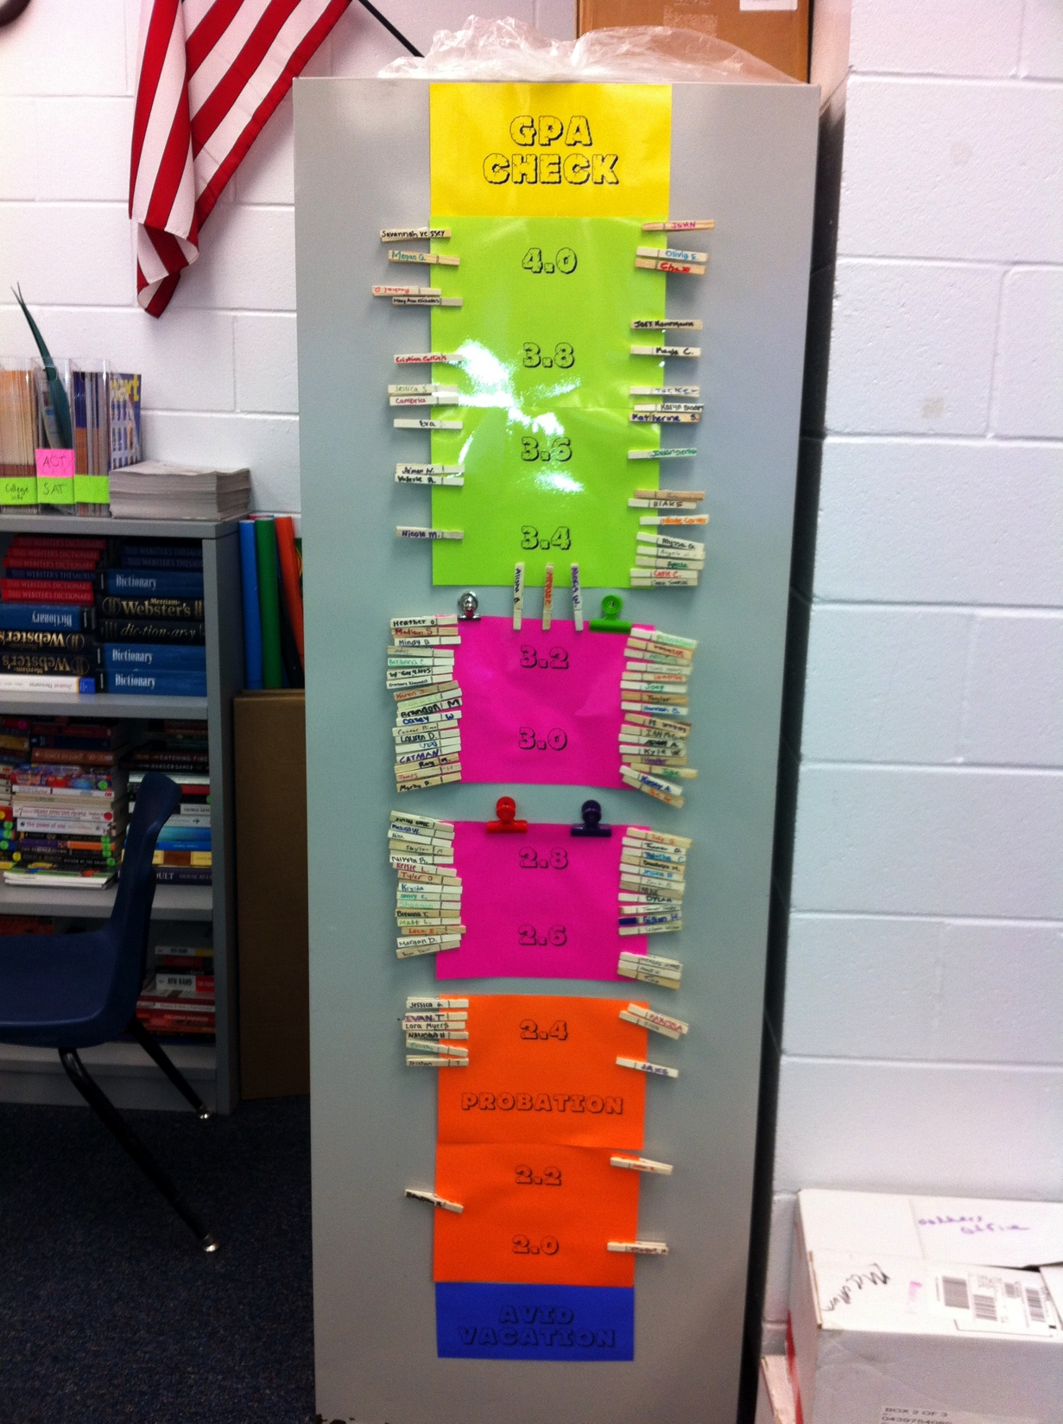
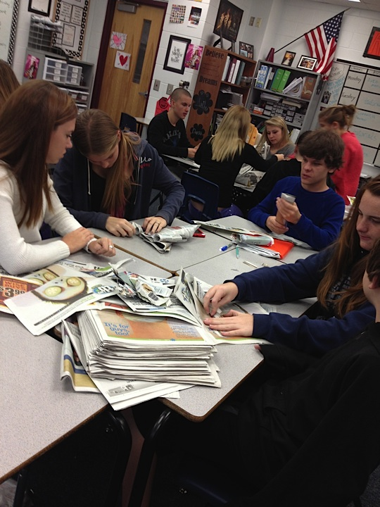
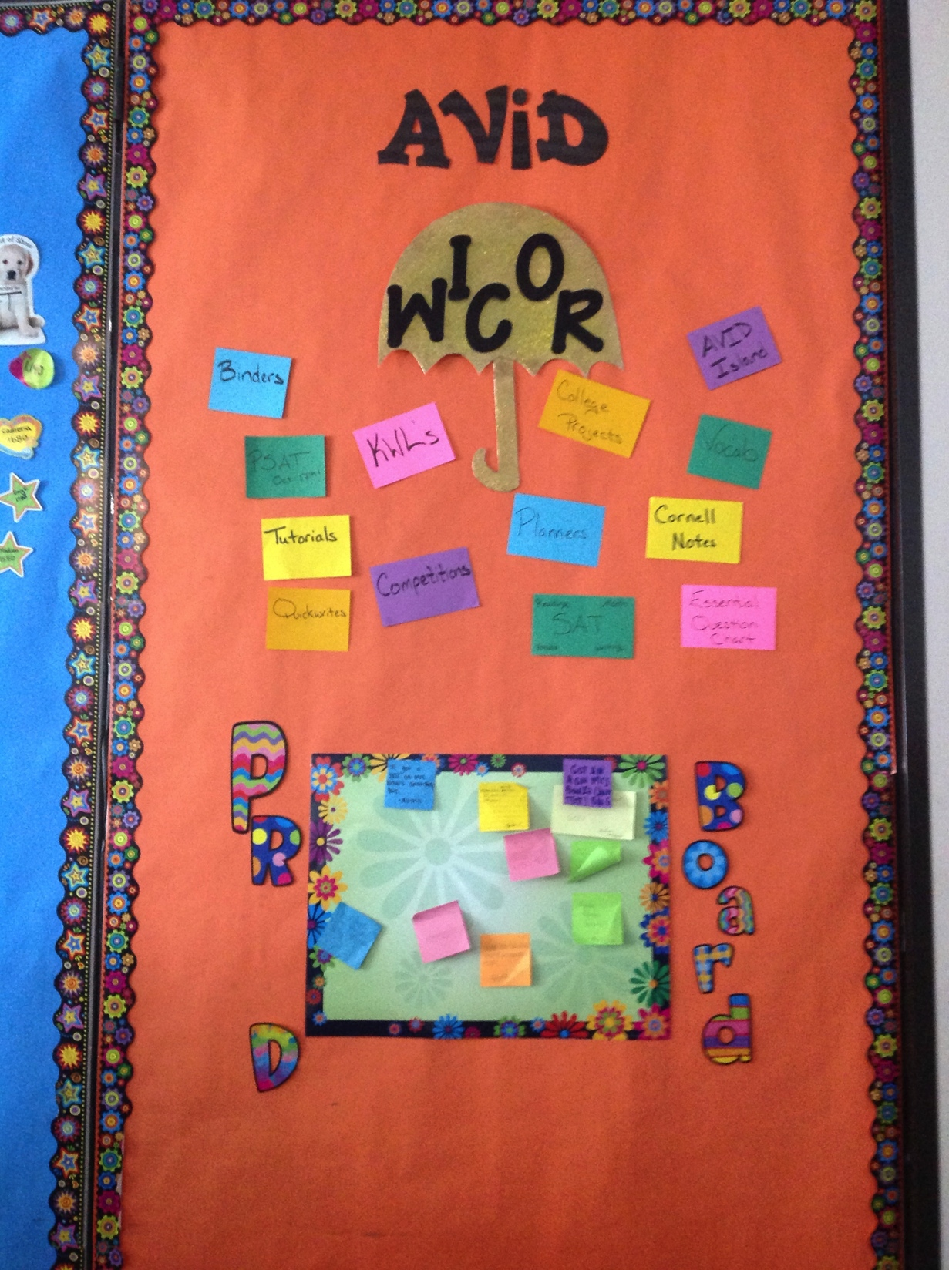
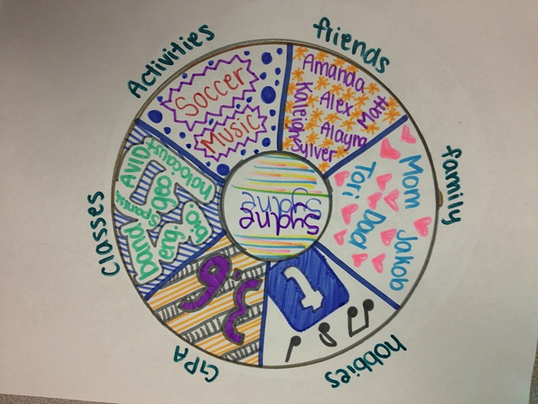

Slide 18
AVID Focus Skills for PHUHS
Marking the Text
Reading with Purpose
Research Skills
Group Projects
Complete Organization
Costa’s Levels of Questioning
Cornell Notes
What
How
Why
Way of work
5 Step Method
STAR Notetaking
Notes:
Have a student share about Cornell Notes

Slide 19
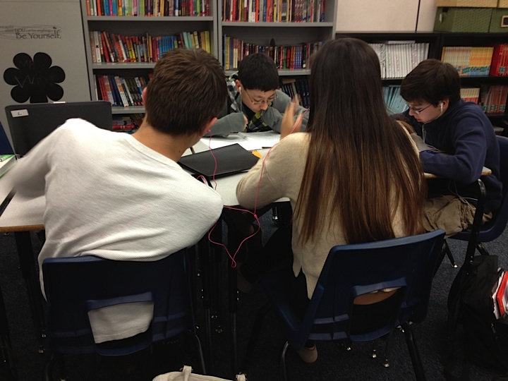
What Else Will Be Covered?
Graduation Requirements
Scholarships
Writing Projects: Mandala, Essays
SAT/ACT Preparation
Test Preparation
AP Preparation and Test Preparation
College Exploration: College Projects, College Applications, College Essays
Vocabulary
Critical Thinking Skills
Public Speaking Skills
Tutorials are Tuesdays and Thursdays!!!

Slide 20
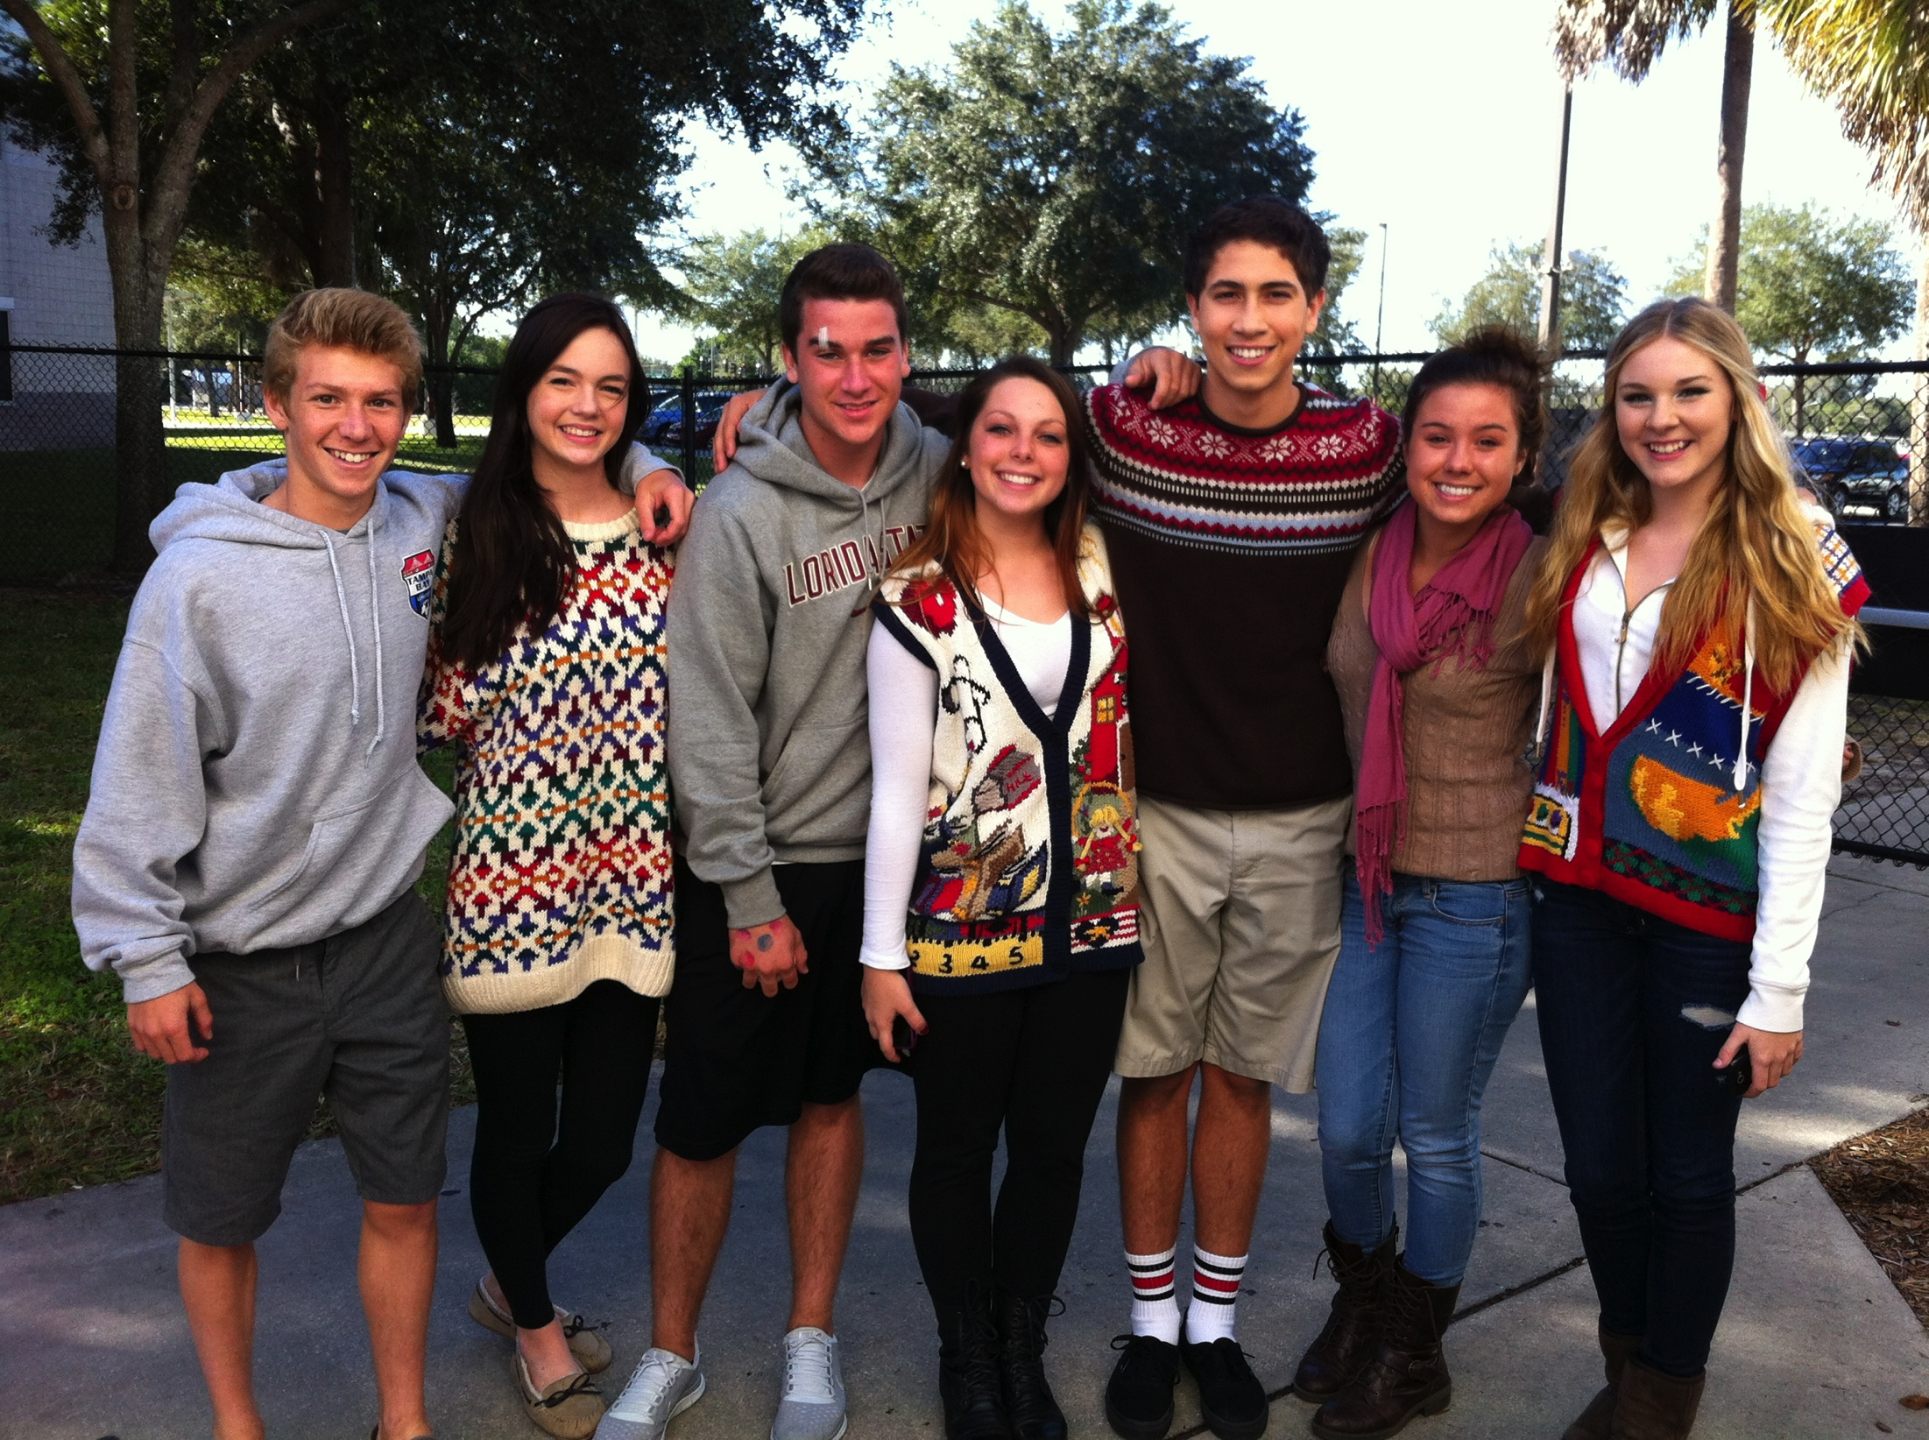
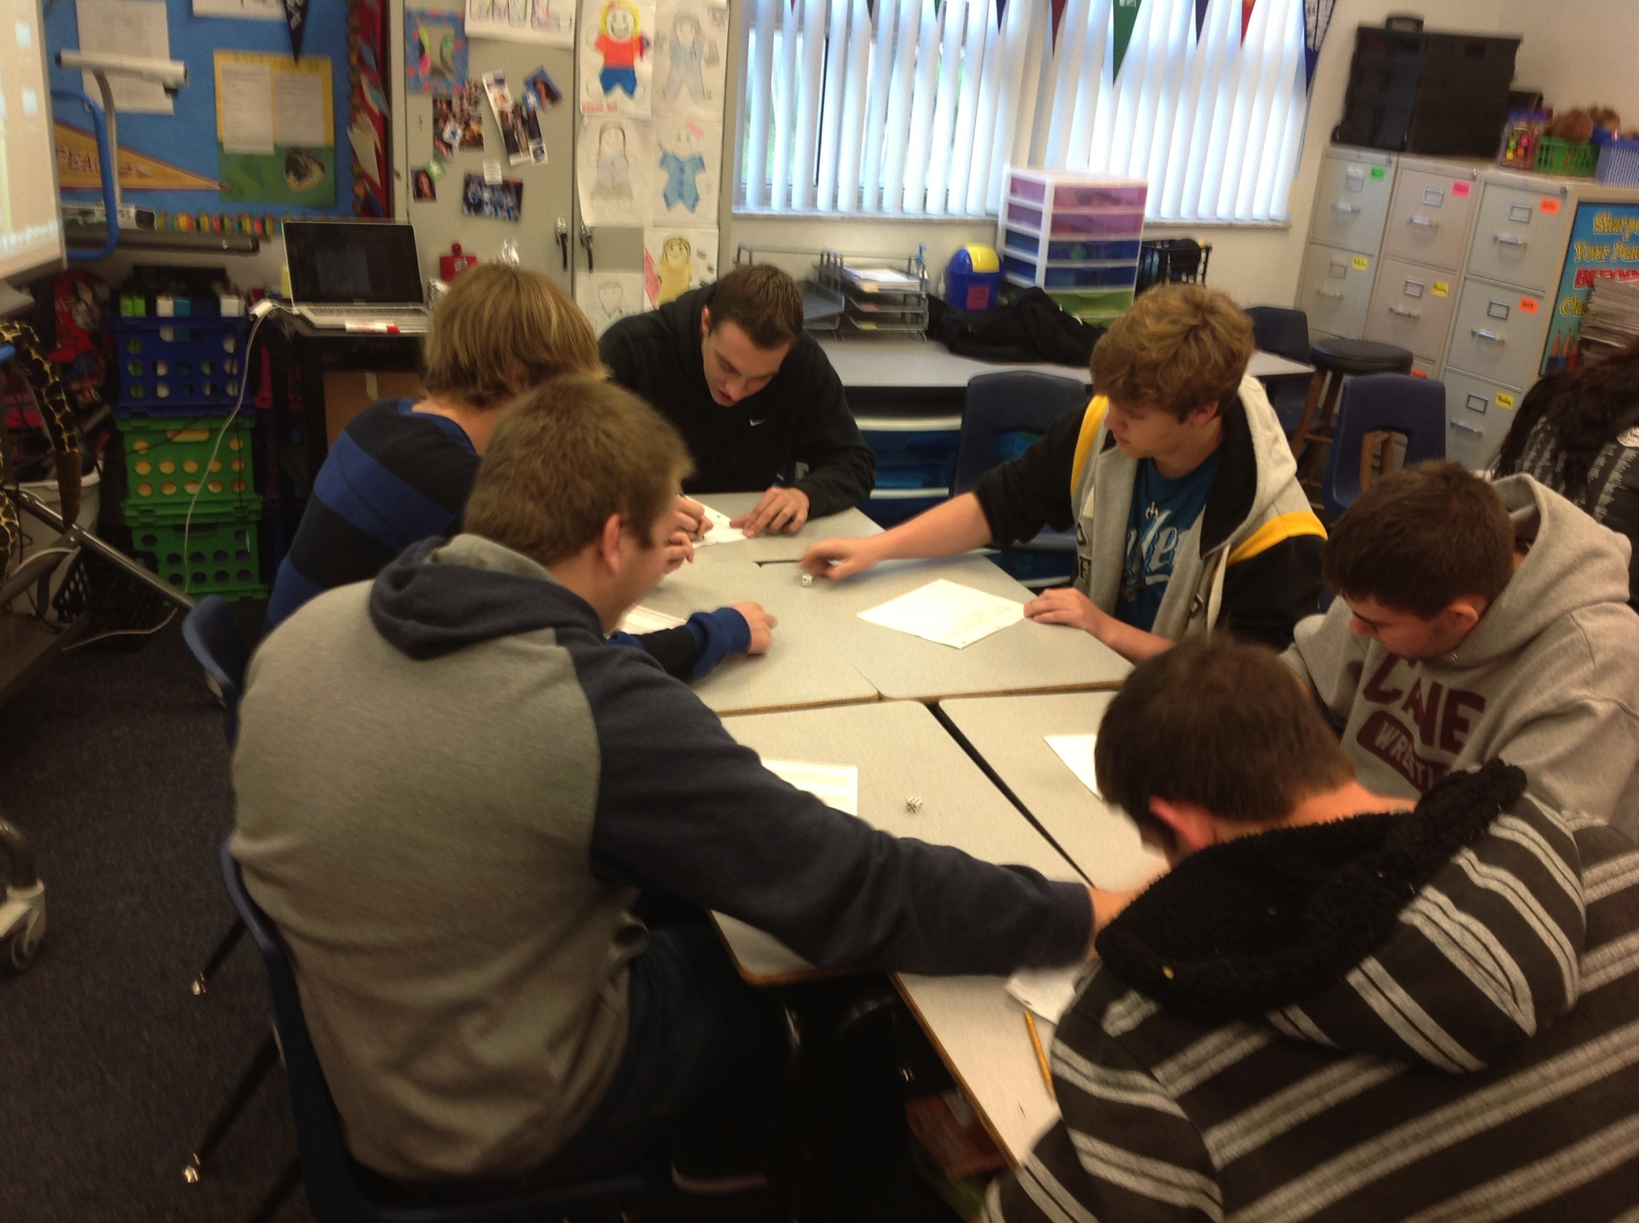
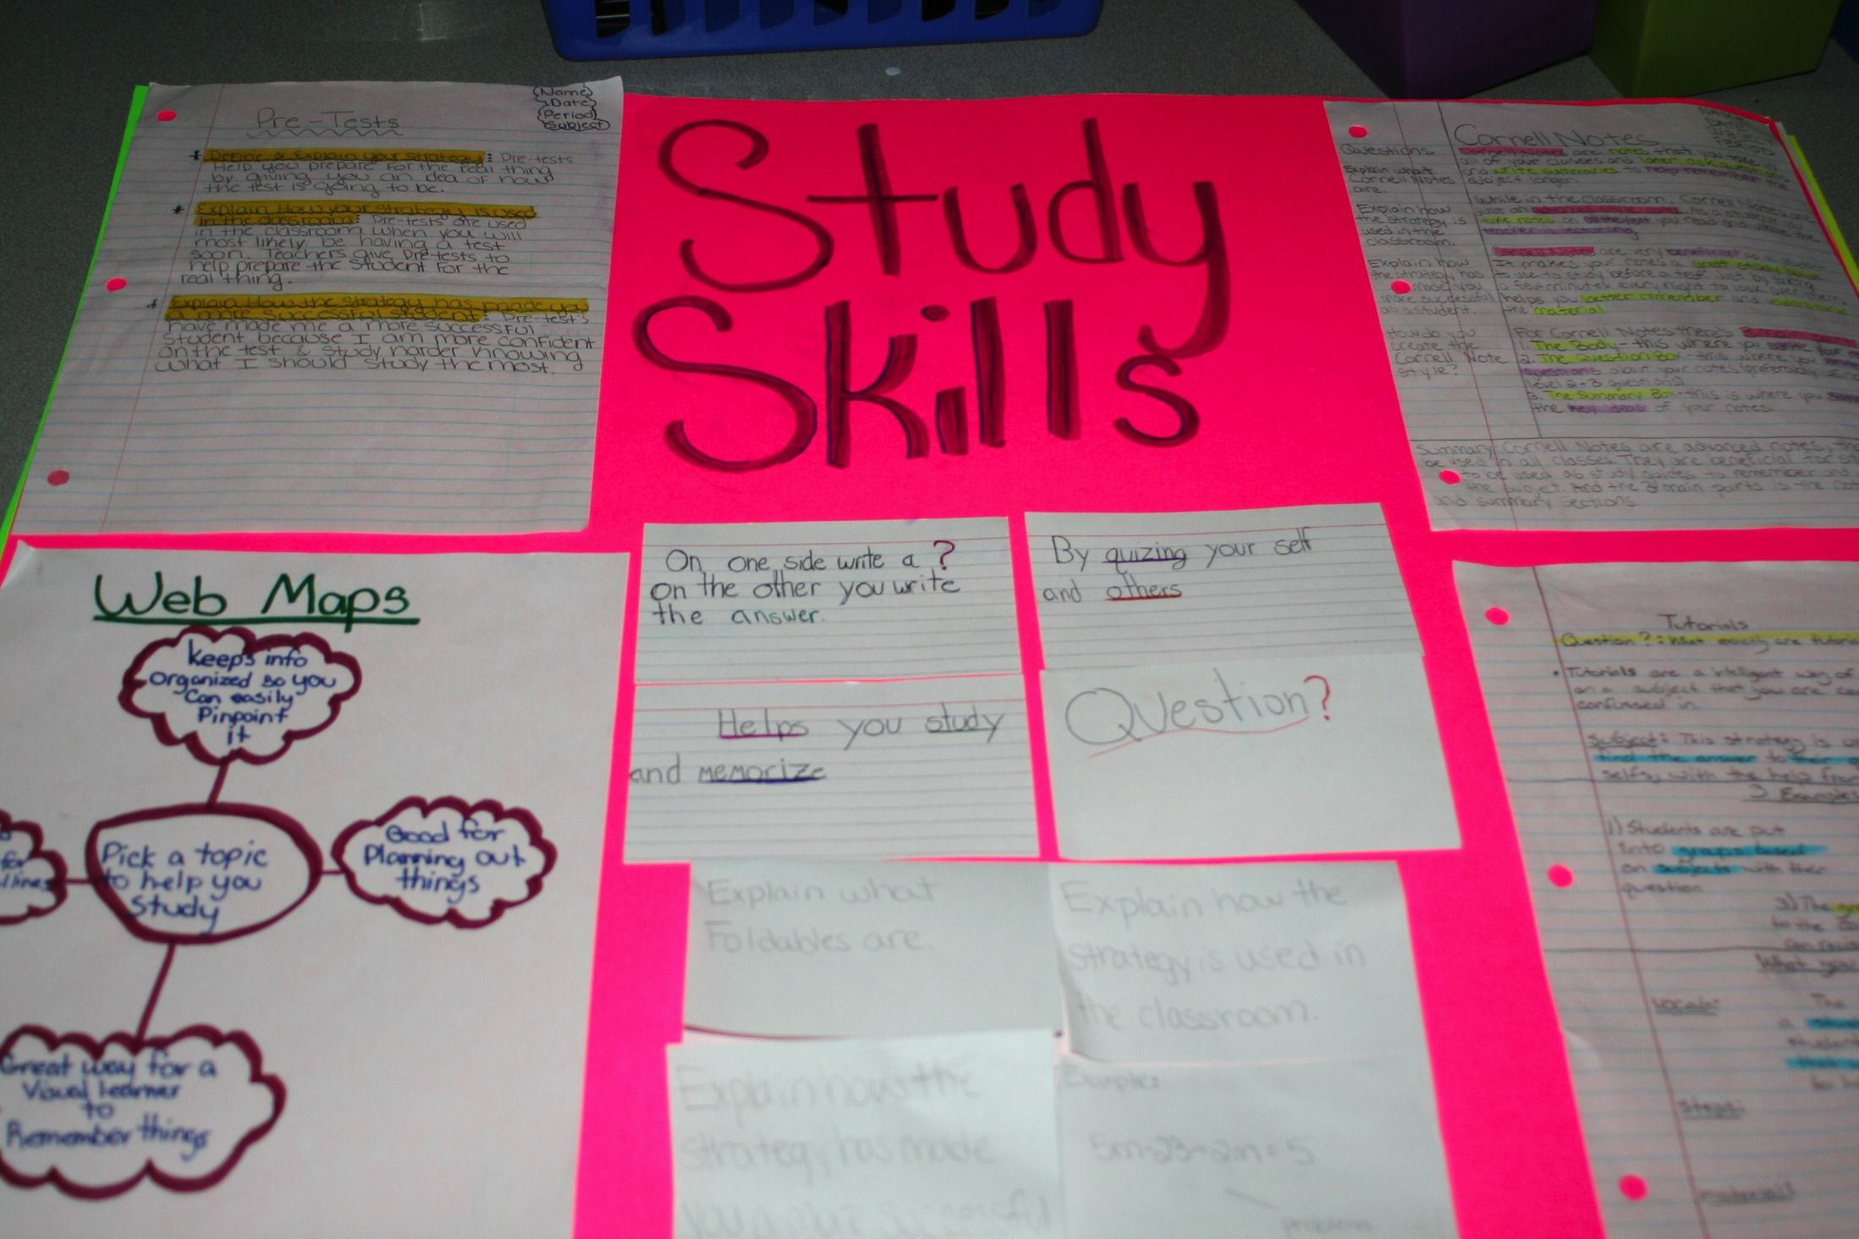
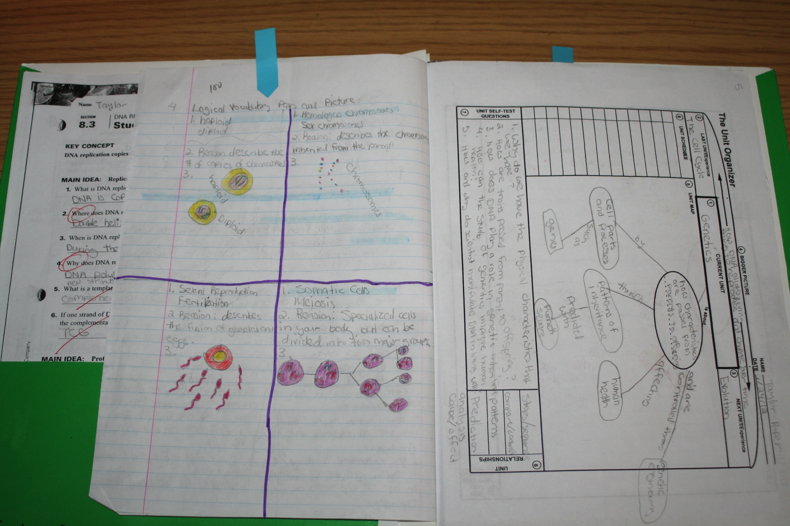
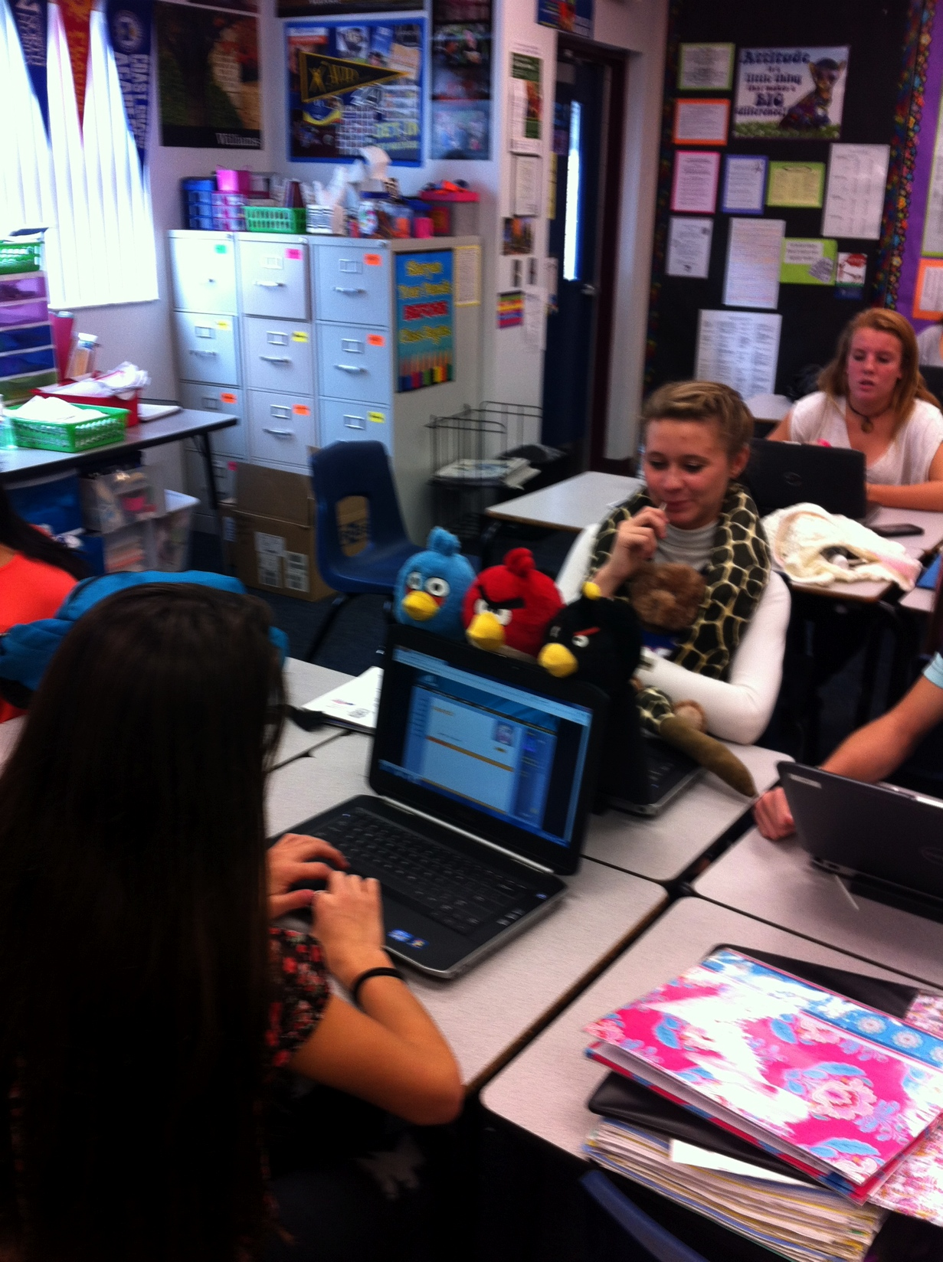
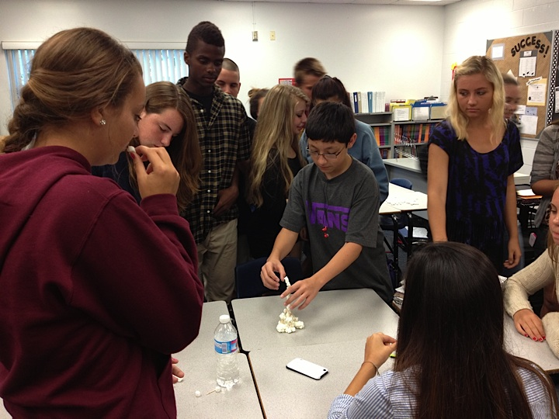
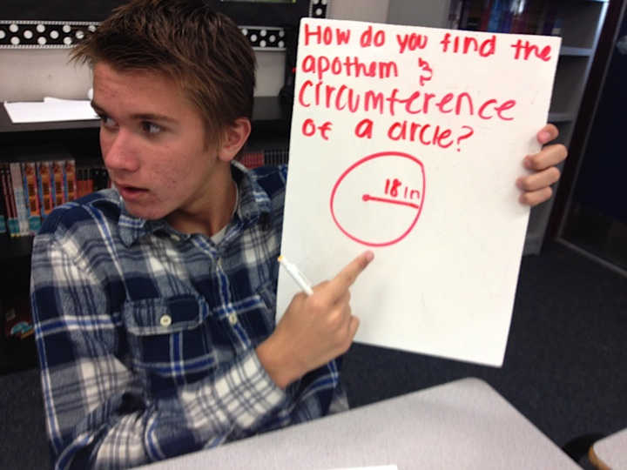
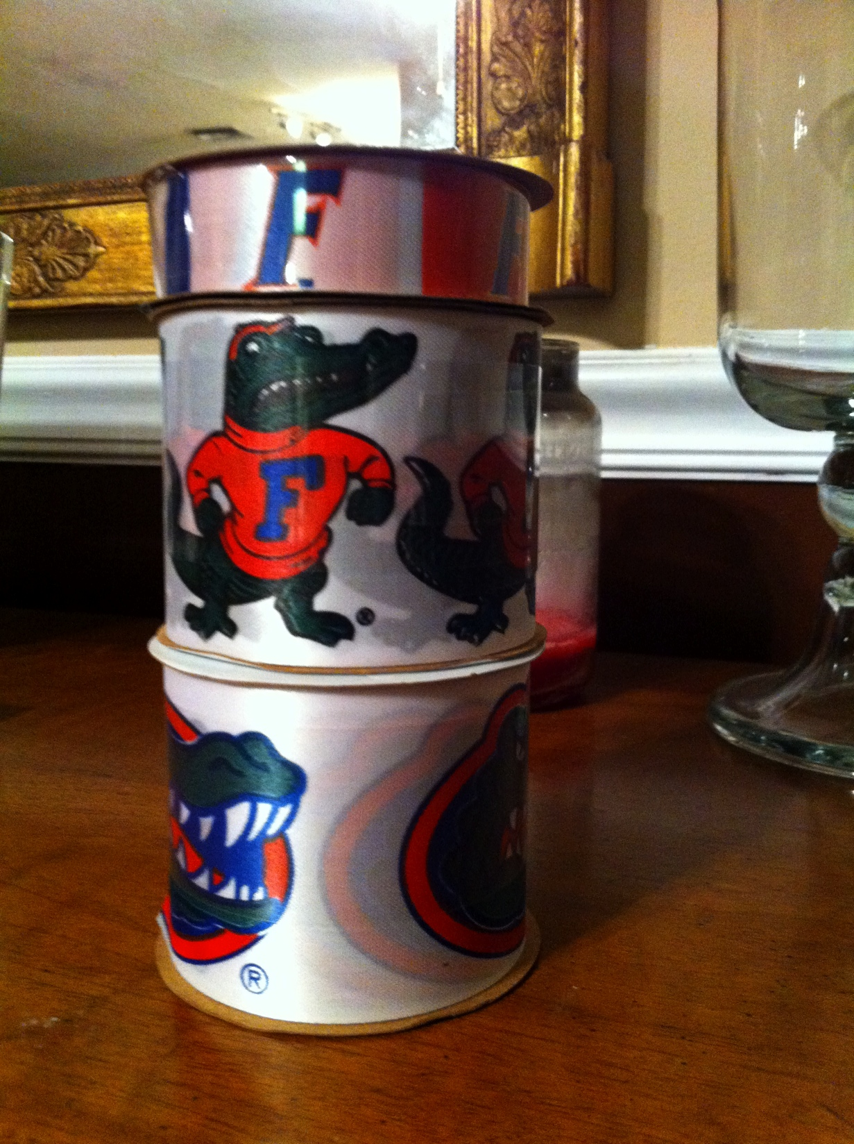
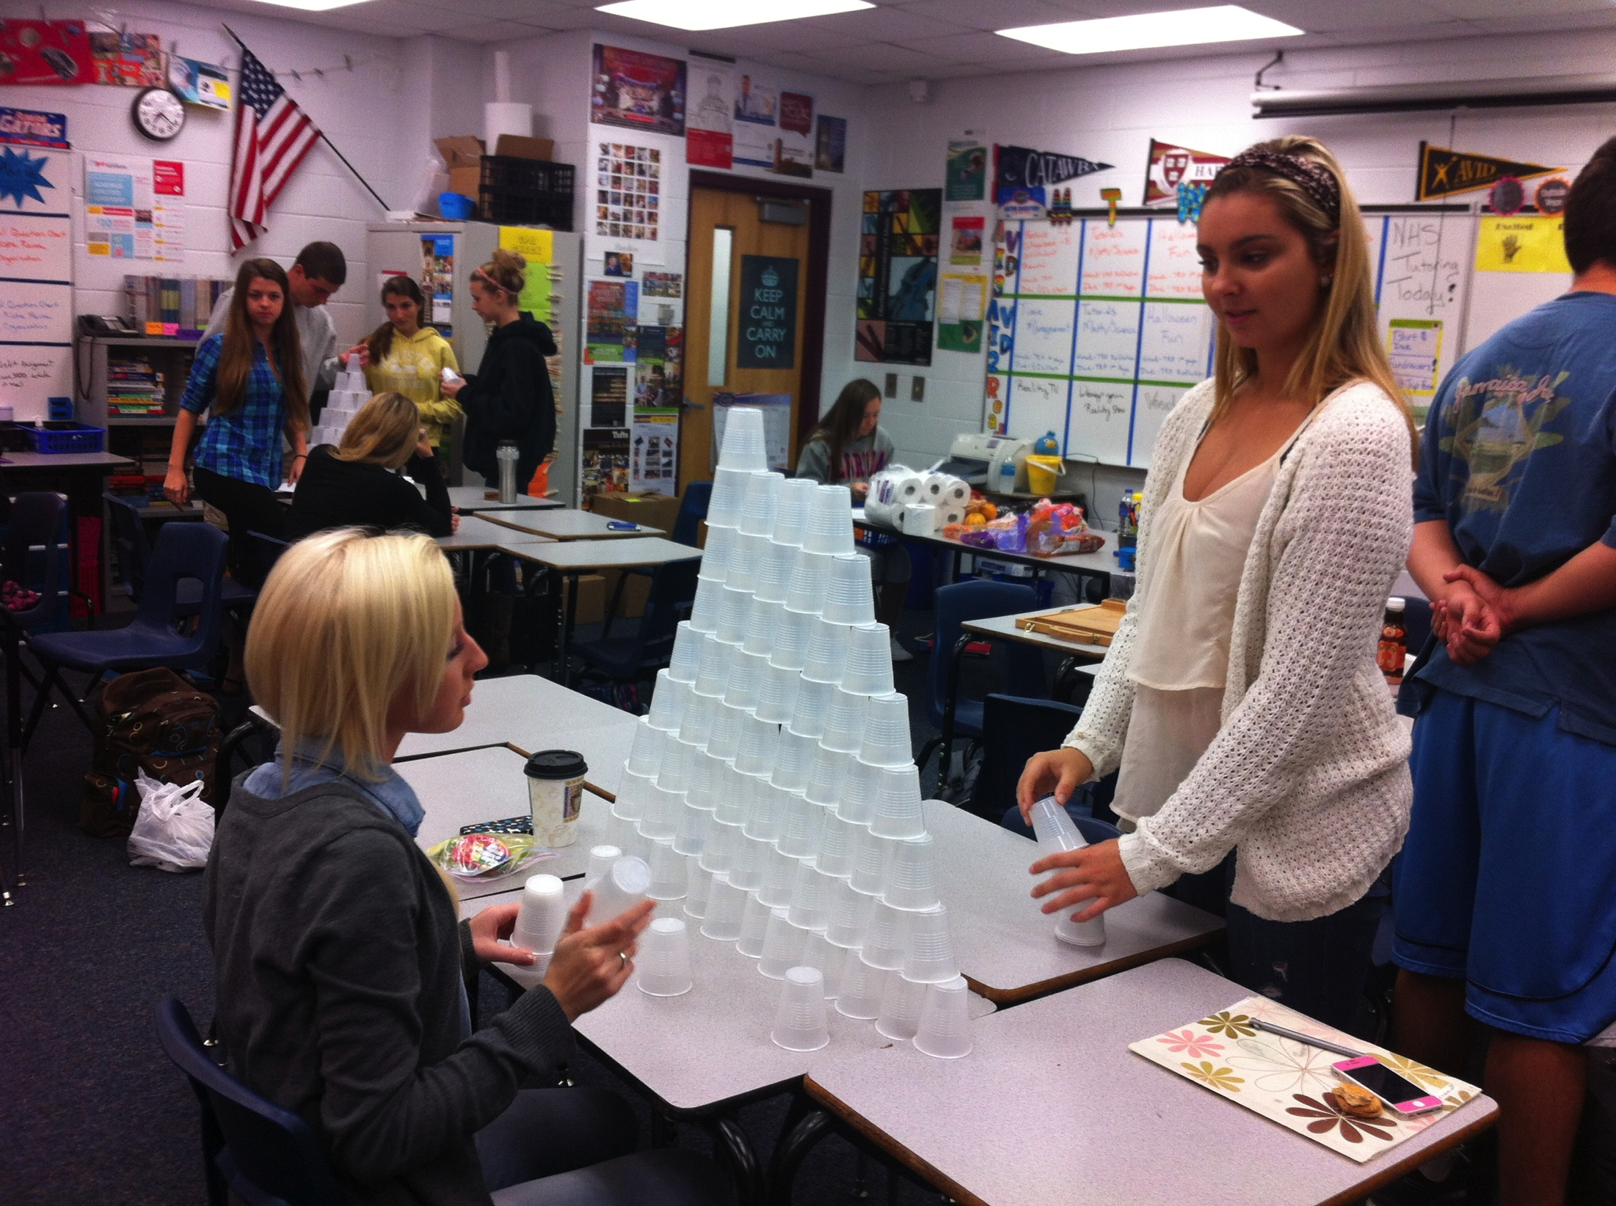
Notes:
Have a student share about what has helped them the most in class. Heatherr has a good story about college prep.

Slide 21
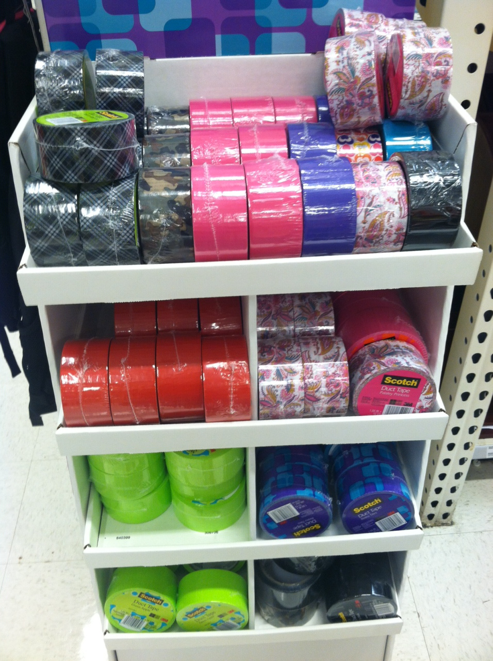
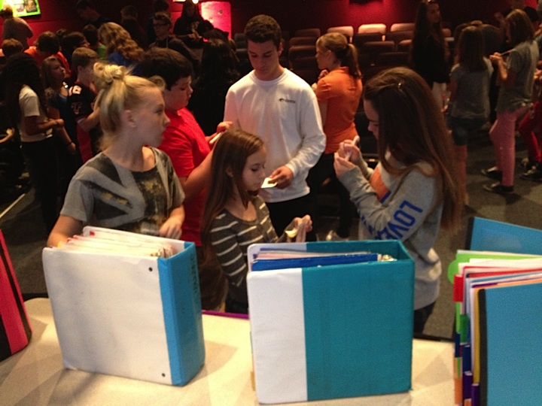
I Like Big Binders! (on youtube)
Why: Helps with overall organization and study skills.
What: Needs to be 3 inches, with dividers, and a pencil pouch. Folders with 3 holes are also very helpful!
How: The students are graded on their binders often.
Notes:
Have a student share about the binder.

Slide 22
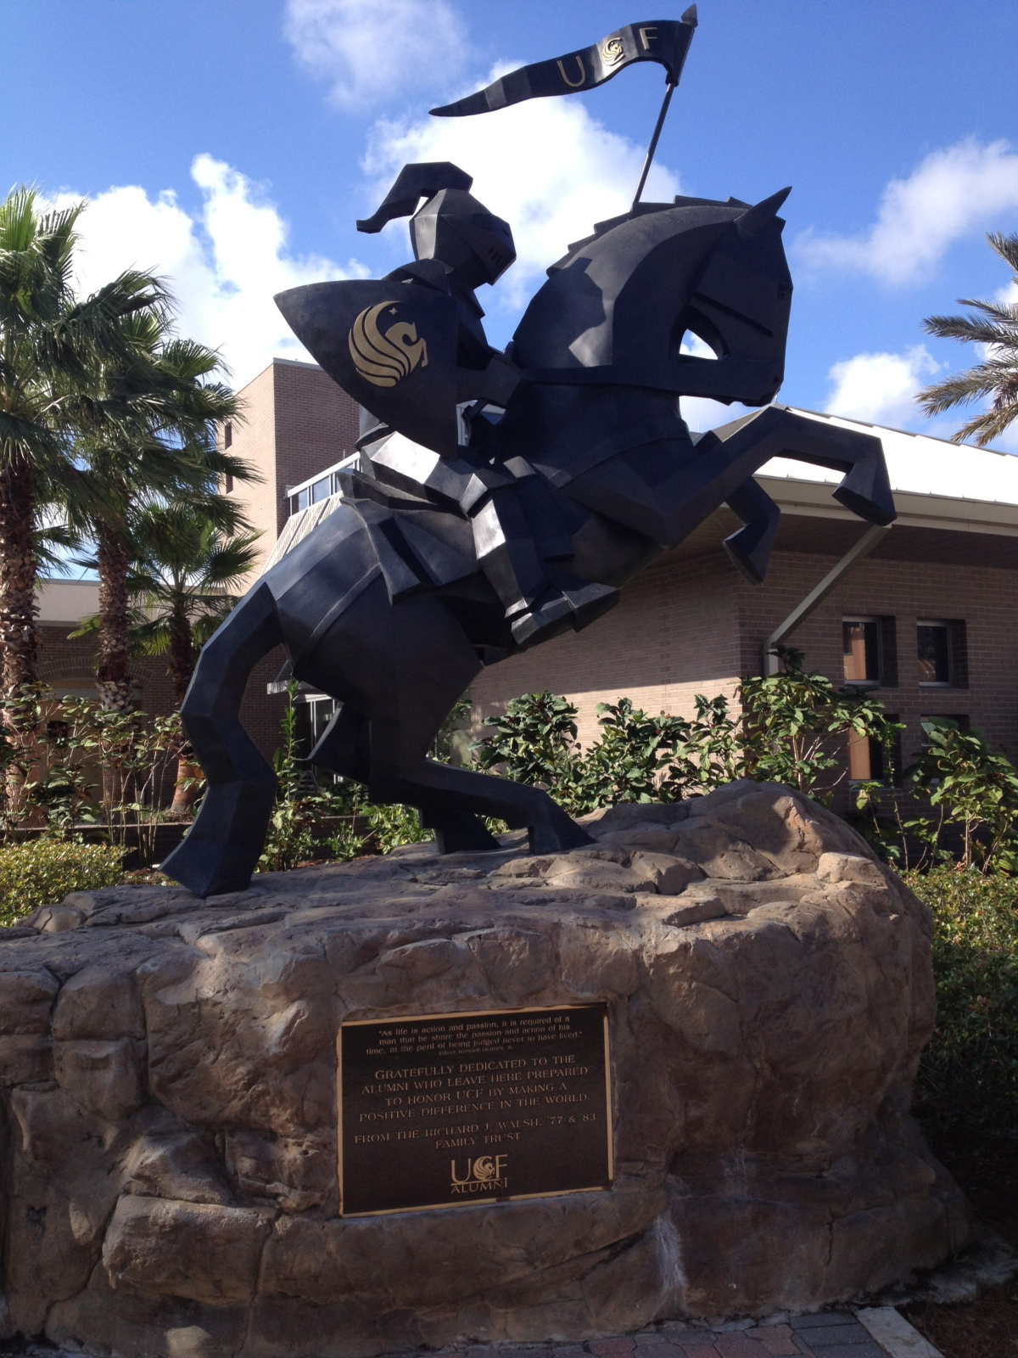
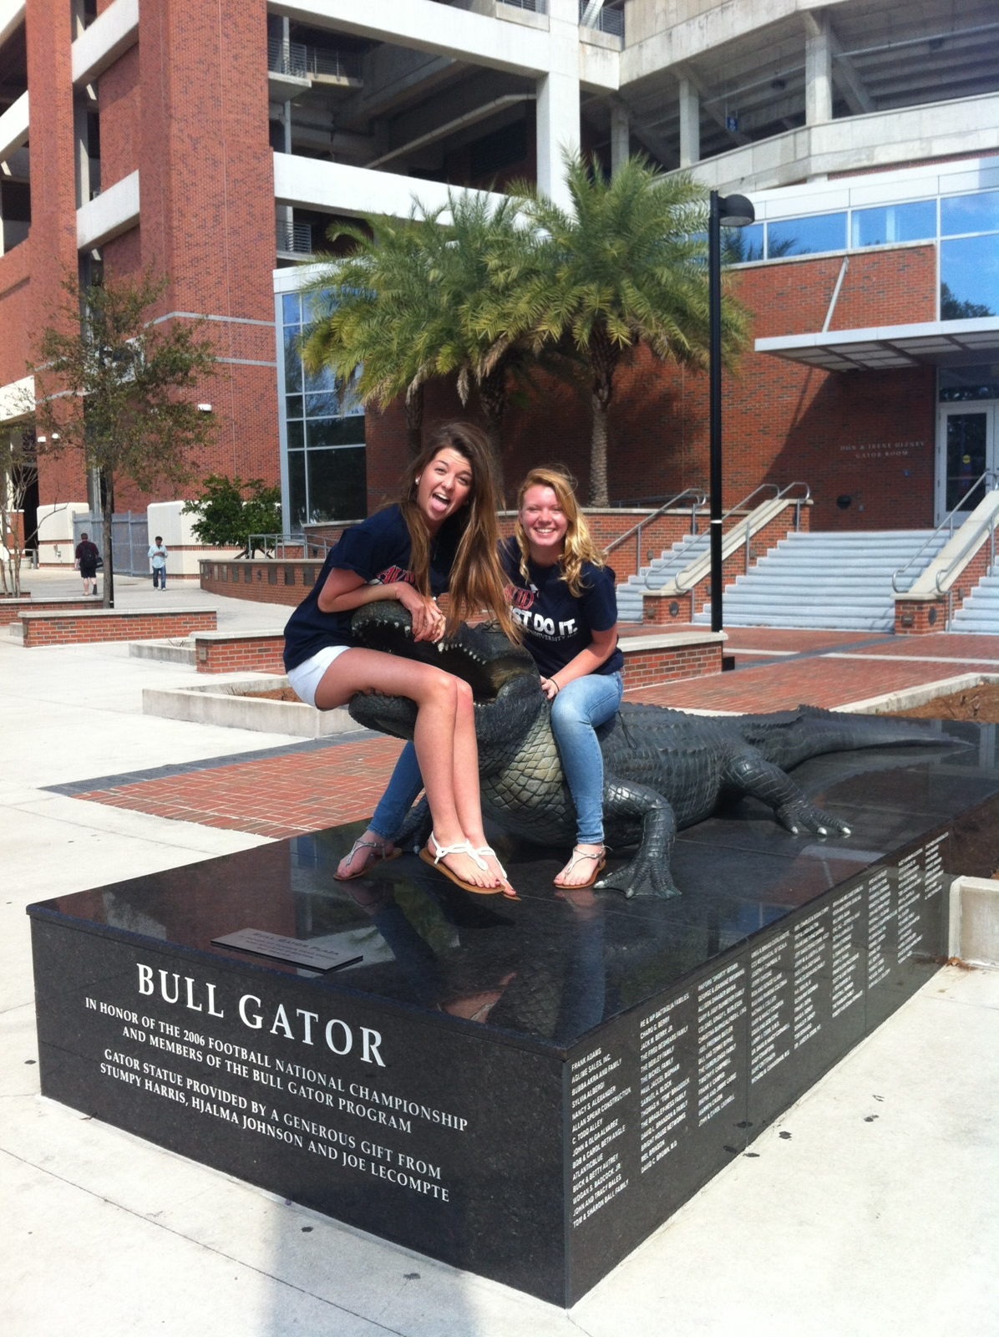
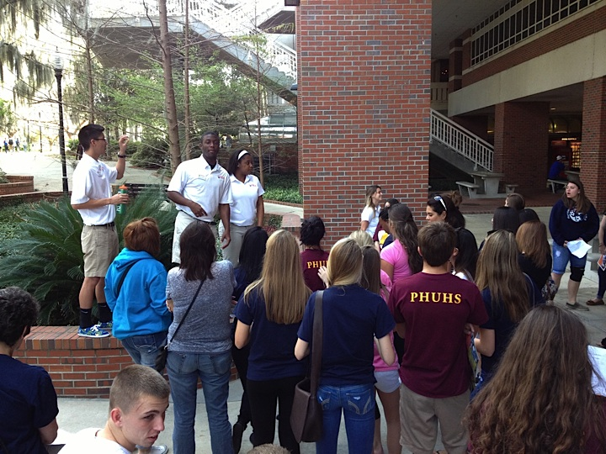
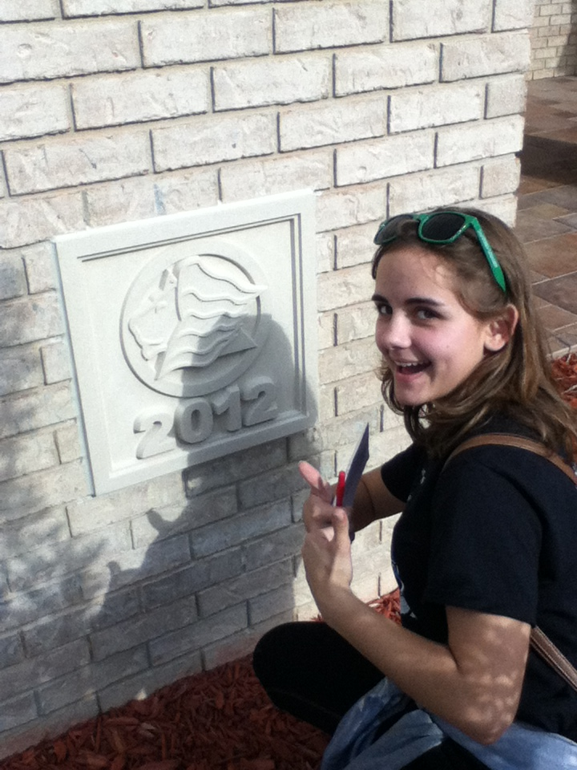
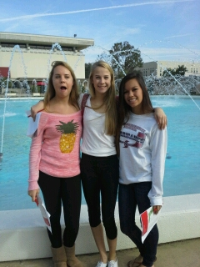
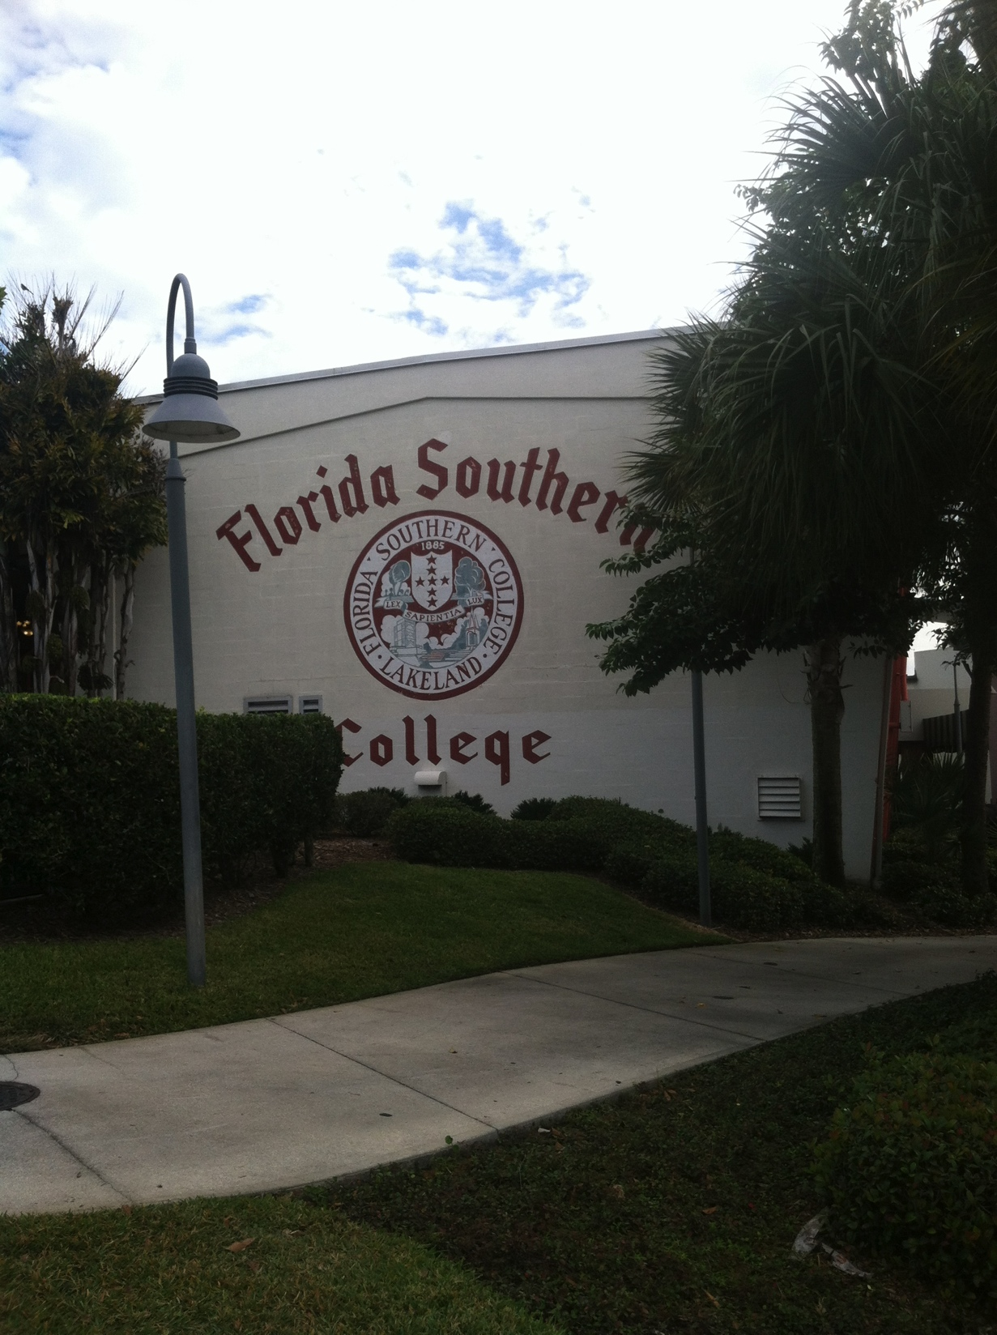
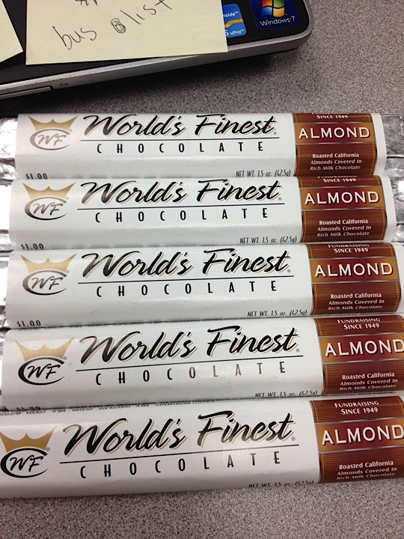
Field Trips and Fundraisers!
Notes:
Have a student talk about fieldtrips

Slide 23
Next Steps
Complete the application
Return application to Mrs. Winer at PHUHS.
Check your course schedule –
9th and 10th graders MUST be in at least 1 Honor’s Level classes
Returning AVID students MUST be in 2 Honor’s
11th graders MUST be in at least 1 AP or Dual Enrollment Course + Honor’s where possible
12th graders MUST be in at least 2 AP or Dual Enrollment Courses + Honor’s where possible
Get ready to have all kinds of opportunities!

Slide 24
phuhsavid.weebly.com

Slide 25
What You Need For Class
Summer Reading Homework
3-in Binder for all classes with dividers as requested by each teacher (minimum of 20)
1-in Binder for Portfolio
Pens, Pencils, and Highlighters
Notebook Paper (1 for you and 1 for us)
Computer Paper (1 for us)
And MORE! Please look on the list provided!

Slide 26
Please contact us if you have any questions or want more information.
Kerrale Prince
princeke@pcsb.org
Allison Winer
winera@pcsb.org

