Slide 1
AVID 2 and 3 Week 9
10/22/12

Slide 2
Bell Ringer Monday
Essential Question Chart from last week due NOW.
TRF Due Tomorrow: TRF Choice
Create Essential Question Chart for this week.
Essential Question for TODAY: How organized are my Cornell Notes?

Slide 3
Housekeeping
T-Shirt Money Due!
PSAT 10/17 periods 2–5
Homework Due Dates
Mon: Essential Question
Tues: TRF – Choice
Wed: TRF Reflection
Thurs: TRF – Choice
Fri: TRF Reflection
Vocab
Weekend Fun!
Mon: Essential Question
AVID 2 – Time Management Chart
AVID 3 – Student Resume
Congrats to ALL!!!
Scoreboard Update?
Proud Board Moments?
Birthdays?

Slide 4
VOCABULARY FUN!!
Definition, Synonym, Antonym, Sentence, Part of Speech, and a Visual
Don’t forget all the requirements!
Abhor, Bias, Canny, Divergent, Ephemeral, Forbearance, Hypothesis, Inevitable, Prosaic, Reconciliation
Vocabulary Options: Choice
NO COPY AND PASTE!!!

Slide 5
Monday
Take 6 sets of Cornell Notes and perfect them
Clean-out your binder
DUE NOW:
Essential Questions from last week
College Essays
Plan of Action
GPA Check

Slide 6
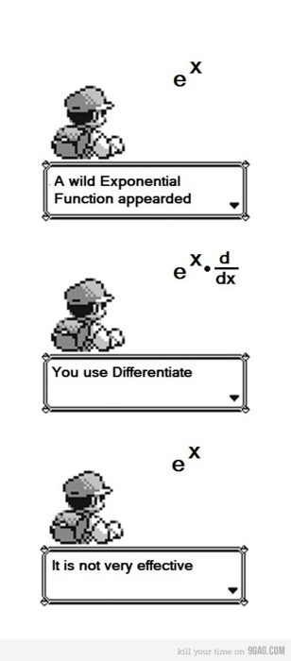
Bell Ringer Tuesday
Essential Question: How does inquiry help me? How well do I collaborate?
Turn in your TRF to the
appropriate magnetic folder.
6 people per group only!!!!
Chair Olympics 1st set-up and 4th Clean-up
TRF Reflection Due Tomorrow

Slide 7
Bell Ringer Wednesday

Slide 8
Wednesday AVID 2
EQ: How well do I use my time?
HMWK: Apology Letters (ZERO tolerance)
Write down all of your responsibilities
Rate your list as the most important to the least
How much time does each activity require each day?
Honestly! How much time do you spend doing homework each day? How much time do you dedicate to studying?
Do you use extended planning? Do you schedule your study time?

Slide 9
Wednesday AVID 2
With your planners time to schedule!
What are your tests, projects, and weekly assignments.
Plan for your tutoring hours, plan for all of your responsibilities.
What does this week look like?
Monitor your week – How will you know if you managed to stay to your schedule? What is your system?

Slide 10
Wednesday AVID 3: What do I need to do now to be prepared for my future?
HMWK: Complete the following
Activities.
Password Page in Your Planner
Collegeboard.com
Register for the site
Go to College Planning
Finding Colleges
Finding Your College Fit
Use your brainstorm
ACTstudent.org
Fastweb.com
Choose one scholarship to apply
For now.

Slide 11
Bell Ringer Thursday
Essential Question: How does inquiry help me? How well do I collaborate?
TRF Due: Choice
Turn in your TRF to the
appropriate magnetic folder.
6 people per group only!!!!
Chair Olympics!!!
Vocab due tomorrow.

Slide 12
Friday: AVID 2
DUE Now: Vocabulary
TRF Reflection
Planner Check
Weekend Planning

Slide 13
Friday AVID 3
DUE Now: Vocabulary
TRF Reflection
Who are You???

