Slide 1
AVID 2 and 3 Week 11
10/29/12

Slide 2
VOCABULARY FUN!!
Definition, Synonym, Antonym, Sentence, Part of Speech, and a Visual
Don’t forget all the requirements!
Abstain, Brazen, Capitulate, Discredit, Evanescent, Fortuitous, Inconsequential, Parched, Renovation, Substantiate
Vocabulary Options: Foldable
NO COPY AND PASTE!!!

Slide 3
Housekeeping
T-Shirt Money Due!
Homework Due Dates
Mon: Essential Question
Tues: TRF – Math/Science
Wed: TRF Reflection AVID CLUB APP!
Thurs: TRF – Choice
Fri: TRF Reflection
Vocab
AVID 3: SAT, ACT, Fastweb, 5 paragraph essay, resume, ACT/SAT test
NHS Tutoring Wednesday! RSVP
Weekend Fun!
Mon: Essential Question
AVID 2 - College Project Out of State
AVID 3 – College Project
Congrats to ALL!!!
Scoreboard Update?
Proud Board Moments?
Birthdays?

Slide 4
Monday: Classwork
DUE NOW:
Essential Questions from last week
Student Resumes
GPA/Plan of Action
Create your EQ Chart for this week
TRF: Math or Science – Reserve which you will study on a post-it
Grammar Rule of the Week: Commas
You will be the expert on one rule for commas. Be prepared to explain your rule and present it to your group.

Slide 5
AVID 2 Weekly Theme Goal Setting
Essential Question – How do your long-term and short-term goals connect?
3 year plan, 6 year plan, academic and life
Brainstorm: How do they all connect?

Slide 6
AVID 3 – Weekly Theme College Prep
Student Resumes
Fastweb.com
Collegeboard.com
Actstudent.org
Directions on the following slides

Slide 7
Student Resumes
Use your notes from class
Include the Following in Bullet Point Format
Header: Your Name and Contact Information
Objective: 1 sentence about why you are applying to that school
Education: School, Special Programs (AVID, Medical) AP/Dual Enrollment Classes, GPA, SAT/ACT test scores
Activities: Clubs, Sports, and Unique Things You are Apart of
Experience: Any activities that are leadership activities, or pertain to your major
Skill: Special skills or certifications you have (CPR, CNA, Microsoft, Adobe etc)
Volunteering: Any volunteer activities
References: Teachers , Coaches, Guidance Counelsors etc.

Slide 8
SAT College Board: collegeboard.com
Register to use the website it is FREE!
Choose a test date $50
Collegeboard College Search:
Go to College Planning and Search for Colleges Using Your Requirements
Find 5 Colleges to do further research on

Slide 9
ACT: actstudent.org
Register to use the site for FREE
Choose a test date if you choose to.

Slide 10
Fastweb.com
Register to use the site
Put in all of your info to find scholarships that meet your needs.
Apply for at least one scholarship!

Slide 11
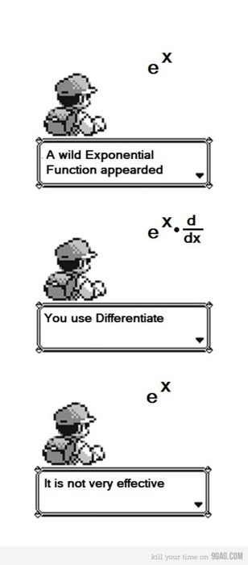
Bell Ringer Tuesday
Essential Question: How does inquiry help me? How well do I collaborate?
Turn in your TRF to the
appropriate magnetic folder.
6 people per group only!!!!
Chair Olympics 1st set-up and 4th Clean-up
TRF Reflection Due Tomorrow

Slide 12
Bell Ringer Wednesday

Slide 13
Bell Ringer Thursday
Essential Question: How does inquiry help me? How well do I collaborate?
TRF Due: Choice
Turn in your TRF to the
appropriate magnetic folder.
6 people per group only!!!!
Chair Olympics!!!
Vocab due tomorrow.

Slide 14
Friday: AVID 2
DUE Now: Vocabulary
TRF Reflection
Planner Check
Goal Setting

Slide 15
Friday AVID 3
DUE Now: Vocabulary
TRF Reflection
5 Colleges
How do I pay for it all?

