Slide 1
AVID 2 and 3 Week 11
11/5/12

Slide 2
Monday: Classwork
DUE NOW:
Essential Questions from last week
Late Work Still Accepted:
Time Logs, Vocabulary and TRF’s from last week
Resumes, Vocabulary, and TRF’s from last week
GET OUT AND GET READY:
Create your EQ Chart for this week
Planner
Tuesday TRF: Math or Science – Reserve which you will study on a post-it
Thursday TRF: Choice – Focus on Note Taking

Slide 3
VOCABULARY FUN!!
Definition, Synonym, Antonym, Sentence, Part of Speech, and a Visual
Don’t forget all the requirements!
Superfluous, Prosperity, Foster, Exemplary, Conditional, Camaraderie, Condescending, Asylum, Arid, Anachronistic
Vocabulary Options: Choice
NO COPY AND PASTE!!!

Slide 4
Housekeeping
T-Shirt Money Due!
FUNDRAISER DUE BY Wednesday!
Homework Due Dates
Mon: Essential Question
Tues: TRF – Math/Science
Wed: TRF Reflection
Thurs: TRF – Choice
Fri: TRF Reflection
Vocab
No NHS Tutoring on Wednesday
Extra Credit Opportunities:
Vocabulary game using all the words.
Research a study skill
Research an Extra College from the wall
Homefun AVID3 – 5 Colleges
Congrats to ALL!!!
Scoreboard Update?
Proud Board Moments?
Birthdays?

Slide 5
Grades and AVID
Grade Chat
Must have a C or higher to attend Field Trips in AVID for the current 6 weeks.
Probation Notices will be filed this week
Must be taken care of during the next 6 week

Slide 6
Extra Credit Directions Due by 11/12/12
Vocabulary Game: Use all the words from the past 12 weeks and create a game to play: Go Fish, Matching, Scrabble, Jeopardy, Board Game etc. Must use definitions, words, part of speech, antonym/synonym. This is worth 5%.
Study Skill Presentation: Research a study skill and present it to the class. This must include the article used, Cornell Notes over the article, a student activity for the class to learn the skill, an example, and a visual – posterboard or powerpoint. This is worth 5%
College Project Based on the Colleges on the Wall: Research one of the colleges on the wall that is not St. Leo/UF/FSU/UCF/USF. You must use the college research worksheet off of weebly. You will then present this information to the class using a brochure/pamphlet and a visual presentation – posterboard, or powerpoint. You must sign-up for the school you are choosing. 3%

Slide 7
AVID 2 Weekly Theme Goal Setting
Building your Goal Setting Blue Print
Use the Goal Setting Worksheet from weebly

Slide 8
AVID 3 – Weekly Theme FAFSA
Cornell Notes Continued for Your Topic
Begin Research Online Your Topic
Must Include 3 Sources and Use MLA Formatting
Create Your Poster and Brochure/Pamphlet to Hand-out to the Group
Create a Student Activity for the Class to Do That will Enhance their Understanding of the Topic.

Slide 9
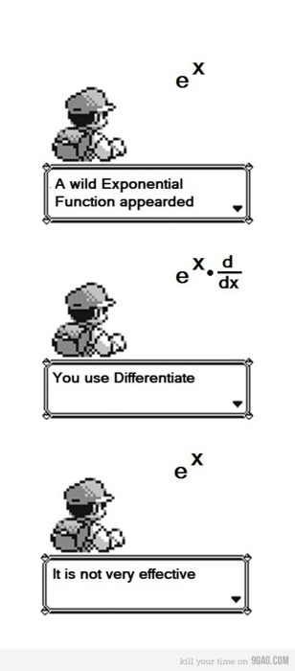
Bell Ringer Tuesday
If Absent you must do a
TRF Make-up on Weebly
Essential Question: How does inquiry help me? How well do I collaborate?
Turn in your TRF - Math or Science
6 people per group only!!!!
Chair Olympics 1st set-up and 4th Clean-up
TRF Reflection Due Tomorrow

Slide 10
Bell Ringer Wednesday

Slide 11
AVID 2 Weekly Theme Goal Setting
Building your Goal Setting Blue Print
Look at goals sheet and determine your top goals.

Slide 12
AVID 3 – Weekly Theme FAFSA
Cornell Notes Continued for Your Topic
Begin Research Online Your Topic
Must Include 3 Sources and Use MLA Formatting
Create Your Poster and Brochure/Pamphlet to Hand-out to the Group
Create a Student Activity for the Class to Do That will Enhance their Understanding of the Topic.

Slide 13
Bell Ringer Thursday
Essential Question: How does inquiry help me? How well do I collaborate?
TRF Due: Choice
Turn in your TRF
6 people per group only!!!!
Chair Olympics!!!
TRF Reflection Due Tomorrow
Vocab due tomorrow.

Slide 14
Friday: AVID 2 and 3
DUE: TRF Reflection and Vocab for Week 12
How are your tables grades? We only play games if EVERYONE is up to date!
Newspaper Towers
You have 5 minutes of planning time – your group must work together silently to build the tallest free standing tower that is still standing by the end of the time.
How well do you collaborate?

