Slide 1
AVID 2 and 3 Week 13
11/25/12

Slide 2
Housekeeping
T-Shirt Money Due!
Congrats to ALL!!!
*Fundraiser Update*
Scoreboard Update?
Proud Board Moments?
Birthdays?
Planner Update:
Homework Due Dates
Mon: Essential Question
Tues: College Research/
Field Trip 7am – 5pm
Wed: Field Trip Scavenger Hunt
Thurs: TRF – Choice
Fri: TRF Reflection
Vocab
NHS Tutoring on Wednesday
Week Theme
AVID 2 - Backwards Mapping
AVID 3 - SAT Essay Prep
Home Fun for ALL: (Weebly)
Plan of Action for 3rd 6 weeks
GPA Reflection for 2nd 6 weeks
Report Card Signed (can be a portal print off)
Tutoring Plan

Slide 3
Monday: Classwork
DUE NOW:
Fieldtrip Money and Fieldtrip Forms
GET OUT AND GET READY:
Create your EQ Chart for this week
“How prepared am I?”
The NEW Monday!!!!!!!!!!!!!!!!!!!!!!!!!!!!!!!!!
Get a computer and log on
Portal Check – GPA Check/ Planner Set-up
Write down all of your tests/quizzes/projects on the wall
Note Check – Cornell Note revision time
Binder Check – Organize and get prepared

Slide 4
VOCABULARY FUN!!
Use ALL 20 words!!!
Use the following 20 words from your past lists and write at least 5 sentences using as many of the words in their proper context as possible. Every sentence must have at least 2 words in it. You can reuse words if needed.
Empathy, Digression, Florid, Hackneyed, Impetuous, Jubilation, Precocious, Rancorous, Sagacity, Transient, Abhor, Bias, Canny, Divergent, Ephemeral, Forbearance, Hypothesis, Inevitable, Prosaic, Reconciliation

Slide 5
AVID 3 – Weekly Theme FAFSA
Cornell Notes Continued for Your Topic
Begin Research Online Your Topic
Must Include 3 Sources and Use MLA Formatting
Create Your Poster and Brochure/Pamphlet to Hand-out to the Group
Create a Student Activity for the Class to Do That will Enhance their Understanding of the Topic.

Slide 6
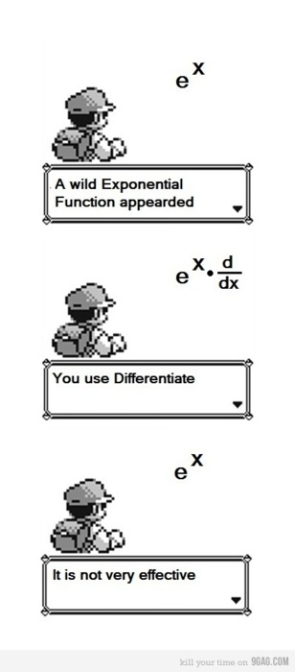
Bell Ringer Tuesday
If Absent you must do a
TRF Make-up on Weebly
Essential Question: How does inquiry help me? How well do I collaborate?
Turn in your TRF - Math or Science
6 people per group only!!!!
Chair Olympics 1st set-up and 4th Clean-up
TRF Reflection Due Tomorrow

Slide 7
Wednesday
Write a 5 paragraph essay based on the research completed on St. Leo and Florida Southern.
The essay should include your impressions about each college, and whether or not you would be interested in attending those schools.

Slide 8
Friday: AVID 2 and 3
DUE: TRF Reflection, essay, and college project and Vocab for Week 13
AVID 2 – Backwards Mapping
AVID 3 – SAT Essay

