Slide 1
AVID 2 and 3 Week 14
12/3/12

Slide 2
Monday: Classwork
DUE NOW:
Essential Questions from last week
GPA Check, Plan of Action (by end of day), Report Card Signed, Tutoring Form from last 6 weeks, and Tutoring Plan for this 6 weeks.
GET OUT AND GET READY:
Create your EQ Chart for this week
Planner
Tuesday TRF: Choice/ AP
Thursday TRF: Math or Science

Slide 3
VOCABULARY FUN!!
Write sentences using the following 20 words. You must use at least 5 sentences and 2 words per sentence. Due Friday!
Abate, Benevolent, Capacious, Deleterious, Orator, Perfidious, Querulous, Spurious, Venerable, Abstain, Brazen, Capitulate, Discredit, Evanescent, Fortuitous, Inconsequential, Parched, Renovation, Substantiate

Slide 4
Housekeeping
First Come First Serve T-Shirt Sales
Homework Due Dates
Mon: Essential Question
Tues: TRF – Math/Science
Wed: TRF Reflection
Thurs: TRF – Choice/AP
Fri: TRF Reflection
Vocab
No NHS Tutoring on Wednesday
Weekly Themes:
AVID 3 – SAT Writing
AVID 2 – Text Marking
Congrats to ALL!!!
Scoreboard Update?
Proud Board Moments?
Birthdays?

Slide 5
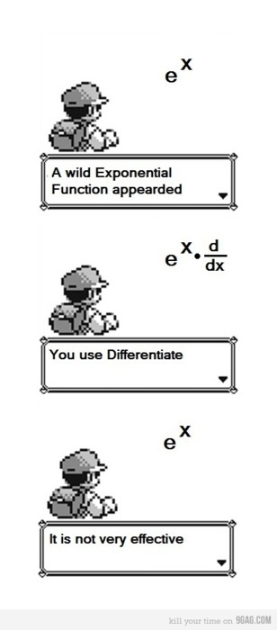
Bell Ringer Tuesday
If Absent you must do a
TRF Make-up on Weebly
Essential Question: How does inquiry help me? How well do I collaborate?
Turn in your TRF - Math or Science
6 people per group only!!!!
Chair Olympics 1st set-up and 4th Clean-up
TRF Reflection Due Tomorrow

Slide 6
AVID 3 – Weekly Theme SAT Writing
Essay prompts
Write a brainstorm for at least 5 prompts including a historical and literary reference.

Slide 7
AVID 2 Weekly Theme Text Marking
Read the article about soccer and use your text marking skills.
1- number the paragraphs
2- make a prediction based on the title
3- highlight author’s claims
4- check your prediction statement
5-write a skirt summary

Slide 8
Bell Ringer Thursday
Essential Question: How does inquiry help me? How well do I collaborate?
TRF Due: Choice
Turn in your TRF
6 people per group only!!!!
Chair Olympics!!!
TRF Reflection Due Tomorrow
Vocab due tomorrow.

Slide 9
Friday: AVID 2 and 3
DUE: TRF Reflection and Vocab for Week 14
AVID 3 – What makes a good thesis statement?
AVID 2 – How can I write good questions based on my reading?

