Slide 1
AVID 2 and 3 Week 15
12/10/12

Slide 2
Monday: Classwork
EQ: How prepared am I?
DUE NOW:
Essential Questions from last week
GET OUT AND GET READY:
Create your EQ Chart for this week
Monday Prep
Planner
Tuesday TRF: Math
Thursday TRF: Choice – Focus on Note Taking

Slide 3
VOCABULARY FUN!!
Sentences with at least 2 words per sentence or write a paragraph or story.
Abdicate, Clairvoyant, Brusque, Demagogue, Emulate, Fortitude, Impute, Haughty, Lobbyist, Opulent, Tactful, Surreptitious, Vindicate, Tenacious, Wary, Reverence, Provocative, Ostentatious, Nonchalant, Mundane

Slide 4
Housekeeping
Fundraiser Due Tomorrow.
Homework Due Dates
Mon: Essential Question
Tues: TRF – Math
Wed: TRF Reflection
Thurs: TRF – Choice
Fri: TRF Reflection
Vocab
NHS Tutoring Wednesday
Congrats to ALL!!!
Scoreboard Update?
Proud Board Moments?
Birthdays?

Slide 5
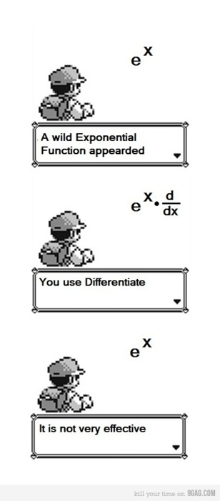
Bell Ringer Tuesday
If Absent you must do a
TRF Make-up on Weebly
Essential Question: How does inquiry help me? How well do I collaborate?
Turn in your TRF - Math or Science
6 people per group only!!!!
Chair Olympics 1st set-up and 4th Clean-up
TRF Reflection Due Tomorrow

Slide 6
AVID 2 Weekly Theme Philosophical Chairs
EQ: What is an academic debate?
Create a persuasive response to the following prompts and discuss with students in the class.
Should cell phones be allowed on campus?
What should our dress code be?

Slide 7
AVID 3 – Weekly Theme SAT Essay
EQ: What are the parts of a SAT essay?
Choose one of your thesis statements and start an essay on the topic. Include the intro paragraph and the body paragraphs.

Slide 8
Bell Ringer Thursday
Essential Question: How does inquiry help me? How well do I collaborate?
TRF Due: Choice
Turn in your TRF
6 people per group only!!!!
Chair Olympics!!!
TRF Reflection Due Tomorrow
Vocab due tomorrow.

Slide 9
AVID 2 Weekly Theme Philosophical Chairs
DUE NOW: TRF (Thurs), Vocab
EQ: What is an academic debate?
Create a persuasive response to the following prompts and discuss with students in the class.
Should cell phones be allowed on campus?
What should our dress code be?

Slide 10
AVID 3 – Weekly Theme SAT Essay
Due NOW: TRF (thurs), Vocab, Essay
EQ: What are the parts of a SAT essay?
Choose one of your thesis statements and start an essay on the topic. Include the intro paragraph and the body paragraphs.

