Slide 1
AVID 2 WEEK 2
8-27-12

Slide 2
Monday: No School
Hurricane Day

Slide 3
Bell Ringer Tuesday
Turn-in your collages: Explain late work
Create your essential question chart for week 2
Write down the essential question for the day.
What is the mission of AVID?

Slide 4
Tuesday: KWL Chart
KWL for AVID
“What is a KWL and why do we use them?”
Fill – in the K on your own. W will be filled in during ppt.
AVID powerpoint/ discussion
Take notes
Homework: Review your notes and fill-in the L portion
Reviewing notes = LONG TERM MEMORY!! How can you use this in other classes?

Slide 5
Bell Ringer Wednesday
Essential Question: Why are Cornell Notes important to take?
KWL – Turn IN
Quickwrite: (Sticky Note)
What does studying look
like, feel like, and sound
like for you?
Describe how you study for
a test, or a project.
BE HONEST!!!!!!!!!!!

Slide 6
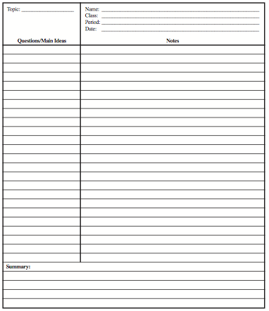
Wednesday: Cornell Notes Part 1, 2, 3
Setting up your paper
Part 1 – Put your name on it, class period, date
Part 2 – Put the essential question/topic/chapter etc on it
Part 3 – Take Notes
What are Notes?????
Lecture Notes
Power Points
Printed Notes
Worksheets
Test Reviews
Take Notes Over Pages 6 and 7 From
Student Code of Conduct.

Slide 7
Homework
Create 3 sets of Cornell Notes to use on Friday!
You can recreate notes from Tuesday or Wednesday!!!

Slide 8
Bell Ringer Thursday
Quickwrite: 5 minutes
Building a class mission: Fill-in a notecard with the following.
What are your expectations of the students in this class?
During individual work, group work, etc.
What are your expectations of the teacher?
What do you need to be successful in class?
What is your responsibility to the class?

Slide 9
Thursday: Tutorials Intro
What are the steps of the tutorial process? (see next slide)
As a group put the tutorial process steps in order. The group who gets the most correct wins a prize.
What do you think happens before the tutorial, during the tutorial, and after the tutorial?
Explain why it is important to follow the steps.
Veterans share your experience.
Watch Video:
While watching the video pay attention to the Tutorial Steps and take notes of what is done well, and what is not. (sticky note)

Slide 10
Thursday: Tutorials Continued
Move Into A Group With the Same TRF Subject
Student Presenter Presents Their Question
Group Members Ask Clarifying Questions & Take Notes
Next Student Presenter Goes – Repeat Process
Students Write Reflection of the Tutorial
Students Turn-In TRF for a Grade
Students Then Use What Was Learned in Class
10 Steps – Write down what you see during each step of the process.
What do you see happening during the tutorial?
What does this tutorial look like, sound like, feel like?
Take Cornell Notes in Classes
Create a TRF From Your Cornell Notes
Come to Class Prepared for Tutorial

Slide 11
Bell Ringer: Thursday
Essential Question: How do I feel about tutorials?
Tutorial Student Questionnaire
Name:
Schedule:
Strongest Subject:
Weakest Subject:
Biggest Concern This Year?
What are 3 things that help you learn the best?
Rate Yourself 1 – 5
Tutorials
Costas Questioning
TRF’s
Working with Others
Organization
Planning
Time Management

Slide 12
Bell Ringer Friday
Essential Question: How are binders graded?
Get the GIST
A GIST is a quick summary that is 20 words only. NOT 19, NOT 21, but 20!!
Write a GIST that describes AVID.
Share your GIST with your table group. Choose one person to share out to the class.
What other subjects could you use GIST in to check for comprehension?

Slide 13
Friday
Binder Check! Binder Check List
Self-Check/ Peer-Check Expectations
I Like Big Binders!
3 sets of Cornell Notes Due From Any Class
Cornell Note Check
HMWK: I Know What You Did Last Summer
On a piece of paper write down 3 things you did this summer and one thing that you did not. DO NOT PUT YOUR NAME ON THE PAPER!!!! 4 Mini Paragraphs.
Must be turned in on Tuesday.

