Slide 1
AVID 2 and 3 Week 21
2/4/13

Slide 2
Monday: Bellwork (Inquiry&Organization)
DUE NOW:
GET OUT AND GET READY:
Create your EQ Chart for this week
EQ: What makes a leader?
Planner Check!
Tuesday TRF: Math or Science – New Form Introduction
Thursday TRF: Choice – New Form Introduction

Slide 3
VOCABULARY FUN!!
Create a crossword puzzle including definitions for each of the following words.
Superfluous, Prosperity, Foster, Exemplary, Conditional, Camaraderie, Condescending, Asylum, Arid, Anachronistic
NO COPY AND PASTE!!!

Slide 4
Housekeeping
Chocolate Money for 1 box due this week!
Field trip forms due Wednesday
Homework Due Dates
Mon: Essential Question
Tues: TRF – Math/Science
Plan of Action
Wed: TRF Reflection
Thurs: TRF – Choice
Fri: TRF Reflection/Vocab
NHS Tutoring on Wednesday
Homefun AVID3-
Homefun AVID2-
Congrats to ALL!!!
Scoreboard Update?
Proud Board Moments?
Birthdays?

Slide 5
Monday: Classwork AVID 2 and 3
Define leadership. How would you rate yourself as a leader?
What are the characteristics of a leader?
With your group create a list of 20 characteristics of a leader. Stick note share.
What is the difference between positive and negative leaders? Make a list of 5 people who are positive, and negative leaders. Who would you rather have as a leader and why? What careers do these leaders have? What career are you thinking of and what leadership opportunities do you think you will have in this career?
What type of leadership position could you take on campus or in your activities?

Slide 6
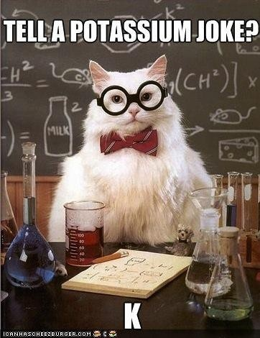
Tuesday; Tutorials! (Inquiry, Collaboration) Math
EQ: How does inquiry help me? How well do I collaborate?

Slide 7
Wednesday: Bellwork (Writing)
Quickwrite: Write SILENTLY and CONTINUOUSLY for 5 minutes!
What does this quote mean to you, and your future goals?

Slide 8
Wednesday: Classwork AVID 2 and 3
EQ: What is leadership?
“Our chief want is someone who will inspire us to be what we know we could be.” (R.W. Emerson)
“All leadership is influence.” (John Maxwell)
“Leadership cannot really be taught. It can only be learned.” (Harold Green)
Write a 5 paragraph essay - Choose the quote that you think represents leadership the most. What about this quote speaks to you about leadership? How does this quote apply to you? Incorporate your notes in your essay.
TED Talk on leadership – Cornell Note Taking
http://www.ted.com/talks/drew_dudley_everyday_leadership.html
http://www.ted.com/talks/derek_sivers_how_to_start_a_movement.html?quote=679

Slide 9
Bell Ringer Thursday
(Inquiry, Collaboration)
Essential Question: How does inquiry help me? How well do I collaborate?
TRF Due: Choice
Turn in your TRF
TRF Reflection Due Tomorrow
Vocab due tomorrow.

Slide 10
Friday: Fun Friday! (Collaboration)
AVID 3 - EQ: What qualities should a good audience have?
TA to watch UF presentations by the freshman.
AVID 2 – EQ: How did you collaborate and work together to create a game for the class?
Game Day!

