Slide 1
AVID 2 and 3 Week 21
2/18/13

Slide 2
Monday: Bellwork (Inquiry&Organization)
DUE NOW:
GET OUT AND GET READY:
No SCHOOL

Slide 3
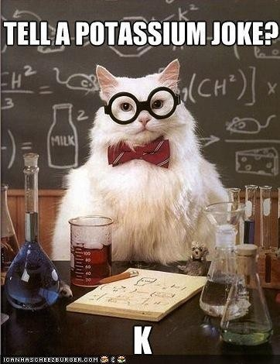
Tuesday; Tutorials! (Inquiry, Collaboration) Math
EQ: How does inquiry help me? How well do I collaborate?

Slide 4
Wednesday: Bellwork (Writing) AVID 3

Slide 5
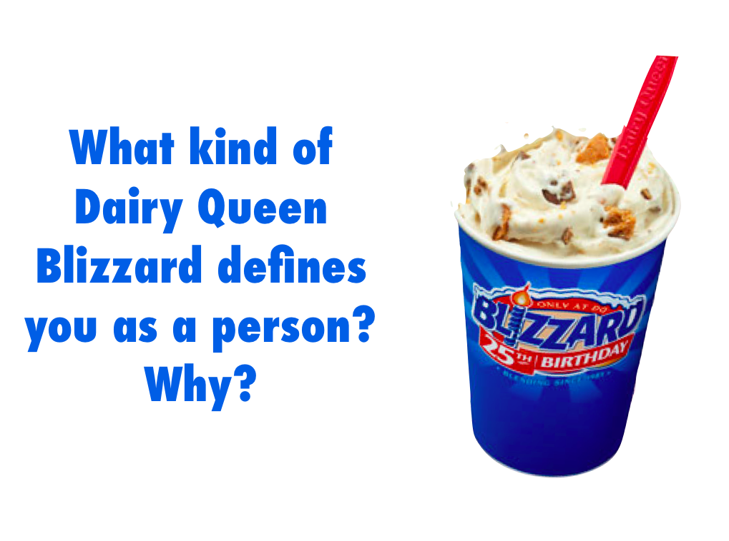
Wednesday Bellwork AVID2

Slide 6
Wednesday: Classwork AVID 3
EQ: How do you set-up
a college research binder?
Binder Set-up:
College Search: What I Want in a College, Parent Interview, Grade Checklist, Current Transcript
One section for each college you are looking into, Pro/Con List, Campus Map, College Info Sheet, Application
Other college letters you might have received/ campus visit scavenger hunt
NCAA if applicable/ Military information if applicable
Standardized Tests
Common Application
Resume
FAFSA/ PIN
Bright Futures Information
Scholarship Information
Personal Statement and Essays
Interview Questionions
Summer Action Plan
Add as needed!

Slide 7
Wednesday: AVID 2
How do you make connections?
Read Online Class Means No Dorm, Gym or Debt
Mark the Text
Write 5 connections

Slide 8
Bell Ringer Thursday
(Inquiry, Collaboration)
Essential Question: How does inquiry help me? How well do I collaborate?
TRF Due: Choice
Turn in your TRF
TRF Reflection Due Tomorrow
Vocab due tomorrow.

Slide 9
Friday: Vocabulary Foldable(Collaboration)
Create a foldable from the words on the board.
Amalgam, Soporific, Archaic, Cognitions, Discernment, Disingenuous, Erudition, Fawning, Ignominy, Pathos
Include: Definition, Part of Speech, Antonym, Synonym, Sentence, and a Visual

