Slide 1
AVID WEEK 3
9/3/12

Slide 2
Monday: No School
Labor Day

Slide 3
Bell Ringer Tuesday
I Know What You Did Last Summer DUE
Essential Question Last Week
Create your essential question chart for week 3 on lined paper
Write down the essential question for the day.
How do I fill-out a TRF?

Slide 4
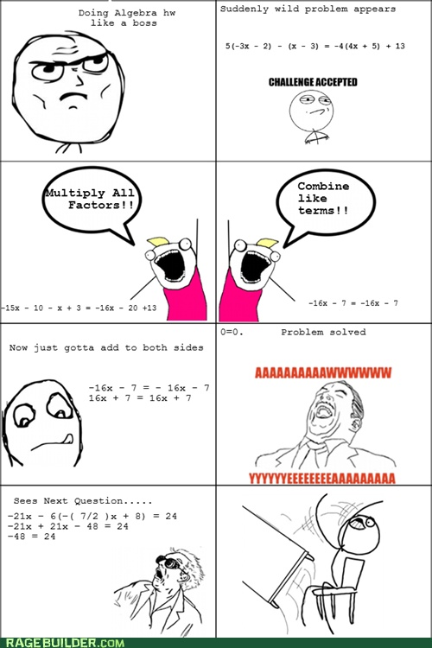

Slide 5
Tuesday: Tutorials
Tutorial Process Review
Step 1 – 3
TRF’s: What is it? What do I have to complete before class? Why do I have to complete all of the parts?
TRF Due on Thursday

Slide 6
VOCABULARY FUN!! IT’S BACK!!!
Definition, Synonym, Antonym, Sentence, Part of Speech, and a Visual
Adroitness, Cognitions, Discernment, Egotists, Fawning, Gestures, Hilarity, Ignominy, Lackadaisical, Mandate
Due on Friday
Vocabulary Options: Foldable, Note Cards, List, 2 Column Notes, Chart, etc.

Slide 7
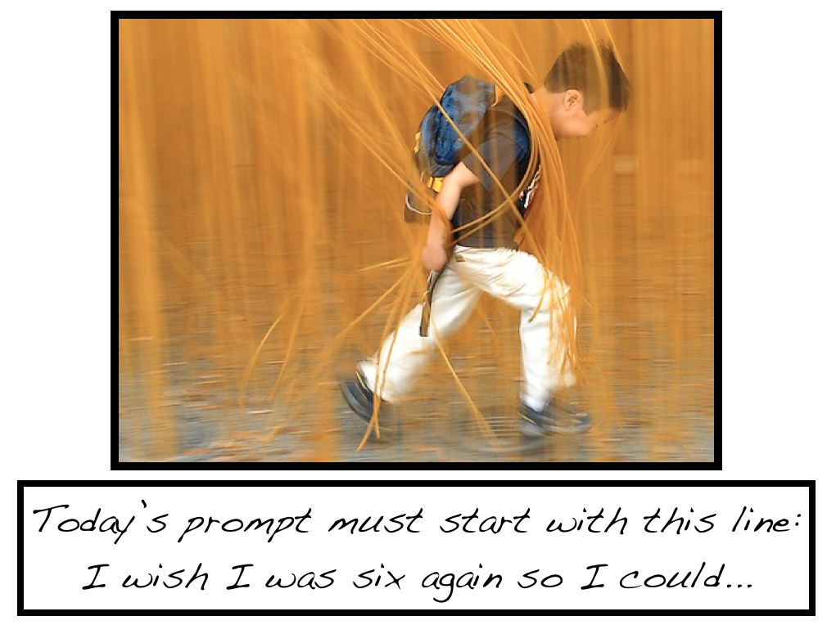
Bell Ringer Wednesday
Essential Question: What are the steps to taking quality Cornell Notes?

Slide 8
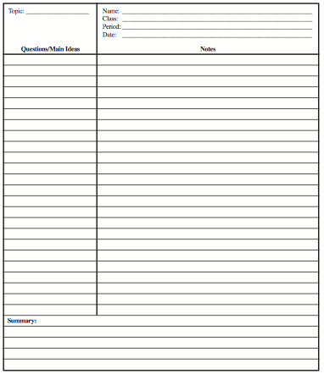
Wednesday: Cornell Notes Part 4, 5, 6
Setting up your paper
Part 4 – Revise and Highlight
Part 5 – Create Questions: (Costa’s Level 2 and 3)
Part 6 – Summary (Skirt Summary)

Slide 9
Bell Ringer Thursday
Essential Question: What is the set-up of a Tutorial?
CHAIR OLYMPICS DAY!!!

Slide 10
Bell Ringer Friday Period 1
AVID Islands Essential Question: How do you build a team?
Tables 1 Table 2 Table 3:
Kinsey Heather Olivia
Brooklyn Cambria Laura
Shannon Ray Katherine
Max Logan Zack
Tyler O
Table 4 Table 5 Table 6
Cory Megan Natasha
Kelsie Devin Karissa
Eva Madison Casey
Tyler K James Matt
Marko Mandi Tristan

Slide 11
Bell Ringer Friday Period 2
AVID Islands Essential Question: How do you build a team?
Tables 1 Table 2 Table 3:
Alisha Hannah Breanna
Rachel Mindy Lauren
Emily Gillian Taylor
Luca Blake Kyle
John Dan Chase
Tanner Shane Tucker
Table 4 Table 5 Table 6
Tabitha Courtney Cait
Morgan Alyssa Jessica G
Heather Jessica S Breanna
Jake Dylan Tino
Jarred Brandon Skyler
Steven Jack

Slide 12
Bell Ringer Friday Period 3
AVID Islands Essential Question: How do you build a team?
Tables 1 Table 2 Table 3:
Ciara Aimy Kayla
Corrine Courtney Lily
Megan Nikita Karen
Adam Daniel Brookelyn
Angelo Dimitri
Table 4 Table 5 Table 6
Christina Julia Alyssa
Sara Nicole Mary Ann
Ryan Valeria Alexis
Joey Dillon Sterling
Tanner Wyatt

Slide 13
Bell Ringer Friday Period 4
AVID Islands Essential Question: How do you build a team?
Tables 1 Table 2 Table 3:
Angela Jazmine Nicole B
Nina Krysia Lora
Savannah Melissa Taylor
Ian Joey Steven
Connor P
Table 4 Table 5 Table 6
Kalyn Nicole C Jordan
Marina Taylor Samon
Michael Jacob Connor E
Jessica Jared Ivan

Slide 14
Friday
Teamwork: Create Your Own AVID Island
All elements below must be on the poster.
Name Your Island.
Choose a shape for your island and draw a representation.
Create at least 8 features for the island. For example; rivers, mountains, lakes, and give them names
Write at least five laws for the island.
What is the job for each member of your island? material gatherer, chair olympics, paper turn in, etc
Create a flag for your island with a motto/slogan for your island.
Create a clap/cheer for your island.
Create currency (money) for your island
What is the Island’s most celebrated holiday on your island?
All group members must be represented in the island.
Be Creative, and be prepared to present your island to the class!

