Slide 1
AVID Week 4
9/10/12

Slide 2
Bell Ringer Monday
Essential Question Chart from last week due NOW.
TRF Due Tomorrow: Your Choice
Create Essential Question Chart for this week.
Essential Question: Who are my team members?
Find out two things about each person in your group
and write it on a half sheet of paper.
Seating Chart

Slide 3
VOCABULARY FUN!! Due Thursday
Definition, Synonym, Antonym, Sentence, Part of Speech, and a Visual
Abate, Benevolent, Capacious, Deleterious, Orator, Perfidious, Querulous, Spurious, Venerable
Vocabulary Options: 2 Column Notes
Word | Def, Syn, Ant, Sent, POS, Visual
Word | Def, Syn, Ant, Sent, POS, Visual

Slide 4
Housekeeping
This week is the last week to buy homecoming tickets. $35 at lunch
Homecoming voting Thursday
No School FRIDAY!!!
PSAT money due by Thursday for 11th graders. Check of Exact cash.
Monday is Decades Day – 10th = 60’s (Beatles, Mod Squad)
11th = 70’s (Hippies, Disco)
Tuesday is Twin Day
Wednesday is Roaring 20’s (Gangsters and Flappers Think Great Gatsby)
Thursday is Nerd Day
Friday is PHUHS Day
Congrats to ALL!!!
Scoreboard Update?
Proud Board Moments?
Birthdays?

Slide 5
Monday
Continue working on AVID Islands. Be prepared to present on Wednesday!!!!

Slide 6
AVID ISLAND DIRECTIONS
Teamwork: Create Your Own AVID Island
All elements below must be on the poster.
Name Your Island.
Choose a shape for your island and draw a representation.
Create at least 8 features for the island. For example; rivers, mountains, lakes, and give them names
Write at least five laws for the island.
What is the job for each member of your island? material gatherer, chair olympics, paper turn in, etc
Create a flag for your island with a motto/slogan for your island.
Create a clap/cheer for your island.
Create currency (money) for your island
What is the Island’s most celebrated holiday on your island?
All group members must be represented in the island.
Be Creative, and be prepared to present your island to the class!

Slide 7
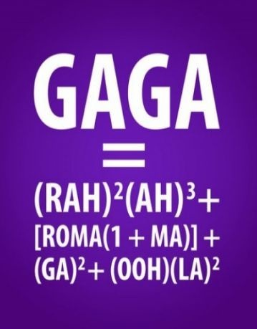
Bell Ringer Tuesday
Essential Question: How does inquiry help me? How well do I collaborate?
Turn in your TRF to the
appropriate magnetic folder.
6 people per group only!!!!
Chair Olympics 1st set-up and 4th Clean-up
TRF Reflection Due Tomorrow

Slide 8
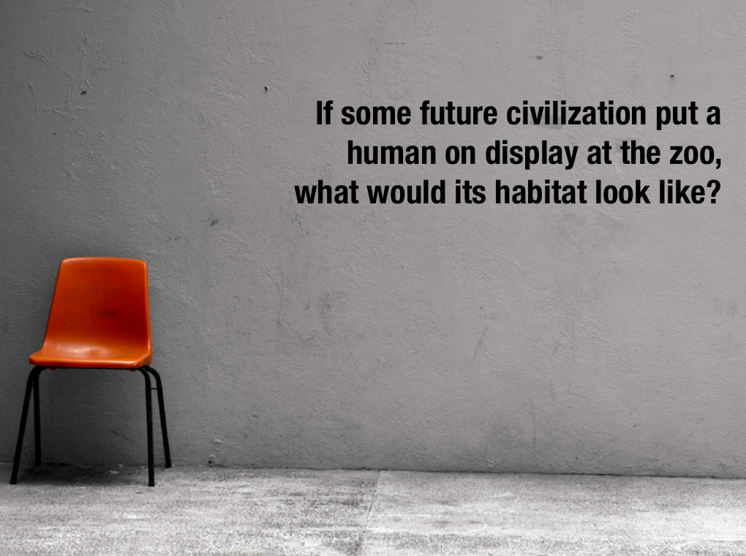
Bell Ringer Wednesday
Essential Question: What is SLANT?
Bell Ringer: Timed writing. Read and respond with NO TALKING!

Slide 9
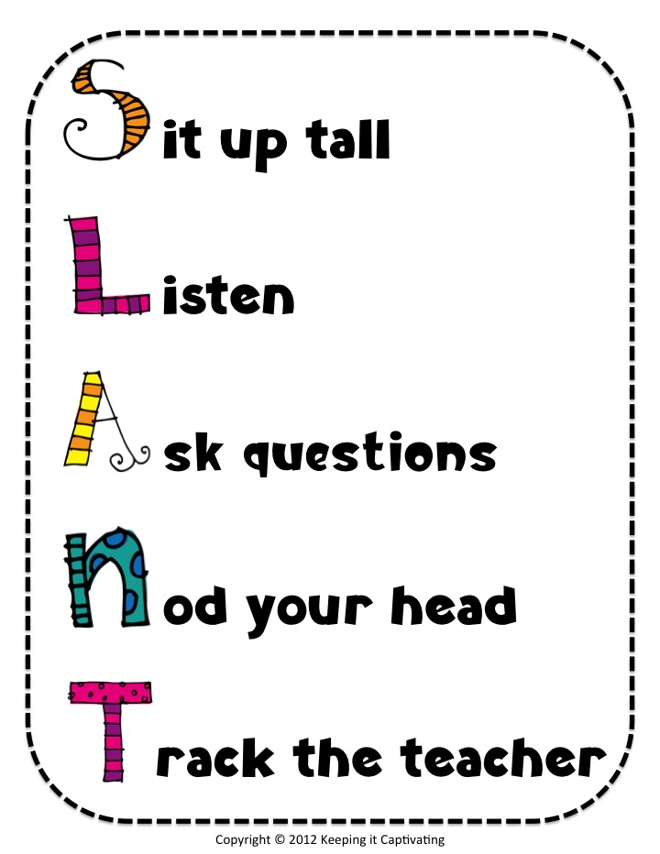
Wednesday: SLANT
SLANT is a body language, a behavior. It shows the teacher and your classmates you are interested and involved in the learning. It keeps you more alert and focused.
S - Sit Up in class when others are talking. It helps you pay attention and stay focused.
L – Lean forward to show you are interested and to become involved in what is being said.
A – Ask questions to help to stay involved and
to help others to understand what is being taught.
N – Nod yes and no to show nonverbal
communication
to the speaker about your understanding and
involvement.
T – Talk with teachers during and after class to
increase your comprehension of what is being
taught and what the expectations are.

Slide 10
Bell Ringer Thursday
Essential Question: How does inquiry help me? How well do I collaborate?
Vocabulary DUE NOW
Turn in your TRF to the
appropriate magnetic folder.
6 people per group only!!!!
Chair Olympics!!!
TRF Reflection Due Monday
No School Tomorrow!

