Slide 1
AVID 2 and 3 Week 7
10/1/12

Slide 2
Bell Ringer Monday
Essential Question Chart from last week due NOW.
College Research Project AVID 2 Due
Parent College Interview AVID 3 Due
TRF Due Tomorrow: Choice
Create Essential Question Chart for this week.
Essential Question for TODAY: In what way is the PROVE method helpful?

Slide 3
Housekeeping
PSAT money due.
PSAT 10/17 periods 2 – 5
Homework Due Dates
Mon: Essential Question
Tues: TRF – SAT Math
Wed: TRF Reflection
Thurs: TRF – SAT Math
Fri: TRF Reflection
Vocab
Parent Interview on Weebly
Due Monday!
Congrats to ALL!!!
Scoreboard Update?
Proud Board Moments?
Birthdays?

Slide 4
VOCABULARY FUN!!
Definition, Synonym, Antonym, Sentence, Part of Speech, and a Visual
Don’t forget all the requirements!
Abdicate, Clairvoyant, Brusque, Demagogue, Emulate, Fortitude, Impute, Haughty, Lobbyist, Opulent
Vocabulary Options: Choice
NO COPY AND PASTE!!!

Slide 5
Monday
Complete Sentence Completion “Cool”
Pages 44, 60, 66
We will go over these and review the answers.
You may work together, and use resources to determine the meaning of the words.
Write down the answer.
1. Letter of the answer word and definition

Slide 6
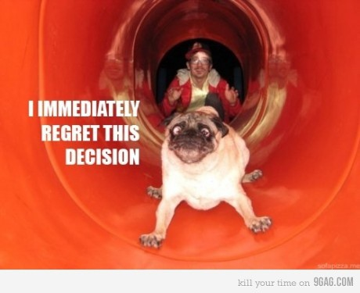
Bell Ringer Tuesday
Essential Question: How does inquiry help me? How well do I collaborate?
Turn in your TRF to the
appropriate magnetic folder.
6 people per group only!!!!
Chair Olympics 1st set-up and 4th Clean-up
TRF Reflection Due Tomorrow

Slide 7
Bell Ringer Wednesday
Essential Question: How does the PROVE method help me on sentence completion questions?
Bell Ringer: Timed writing. Read and respond with NO TALKING!
What does this quote mean to you?
TRF SAT Math Tomorrow

Slide 8
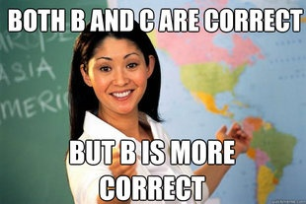
Wednesday: Sentence Completion
SAT Book pages 44, 60, 66
Answer all of the Questions

Slide 9
Bell Ringer Thursday
Essential Question: How does inquiry help me? How well do I collaborate?
TRF Due: Choice
Turn in your TRF to the
appropriate magnetic folder.
6 people per group only!!!!
Chair Olympics!!!
Vocab due tomorrow.

Slide 10
Friday: Team Competitions
Finish Who’s Who
Team Scavenger Hunt
Monday: I will be absent. Be good!!! You will work on the SAT “Cool” Books.

