Slide 1
AVID 2 and 3 Week 8
10/8/12

Slide 2
Bell Ringer Monday
Essential Question Chart from last week due NOW.
TRF Due Tomorrow: TRF SAT Math
Create Essential Question Chart for this week.
Essential Question for TODAY: What should I be doing now to be college ready?

Slide 3
Housekeeping
PSAT 10/17 periods 2–5
Homework Due Dates
Mon: Essential Question
Tues: TRF – SAT Math
Wed: TRF Reflection
Thurs: TRF – SAT Math
Fri: TRF Reflection
Vocab
Weekend Homework!
Mon: Essential Question
AVID 2 and 3 – PSAT Workbook
Congrats to ALL!!!
Scoreboard Update?
Proud Board Moments?
Birthdays?

Slide 4
VOCABULARY FUN!!
Definition, Synonym, Antonym, Sentence, Part of Speech, and a Visual
Don’t forget all the requirements!
Scrutinize, Restrained, Prudent, Longevity, Intuitive, Hedonist, Frugal, Extenuating, Diligent, Convergence
Vocabulary Options: Choice
NO COPY AND PASTE!!!

Slide 5
Monday
Essential Question for TODAY: What should I be doing now to be college ready?
Read the Articles in NEXT magazine, and take Cornell Notes.
Pay attention to the details concerning what you should be doing now in order to be college ready.

Slide 6
Bell Ringer Tuesday
Essential Question: How does inquiry help me? How well do I collaborate?
SAT Math: pages 40 – 47
60 – 63 from the workbook

Slide 7
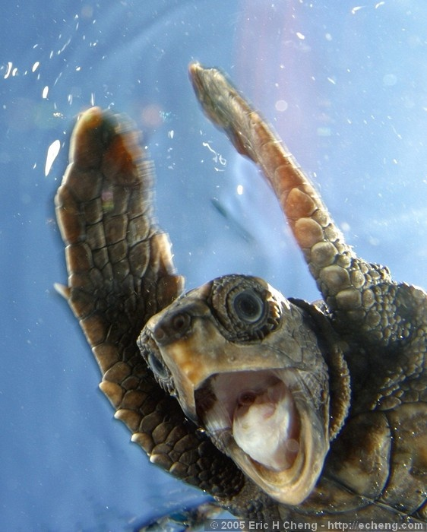
Bell Ringer Wednesday
Essential Question: What are the steps used for SAT critical reading section?
Bell Ringer: Timed writing. Read and respond with NO TALKING!
Write the story to this picture.
TRF Critical Reading Tomorrow

Slide 8
Wednesday: Critical Reading
Video and Notes

Slide 9
Bell Ringer Thursday
Essential Question: How does inquiry help me? How well do I collaborate?
SAT Critical Reading
Vocab due tomorrow.
Sections 3, 5, and 7 due tomorrow
SAT Video Notes

Slide 10
Friday: Team Competitions
Finish Who’s Who
Team Scavenger Hunt

