Slide 1
FCAT Boot Camp Week 2

Slide 2
Monday: Bellwork
What was your favorite children’s story?
What was the title of the story?
Who were the main characters?
Describe the setting.
Write a summary of the story.
Rename the story!
All of these are literary elements!

Slide 3
Monday: Literary Elements
EQ: How do we go about analyzing an author’s use of literary elements to develop literature?
Think – How do authors use literary elements to develop a piece of literature?
How do the plot events contribute to the conflict and resolution?
How can we sum up the theme of a piece in one sentence?

Slide 4
Monday: Question Stems
Which sentence from the passage indicates that __ wants to __?
How does the setting of the essay contribute to the development of the narrative?
Which event in the essay is most important in changing the narrator’s opinion of __?
Which sentence best expresses the central conflict in the passage?
Which line from the poem most clearly reveals its theme?

Slide 5
Monday: Question Stems Continued
Which phrase best describes both the ___ in “___” and the speaker in “____”?
Which statement best expresses the speaker’s point of view in the first stanza of the poem?
Which statement best conveys the resolution in the ___?

Slide 6
Monday: Activity
Theme
Plot
Foreshadowing
Flashback
Setting
Protagonist
Antagonist
Character Point of View
Conflict – Internal and External
Resolution
Write all of the literary terms on a piece of chart paper and define them visually as a group.
Define all of the terms in your notebook.

Slide 7
Tuesday: Bellwork
Explain the graph. What does the information show you?
What type of article might this graph be connected to?
What would be the main idea of the article,
and the author’s purpose for writing the article?

Slide 8
Tuesday: Synthesize, Analyze, Evaluate
EQ: What important information do the different parts of the passage (topics, ideas, text features, text structures) offer?
Ask purpose setting questions when reading an article.
What important information do the different parts of the passage offer?
Who would most likely be able to use the information? For what purpose?
Is there more than one article? If so, which source provided the most useful information for the given purpose?
After thinking about all the different sources of information, what new conclusions can we draw about the ideas/topics?

Slide 9
Tuesday: Synthesize, Analyze, Evaluate
When reading articles:
1 – Ask purpose setting questions
2 – preview text features/structure
Look for clues!
3 – Pause during reading
Make connections
Draw conclusions
4 – Summarize
5 – Evaluate
What parts of the article are the most important?
6 – EVIDENCE!

Slide 10
Tuesday: Question Stems
The ___ would be useful for all the following purposes EXCEPT _____.
How does _____ apply to ____?
According to the information in the article, which would be best/most/least___?
A student researching ___ would find which of the following most useful?
Which information from the article should be used to ___?
People who read this article will learn/be able to ___?

Slide 11
Tuesday: Question Stems
In order to ____, readers must read which two section of the ___?
Based on information from both articles, which conclusion is most accurate?
Based on the information in the first and last paragraphs, which statement best describes ___?
What can the reader infer from the information presented in both article and chart/graph?
What can you conclude about ____ from reading both articles?
Based on the information contained in both the text and map/chart/caption, explain the difference between ___ and ___.

Slide 12
Tuesday: Assignment
Look through the reading passages and questions and find examples of the question stems for analyze, synthesize, and evaluate.
What types of articles will these questions be in?

Slide 13
Wednesday: AVID
EQ: Which FCAT category do I feel strongest in and which do I feel like I need extra help in?
Look through your book/notes to choose.
Each group will get a different FCAT category to create a poster for.

Slide 14
Wednesday: AVID Rubric
Category | Not Yet | Almost | Excellent
Content | Contains definition of the category | Contains definition of the category, and question stems | Contains definition of the category, question stems, and examples of articles.
Neatness | Legible and spelling | Legible, spelling, conventions | Legible, spelling, conventions, and correct usage of content
Creativity | Visual component | Visual component and colorful | Visual component, colorful, and unique presentation

Slide 15
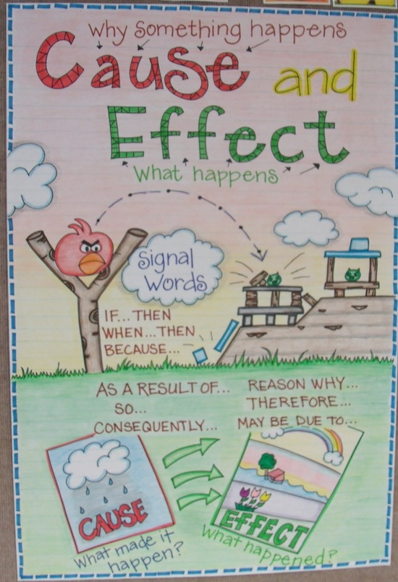
Example of a really
creative FCAT
category poster!

Slide 16
Wednesday: Intensive Language Arts
Achieve 3000
Achieve 3000 story of the day – Must be complete this week and can be completed as homework prior to 11 pm.

Slide 17
Thursday: Bellwork
Cause =Why something happens. Effect = What happens
Write down the cause and the effect for each picture.
What can you predict is the outcome of each picture?

Slide 18
Thursday:
EQ: Why should it be important to understand how authors use cause and effect relationships in texts?
When reading ask purpose setting questions –
What were the causes of the event? What were the effects?
Why did the event happen? What effect did it have?
What type of articles would have cause and effect?

Slide 19
Thursday: Question Stems
Look for common signal words and phrases in an article!!!!
Consequently
Since
As a result
Due to
Because
Thus
Accordingly
Therefore
So

Slide 20
Thursday Question Stems
According to the article, what was one reason for ___?
What caused ___ to ___?
What happened as a result of ___?
How did ___ influence ___?
What was the effect of ___?
Why did ___ happen to ___?
How did the conflict between ___ and___ begin?
What is the main reason/cause that ___ happens?
Which factor influenced_____?

Slide 21
Thursday: Assignment
Read Swing is the Thing and write down 3 different cause and effect relationships within the text.
Share with your group!

Slide 22
Friday: Bellwork
Use your FCAT Bootcamp Notebook
What is one thing that has stuck with you?
What is one area that you still have questions?
Rate your understanding of the topics covered this week –
Confused Kinda Okay Great Awesome!

Slide 23
Friday: Assignment
EQ: What do I need to work on to increase my comprehension?
Complete all assignments from this week.
If you are 100% done
Intensive Language Arts – complete a new Achieve 300 story
AVID – Text mark a current event from the newspaper. Include all text features used.

