Slide 1
AVID PROGRAM
ADVANCEMENT VIA INDIVIDUAL DETERMINATION
[L. avidus]: eager for knowledge
Notes:
NOTES: Welcome, sign-in, and flyers

Slide 2
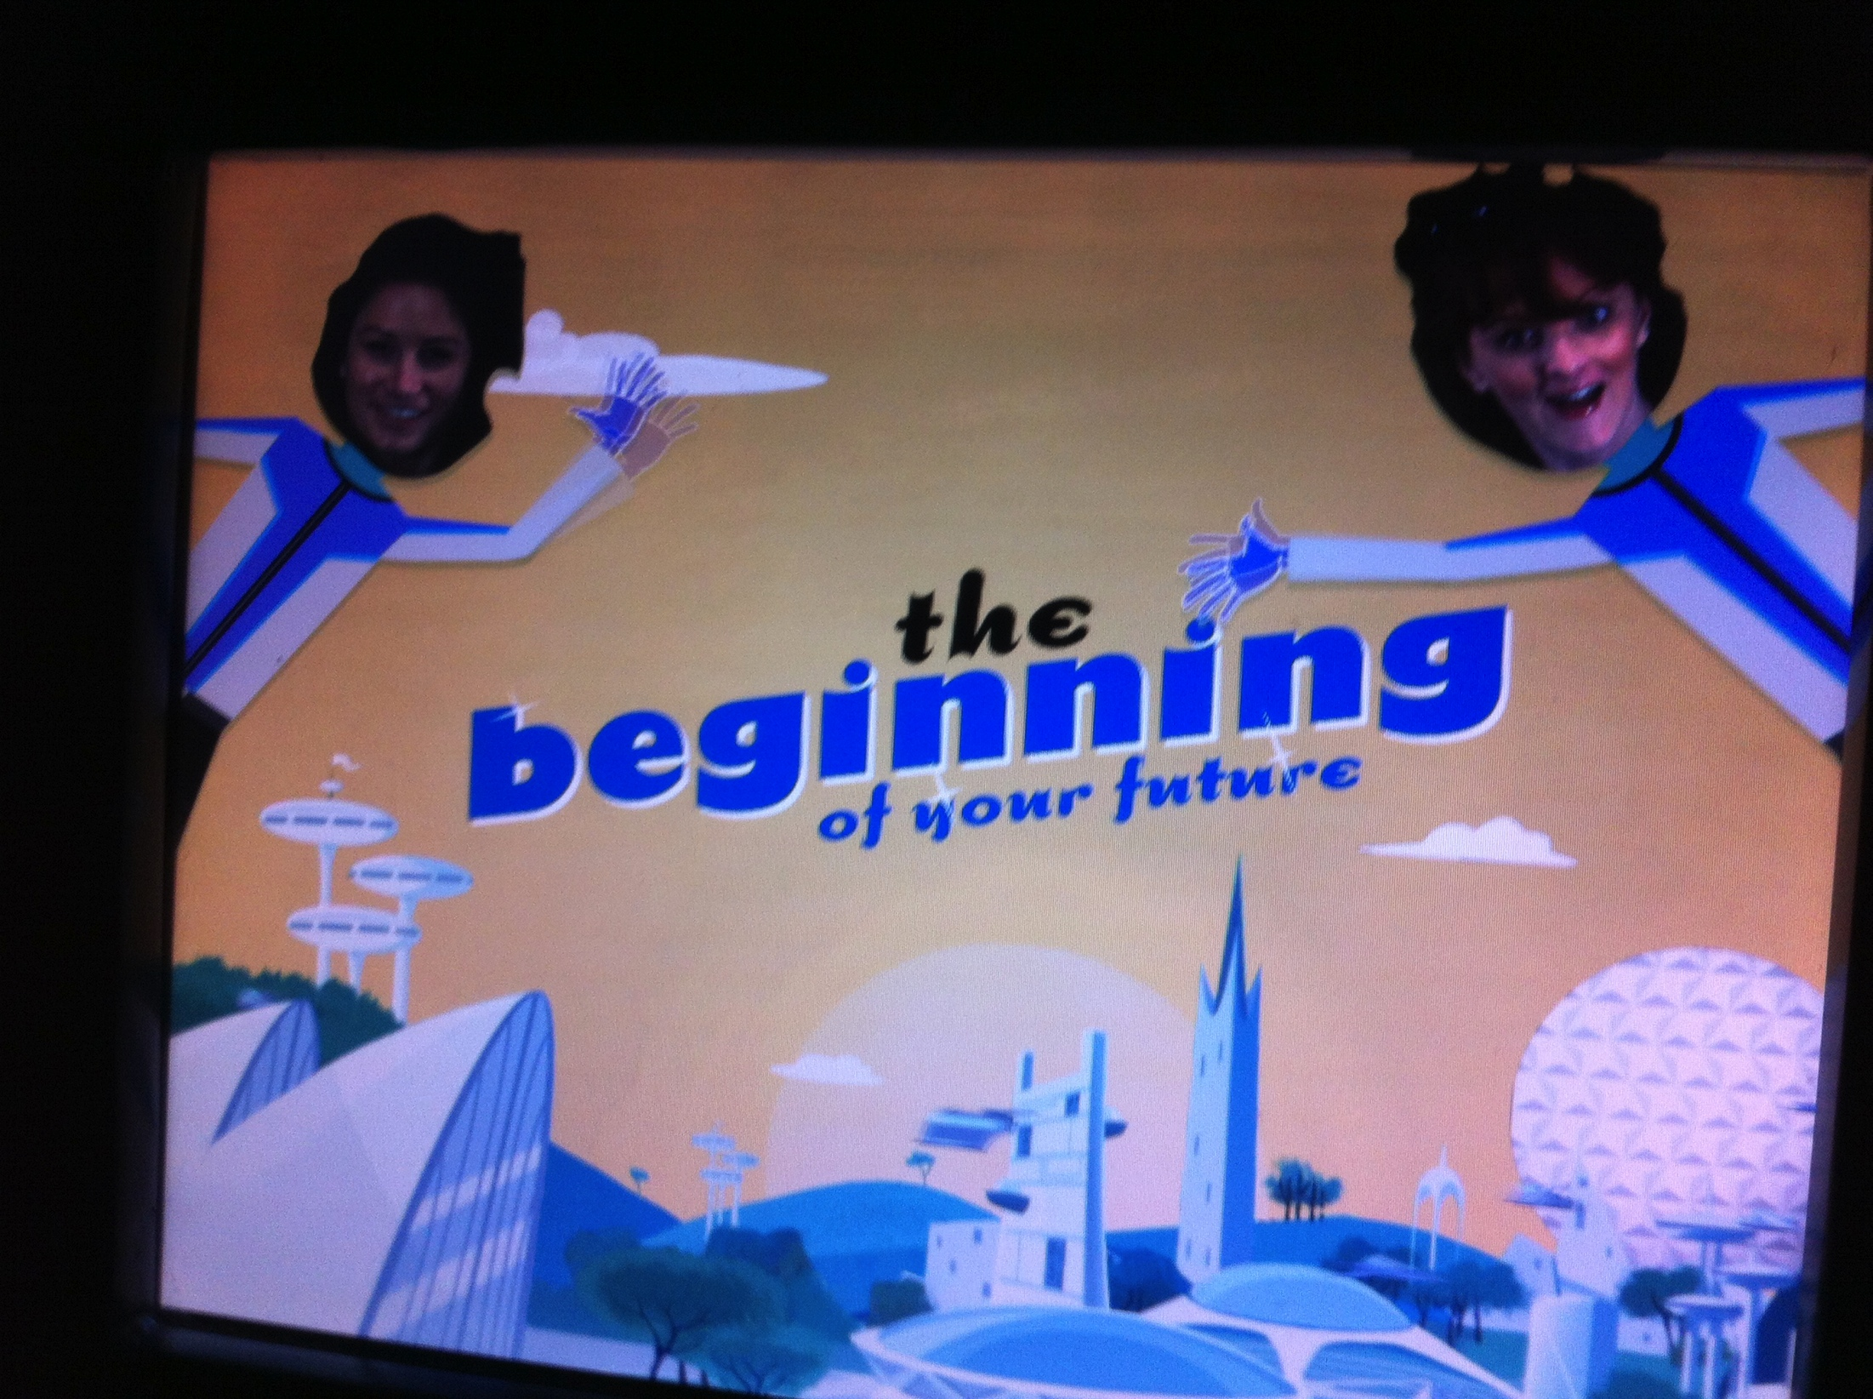
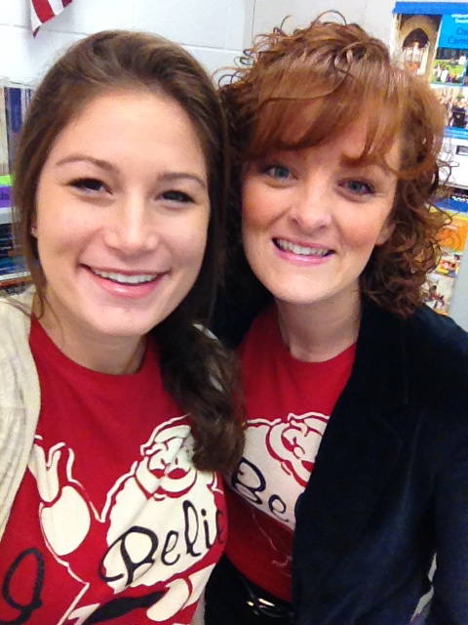
Introductions
Mrs. Prince and Mrs. Winer welcome you to an amazing experience! We are so excited you are a part of AVID!
Notes:
Introduce the kids. Each student should say their name, grade, AP classes they are or have taken, and clubs/sports/activities they are involved in.

Slide 3
Mrs. Colleen Linning
Volunteer Coordinator
Linning Colleen LINNINGC@pcsb.org
Level 2 Screening on September 10th by appointment
Must register as a school volunteer at PHUHS

Slide 4
AVID: Collaborative Support for the Success of Underserved Students
Colleges
and
Universities
AVID
Support
Staff
Community
Parents
AVID
Coordinator
(AVID Elective
Teacher)
Student
Administration
Tutors
Subject
Area
Teachers
Counselors
Notes:
NOTES: When you are an AVID student there is a whole network of people who are there to help. We have a very active faculty and

Slide 5
The AVID Family
Tutors – College students who come in twice a week to help facilitate student led tutoring sessions.
Parents and Families – Chaperones for field trips, tutors, parent board members, fundraising, AVID Club
Community – Guest speakers, volunteer opportunities, college field trips
Notes:
Everyone

Slide 6
Liz Valletti
Elizabeth Valletti lizvalletti@gmail.com
Parent Board
Volunteering Inquiry Forms
AVID Board Member, AVID Club Leader, Guest Speaker, AVID Mailings, Field Trip Chaperone, Field Trip Coordinator, Fundraising
Donations – Hospitality (teachers and students)
Donations – AVID Supplies

Slide 7
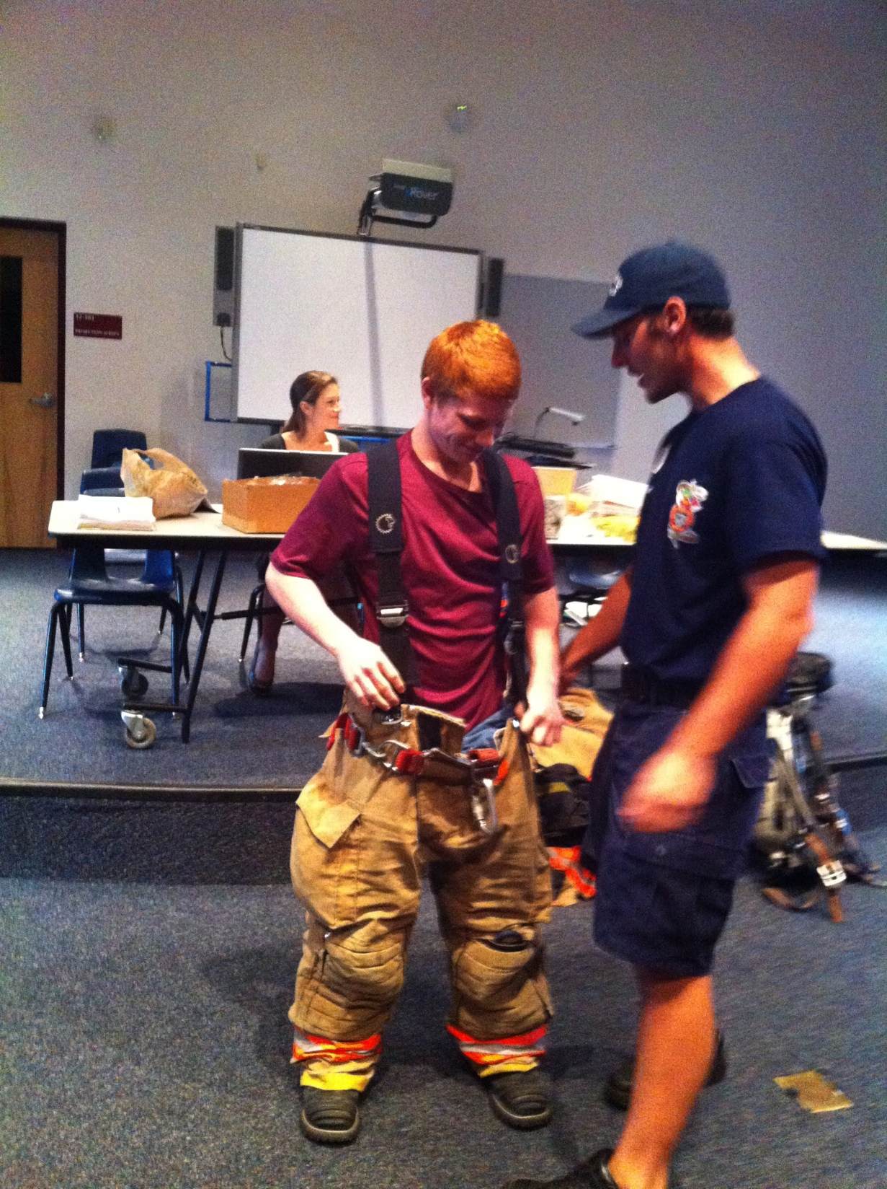
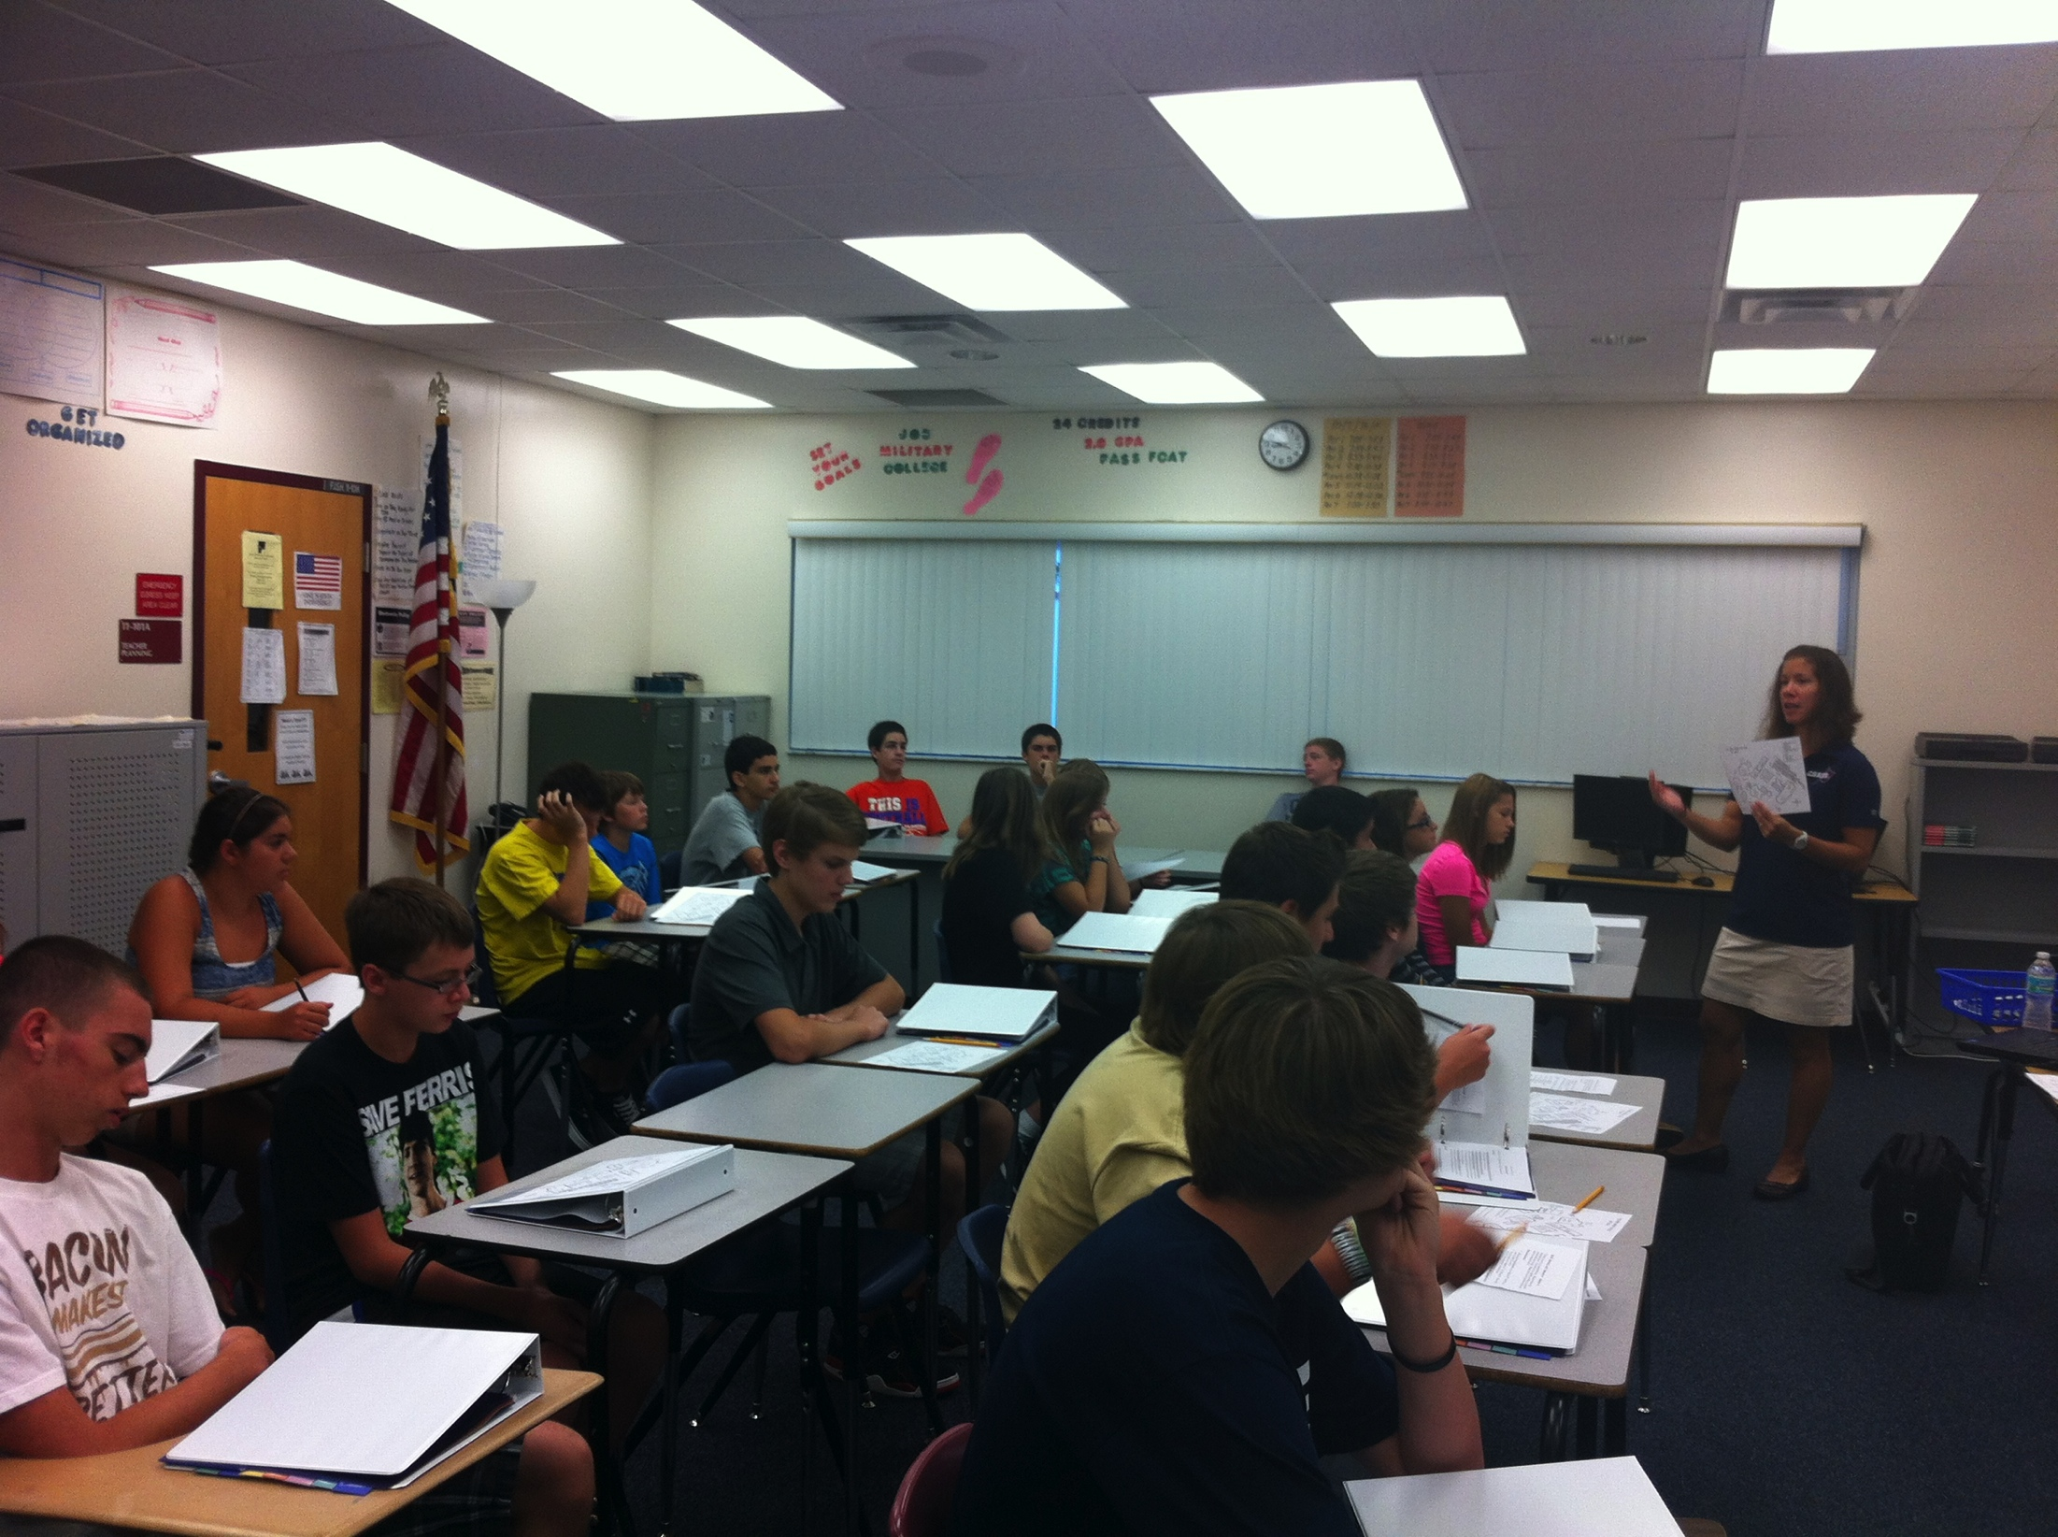
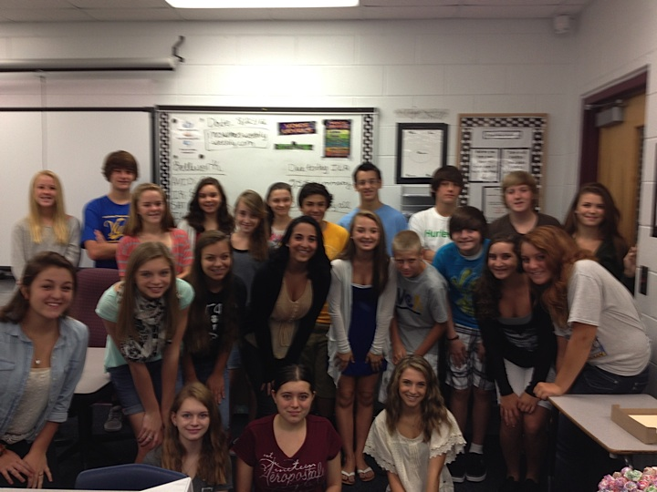
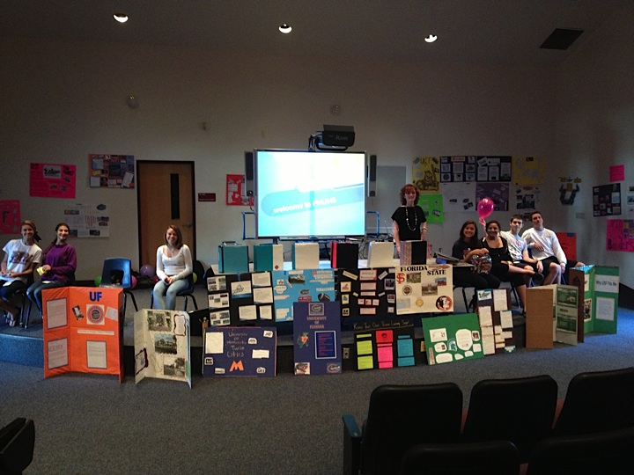
Community Involvement
Notes:
A student will share their experience with being involved with the school, and community with AVID. Probably a good one for Heather C.

Slide 8
AVID Family Nights
Thursday, February 20th, 2014 Gallery Walk Presented by AVID Club!
Agenda: AVID club gallery walk, and presentations from the AVID Club Members
Incoming 9th graders invited!
Location: Cafeteria Time: 6-7:30pm
Thursday, May 8th, 2014 AVID Banquet
Agenda: Celebration of 2013-2014, Senior Cord Presentation
Location: Cafeteria Time: 6-8pm

Slide 9
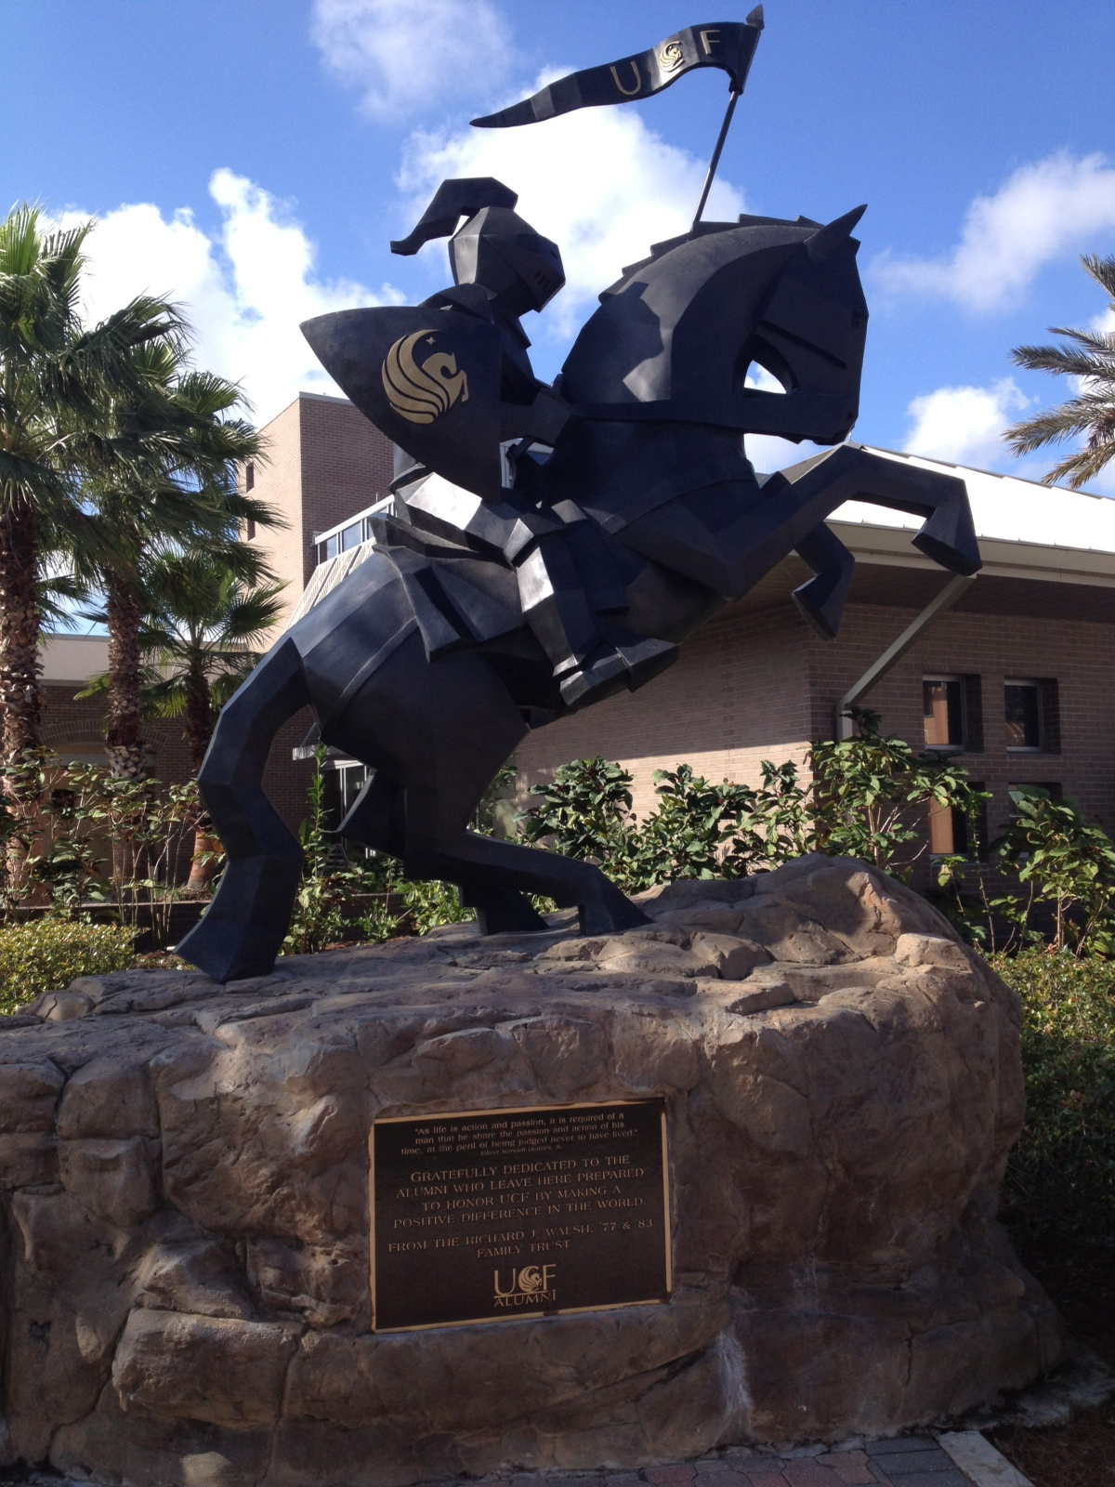
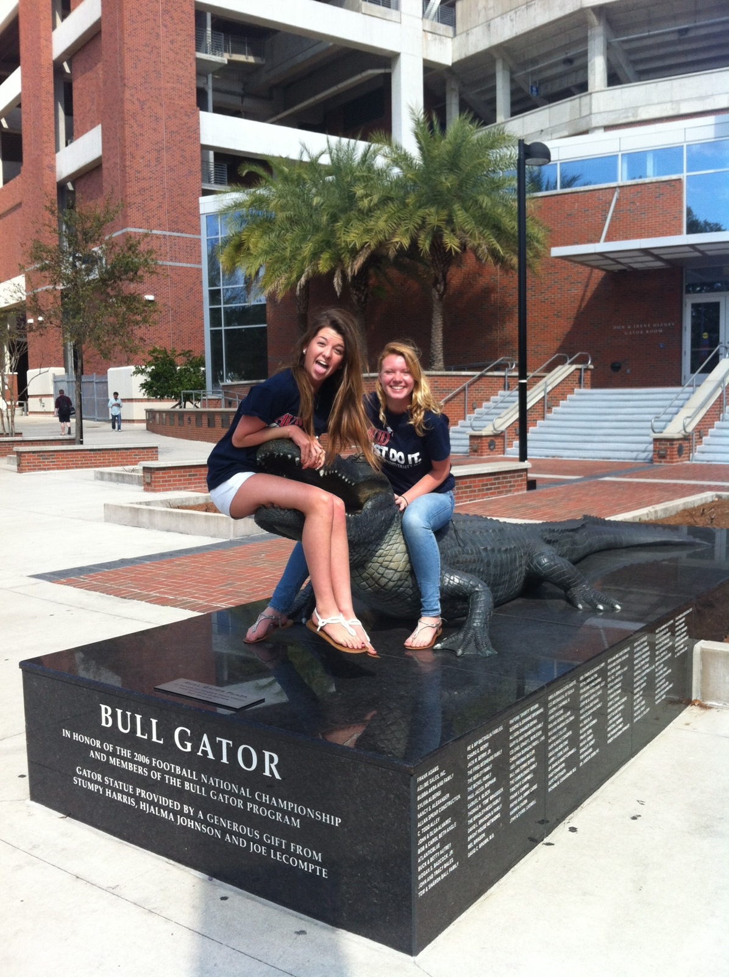
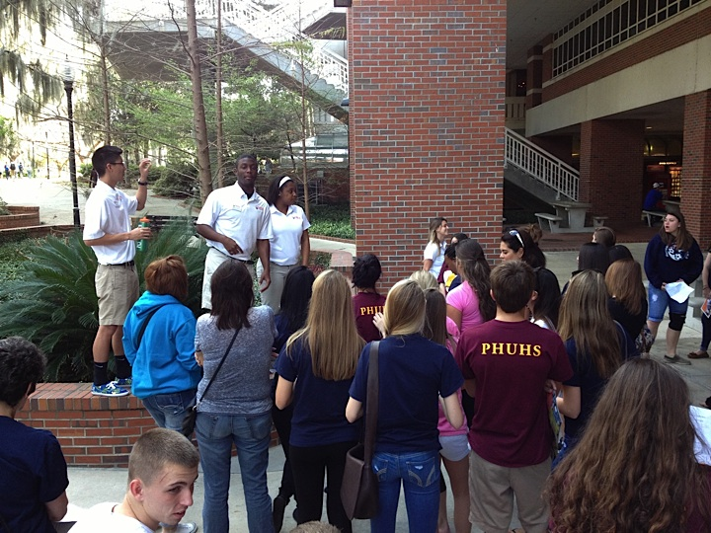
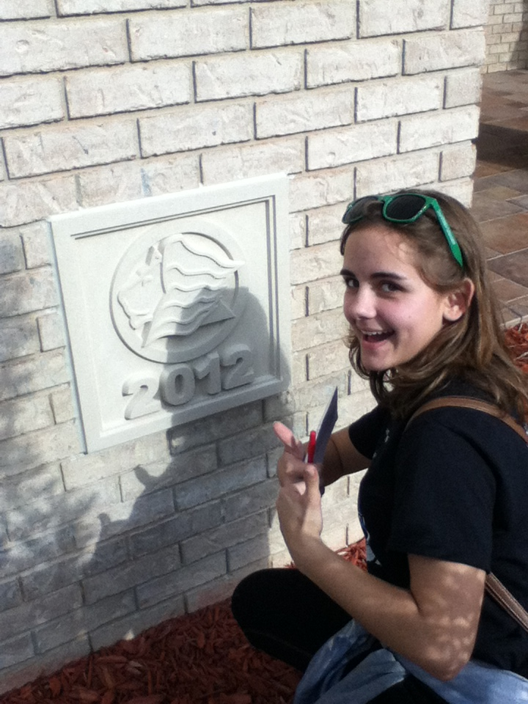
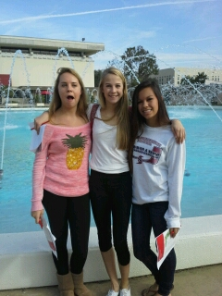
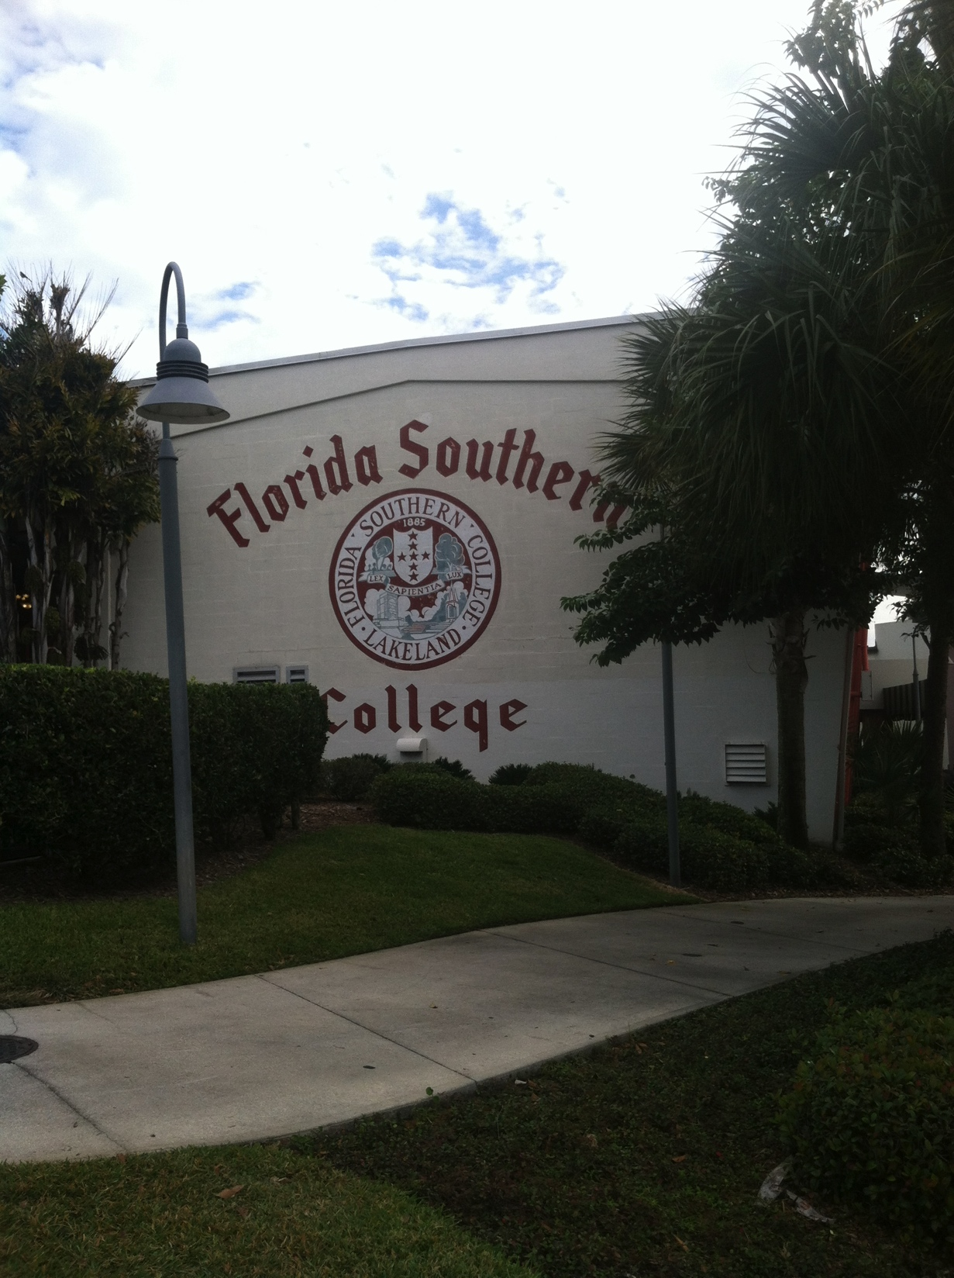
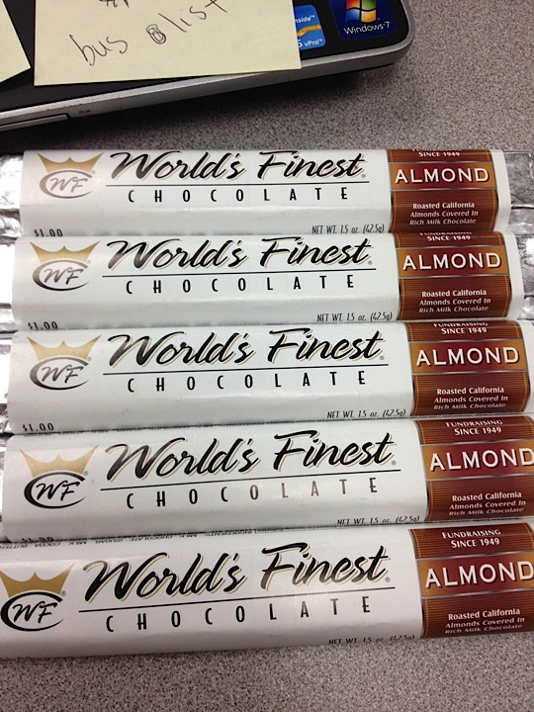
Field Trips and Fundraisers!
Notes:
Have a student talk about fieldtrips

Slide 10
Field Trips
1st 100 students
Florida Gulf Coast University
September 25th 8 – 5pm
University of South Florida Tampa/Mosi
TBA November
Team Building
Florida State University and University of North Florida (overnight)
January 30^{th &} 31st 6 am – 5 pm
Comfort Suites Tallahassee
Busch Gardens
March 7th 7 am – 7 pm
Problem Solving through Inquiry

Slide 11
$$$ Fundraisers $$$$
Fundraisers support the class!
SAT/ACT Books, Content Material, Field Trips, Supplies
Field Trips
Yankee Candle September 3rd – September 17th
Pizza Hut
Chik Fil A Nights
Suggestions welcome!
Grants

Slide 12
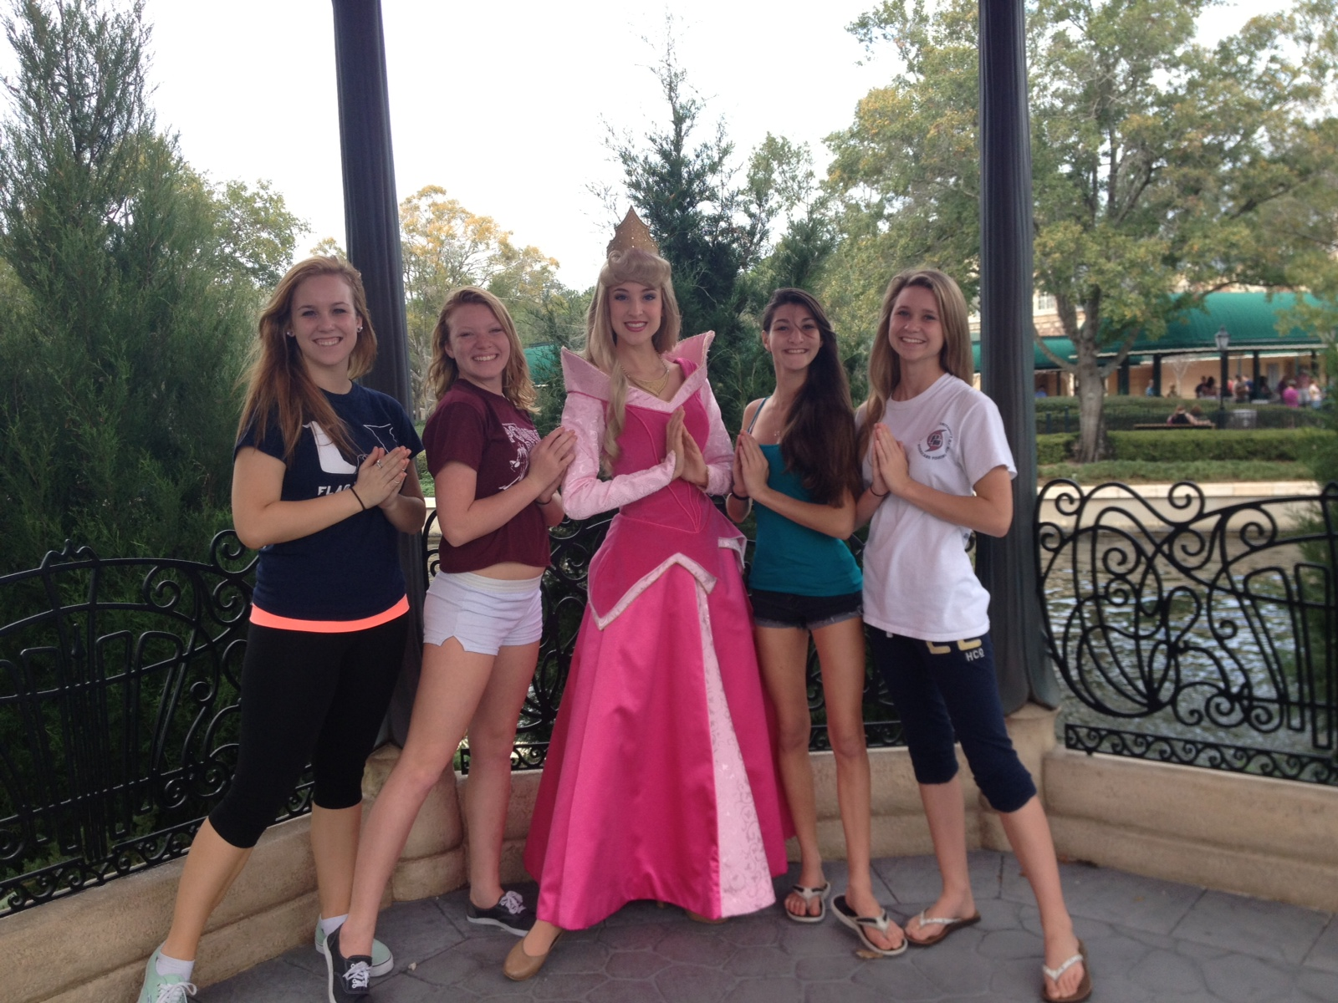
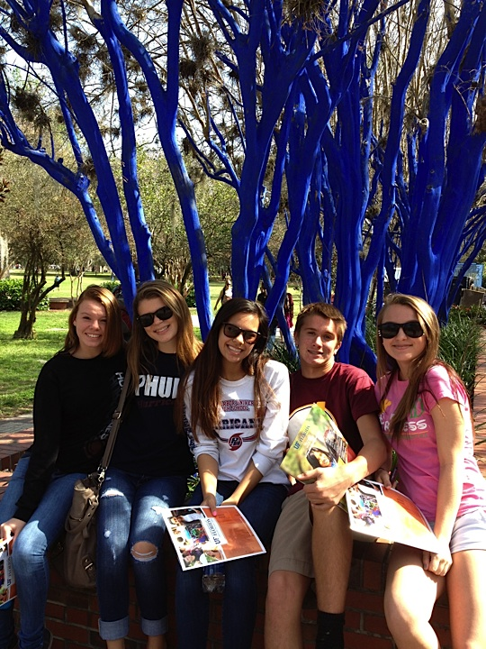
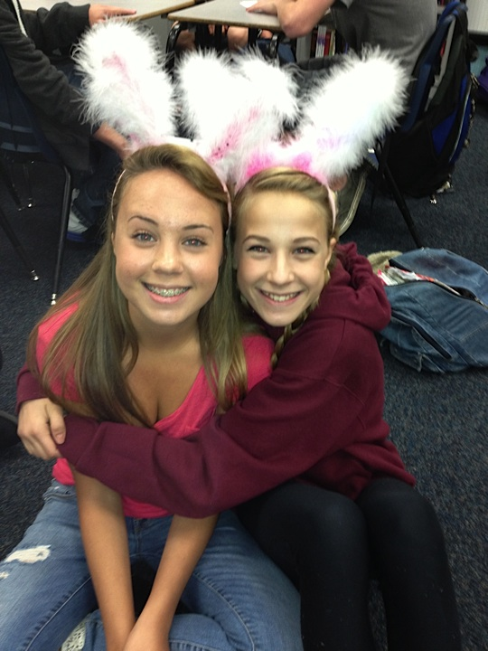
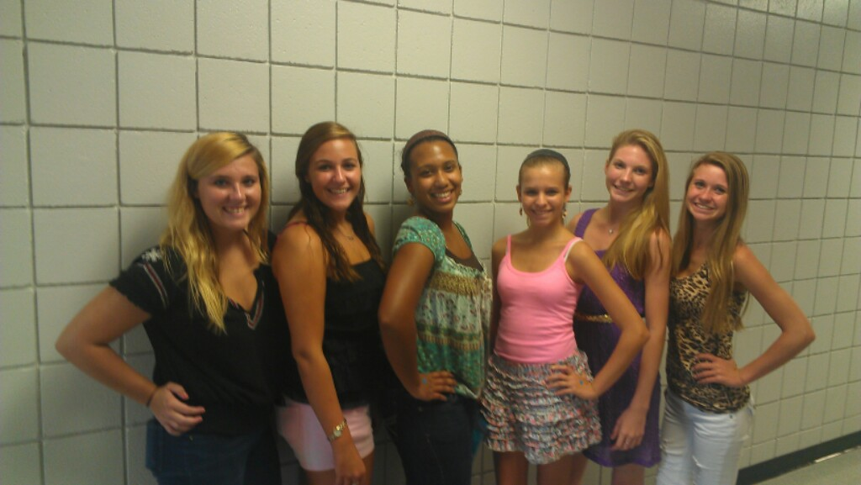
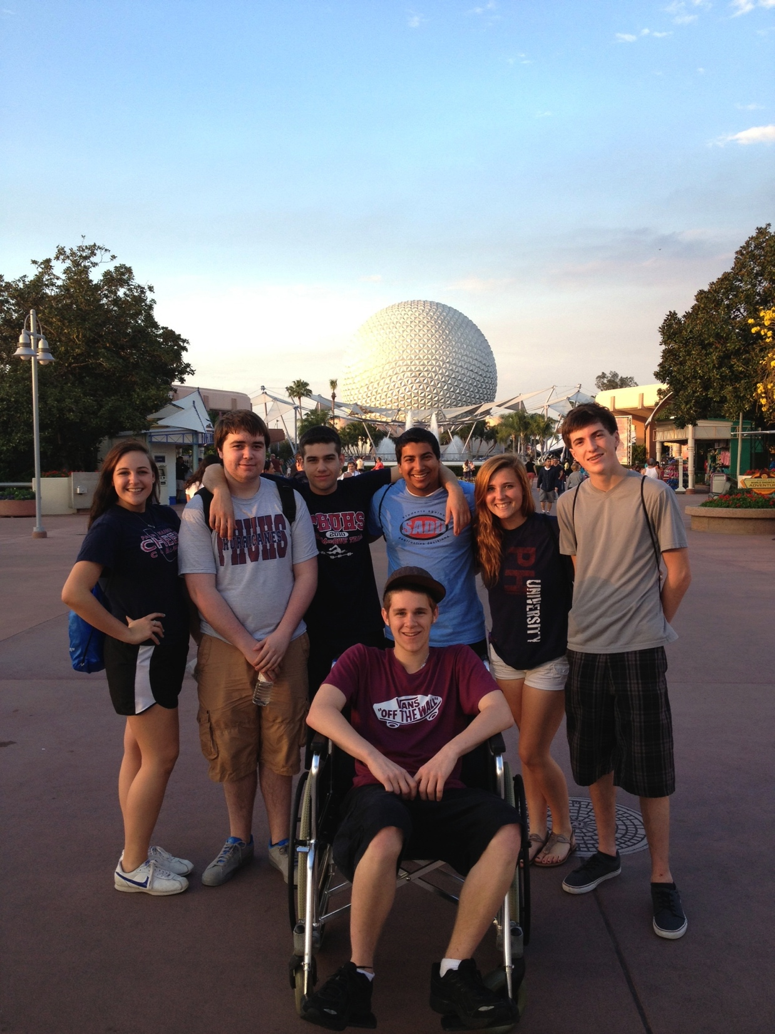
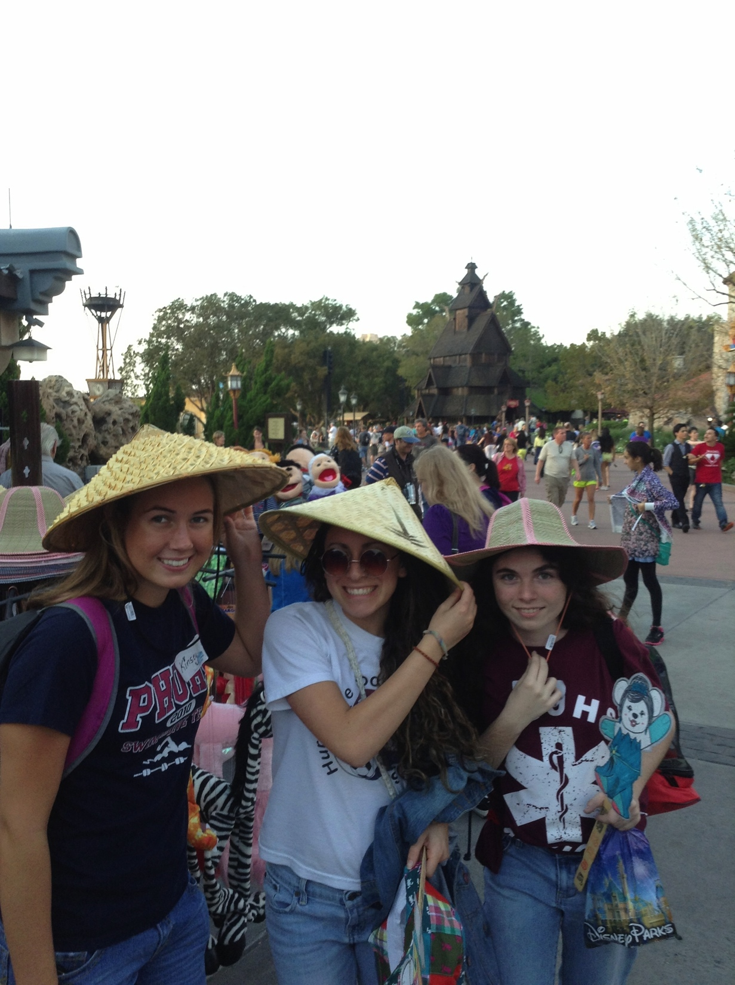
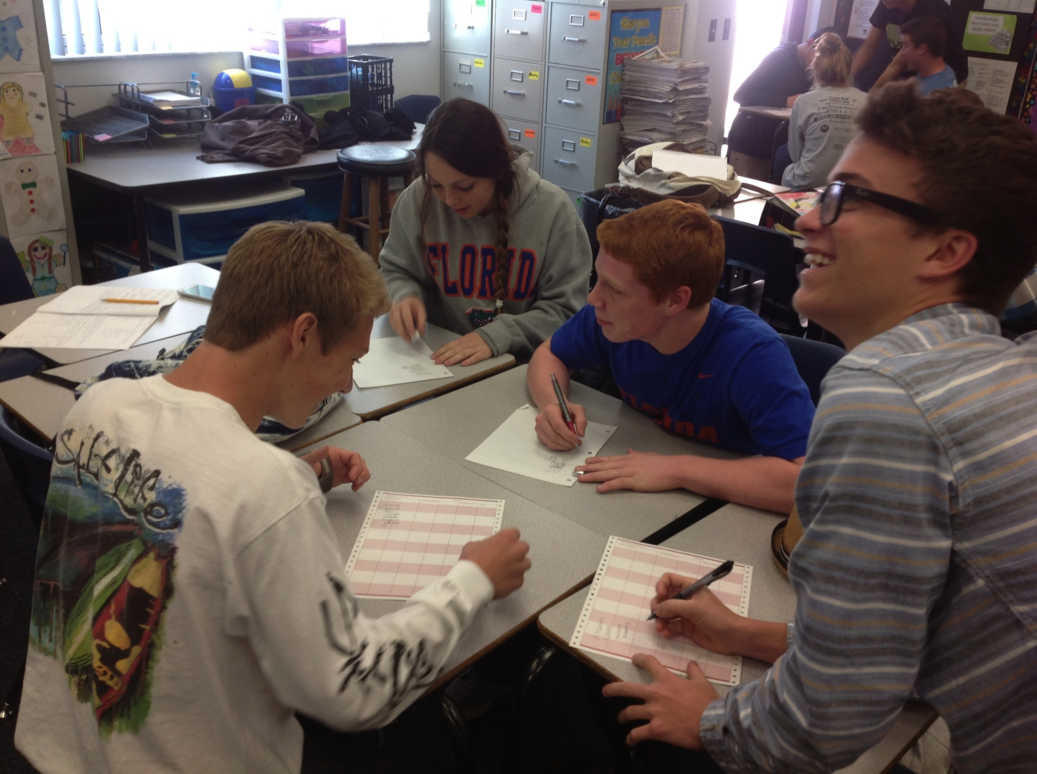
We are Family!!!
Notes:
Have a student talk about the family part of AVID.

Slide 13
T-Shirts
On Sale NOW! $10
Designs –
Checks payable to PHUHS
September 3rd – September 17th
Must be worn on all field trips! The first trip excluded.

Slide 14
AVID Club
WICOR Warriors
Community Service Soldiers: Relay for Life
College Awareness Crew
AVID Ambassadors
Tuesday September 10th
Tuesday October 8th
Tuesday November 12th

Slide 15
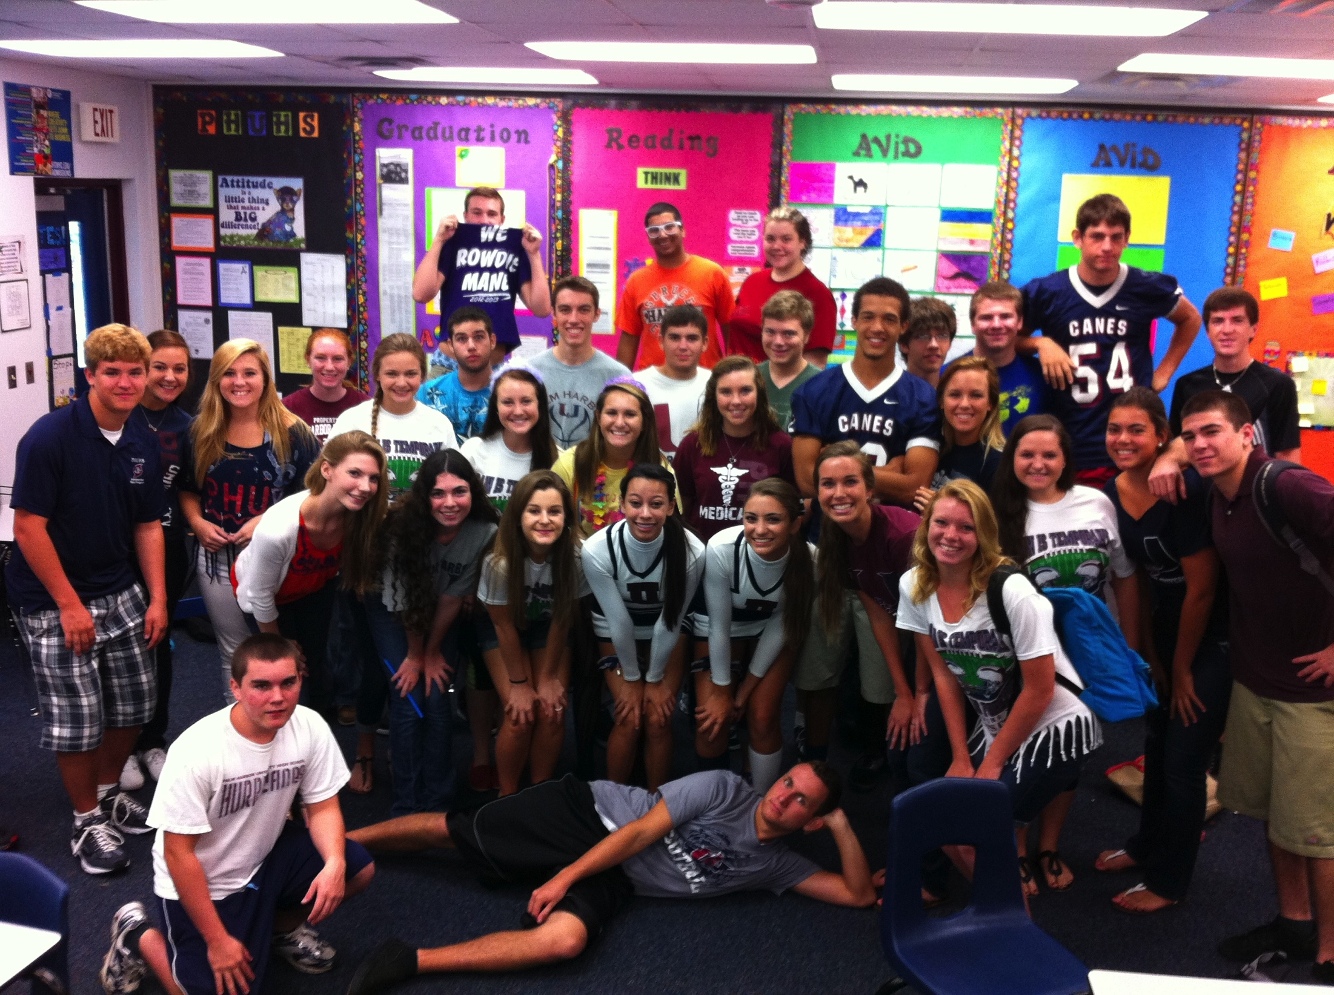
The Mission of AVID
AVID’s mission is to close the achievement gap by preparing all students for college readiness and success in a global society.
Notes:
NOTES: College readiness is what all education is shifting to and our AVID students will be the most prepared!

Slide 16
AVID Contract
I agree to maintain satisfactory citizenship and attendance in all classes.
I agree to maintain the AVID binder with assignment/grade record sheets and daily notes in all classes. I will use the binder in ALL classes.
I agree to complete all homework assignments and commit to at least two hours of homework every night.
I agree to maintain enrollment in college preparatory courses.
I agree to take notes in all my core subject areas as required in AVID.
I agree to participate fully in tutorials as required by AVID.
I agree to participate in field trips, college visitation and other AVID activities.
I agree to keep my parents fully informed of AVID program activities.
I agree to complete all my assignments in all classes including AVID.
I agree to participate in high-level standardized testing.
Notes:
The PHUHS AVID student looks like……..Explain a little why each one is important.

Slide 17
AVID Principles
WICOR: Writing to Learn, Inquiry, Collaboration, Organization, Reading
Organization: Binders, planners, scheduling techniques, Self-Monitoring
Study Skills: Tutorials, Test-Taking Skills, Cornell Notes, Study Smarter - NOT Harder!
Self- Advocacy!! It is YOUR motivation – not OUR motivation
Grade Monitoring and Goal Setting

Slide 18
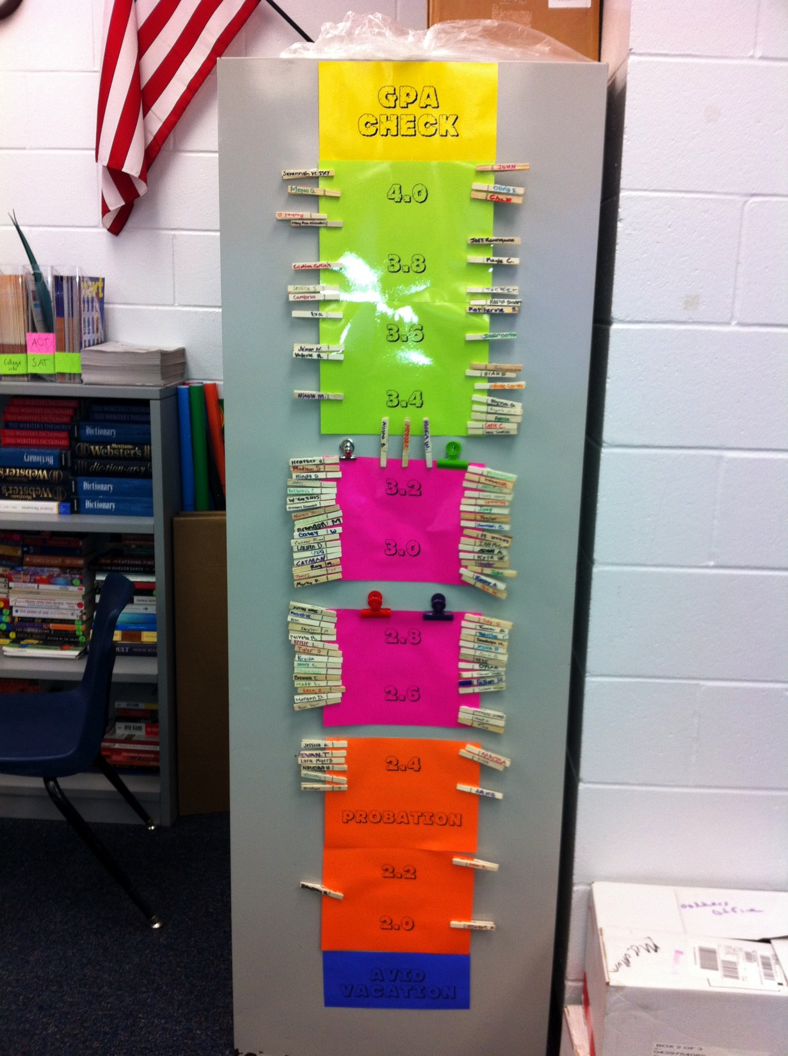
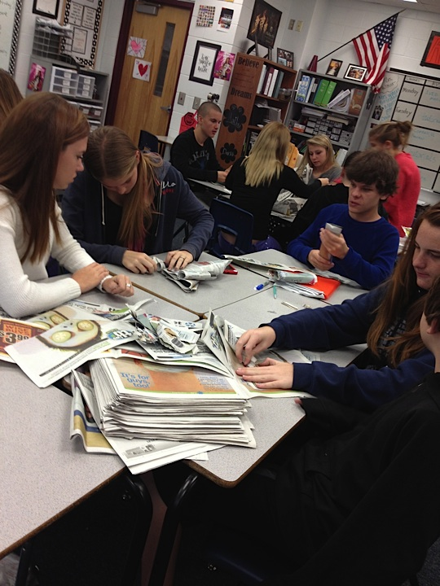
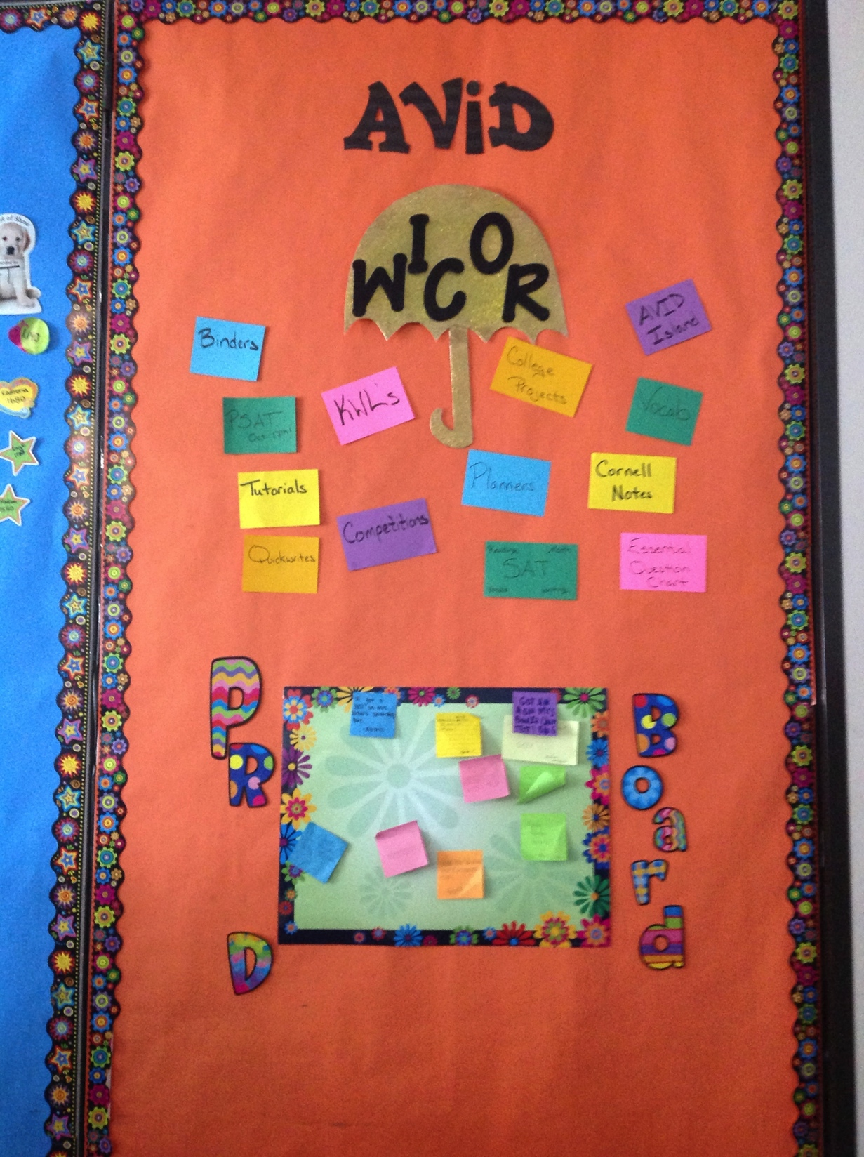
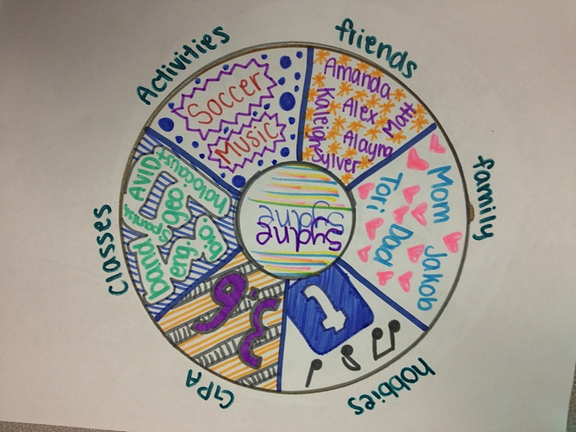

Slide 19
AVID Focus Skills for PHUHS
Marking the Text
Reading with Purpose
Research Skills
Group Projects
Complete Organization
Costa’s Levels of Questioning
Cornell Notes
What
How
Why
Way of work
5 Step Method
STAR Notetaking
Notes:
Have a student share about Cornell Notes

Slide 20
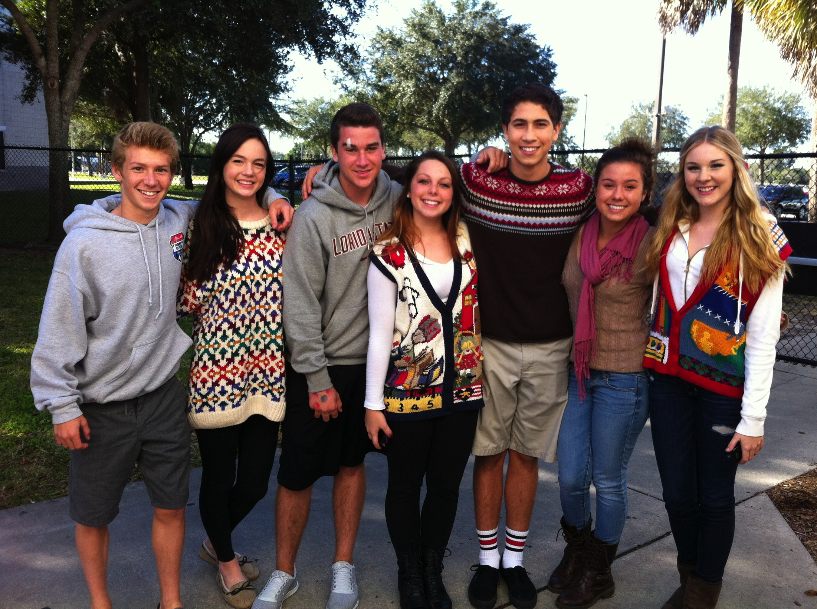
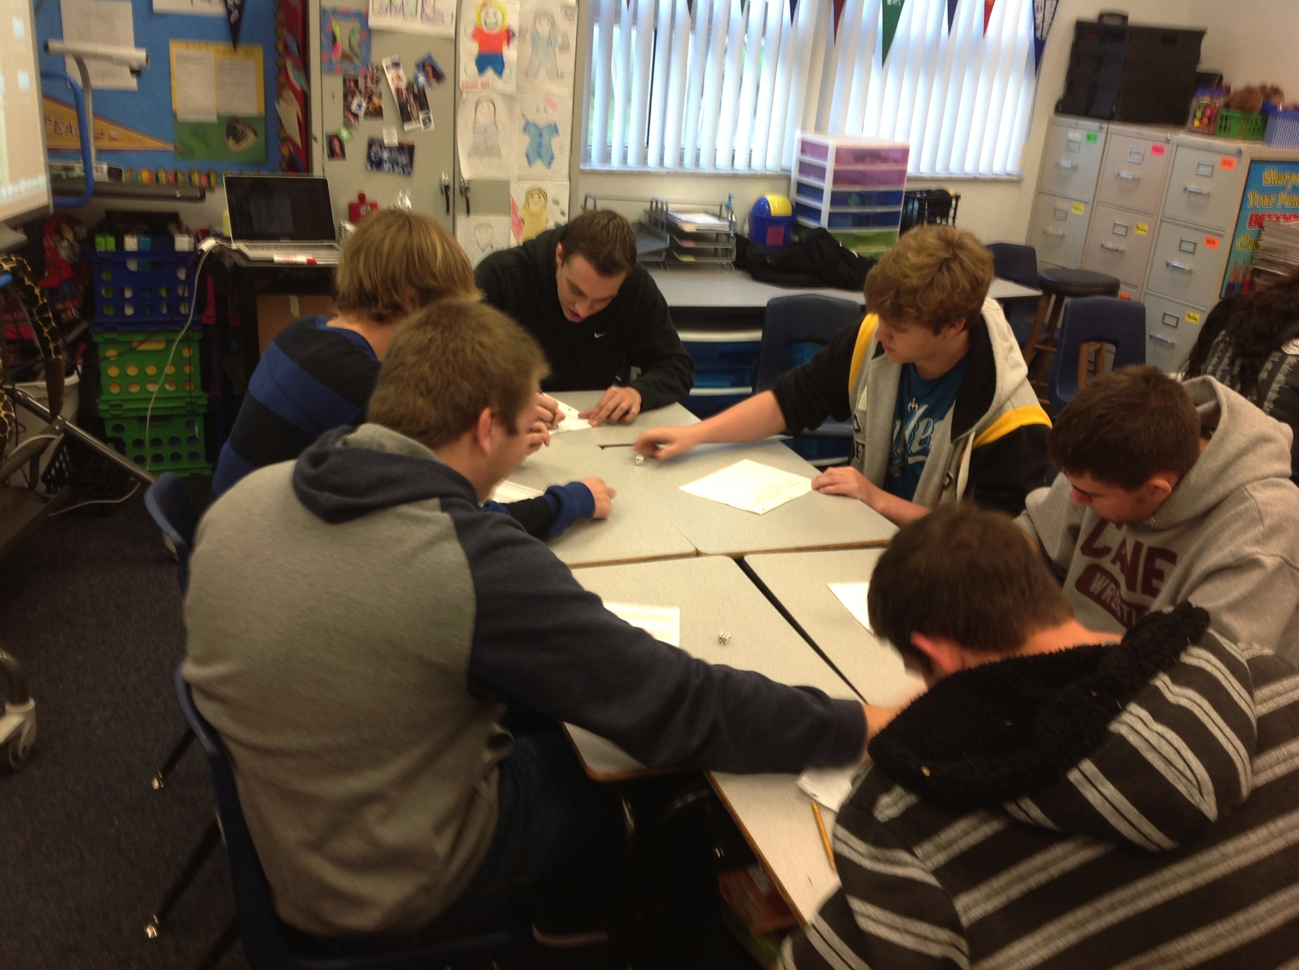
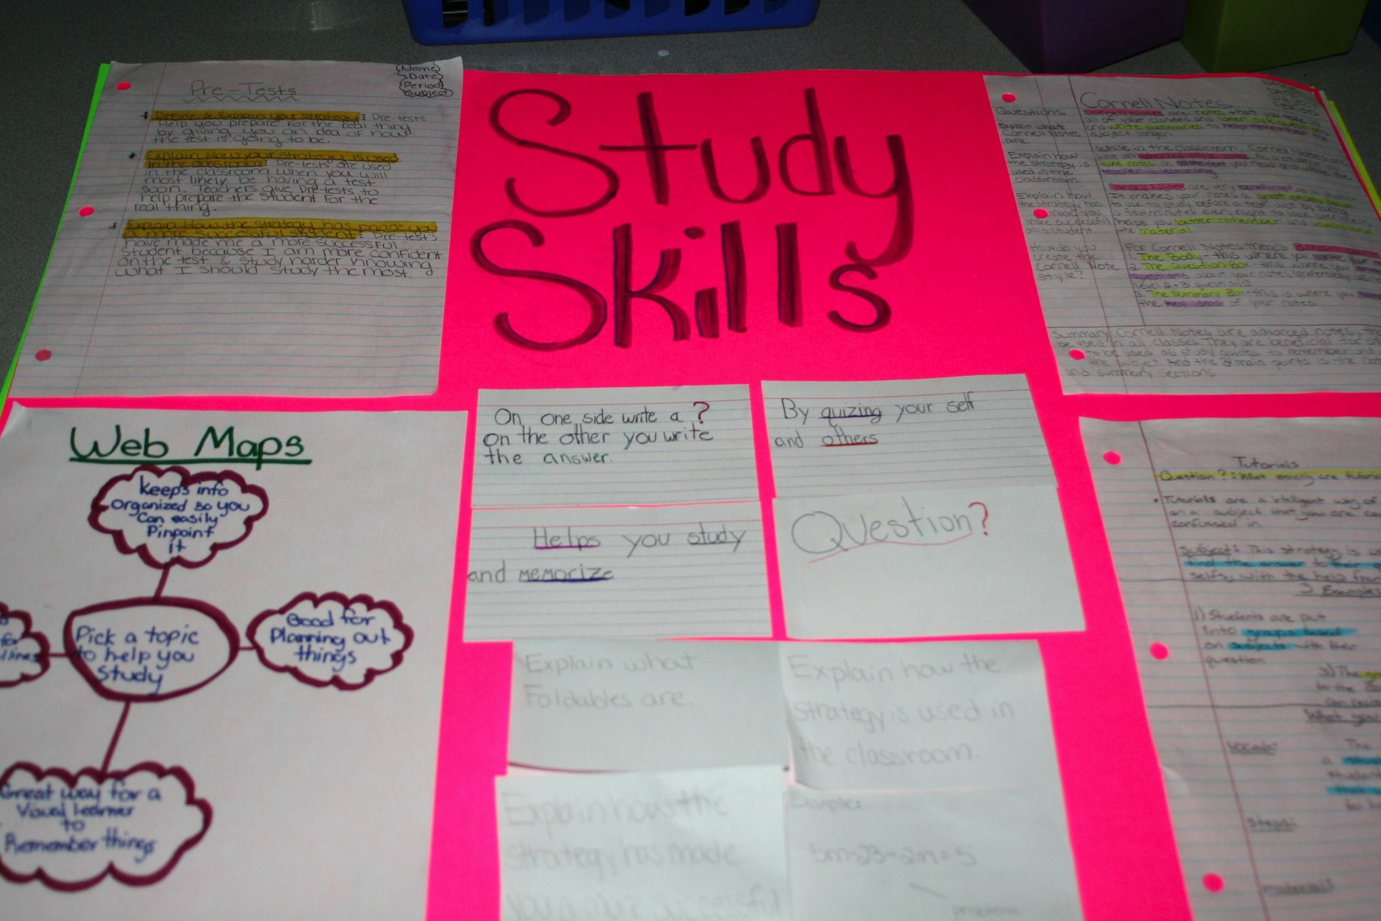
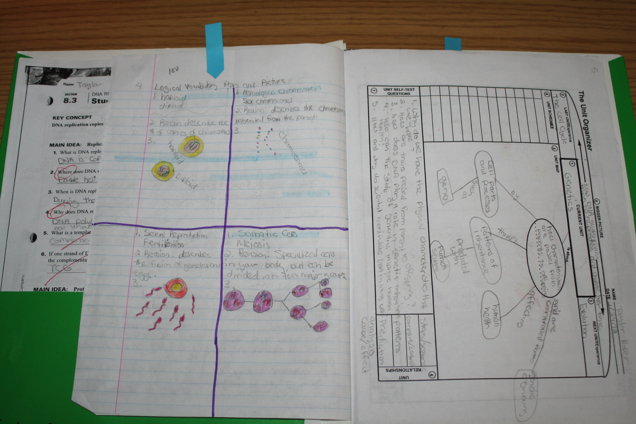
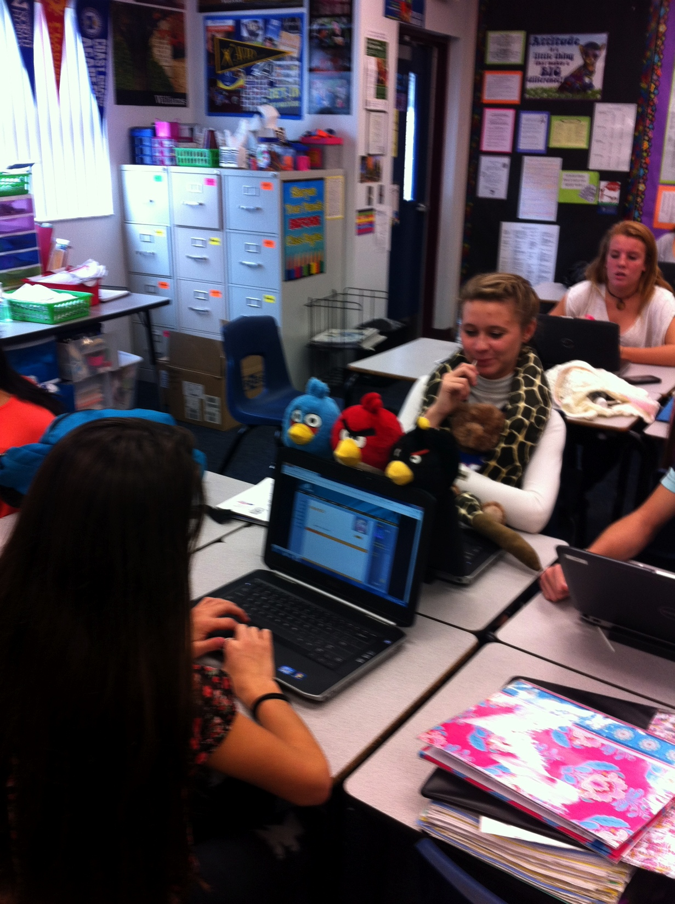
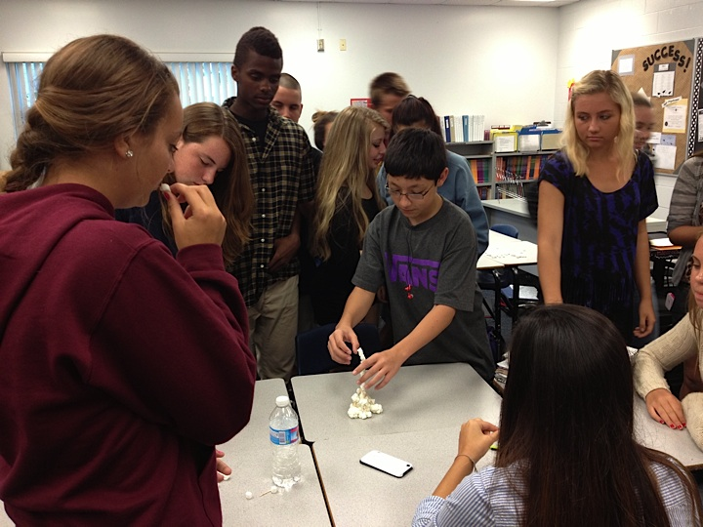
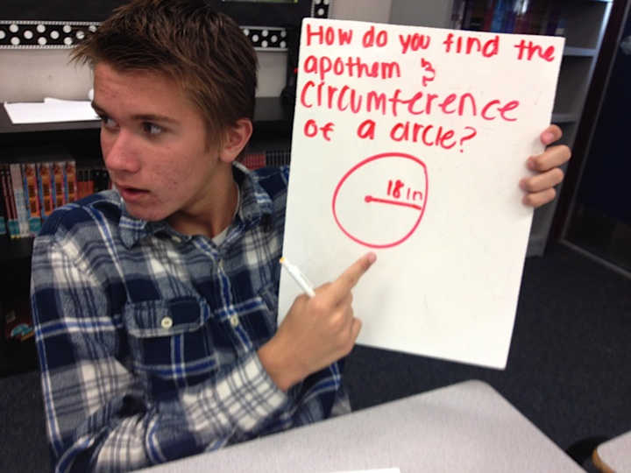
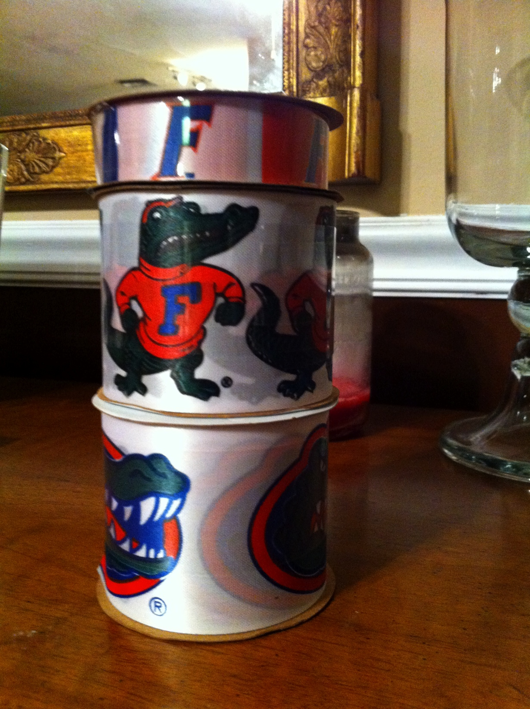
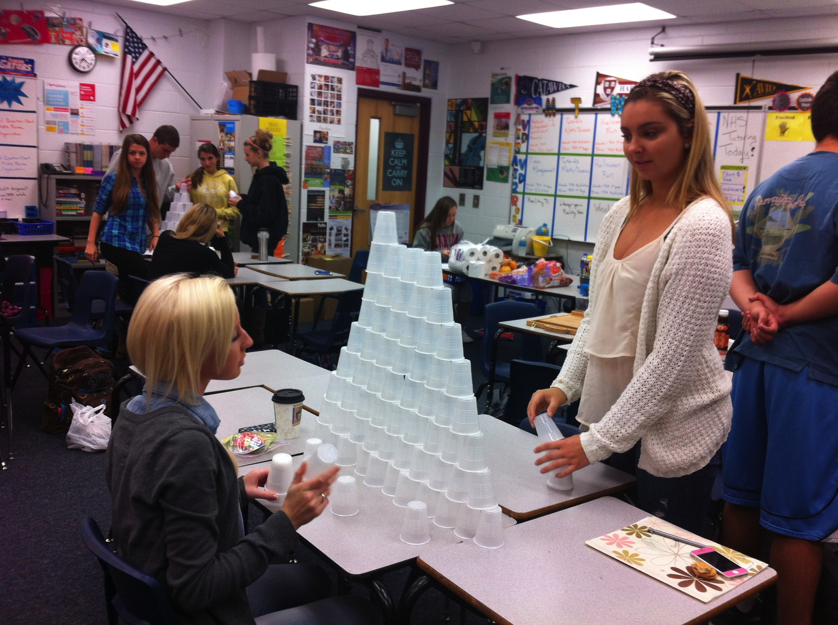
Notes:
Have a student share about what has helped them the most in class. Heatherr has a good story about college prep.

Slide 21
phuhsavid.weebly.com

Slide 22
Please contact us if you have any questions or want more information.
Kerrale Prince
princeke@pcsb.org
Allison Winer
winera@pcsb.org

